Slide 1
HE-50
Handheld Explosive Trace Detector (ETD)
Hooman Shakouri
Product Marketing Manager
Hshakouri@RapiscanSystems.com

Slide 2
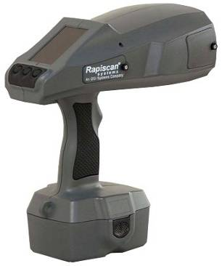
HE50
Explosive Trace Detection

Slide 3
Contents
Introduction to Explosive Trace Detection (ETD)
Comparing Explosive Detection Technologies
ETD Market Segments, Market Drivers, Market Direction
ETD Principles of Operation, Performance Criteria
HE-50 Overview, Specifications
Handheld ETD Competitive Landscape
Conclusion: Why HE-50?

Slide 4
Explosive Detection Technologies
“Bulk” Explosives Detection
  Bulk detection requires the actual explosive material. It involves analysis of mass, density and other properties of materials
  It is less dependent than ETD on sampling technique
Explosive “Trace” Detection (ETD)
  ETD involves chemical detection of explosives by collecting and analyzing tiny amounts of explosive vapors or particles
  ETD includes several different technologies using chemical sensors
  ETD looks for residue or contamination from handling or being in proximity to explosive materials
There is currently no competitive technology (including X-ray) that can compete with ETD capabilities
Trace Detection technology has the ability to concurrently detect explosives and narcotics

Slide 5
Bulk Imaging vs. Trace
Explosive Detection Technologies
Bulk Imaging Detection
EDS
2D (MVXR)
3D (RTT)
Coherent
Trace Detection
Color Change
Field Ion Spectrometer
2D X-Ray
Single Energy
X-ray
Ion Mobility Spectrometer
HE-50
Ion Trap Mobility Spectrometer
Thermo-Redox
Dual Energy
(600 series)
Dual Energy + Backscatter
Backscatter
Multi-View
X-ray (DV)
Electron Capture
Gas Chromo Chemil.
Gas Chromo /IMS
Gas Chromo /Mass Spectrometer
Gas Chromo /SWA

Slide 6
Bulk Imaging vs. Trace
Pros and Cons for explosive detection
Bulk Imaging Detection
Pros
Can detect weapons
Can detect sealed explosives
High Throughput
Trace Detection
Pros
Cons
High Cost of Equipment
Cons
Cannot identify explosive “type”
Limited to military and commercial
Requires Actual Explosive
Large Footprint
Medium Equipment Cost
Can detect narcotics
No sitting cost
Labor intensive
Cannot detect sealed explosives
Cannot detect weapons
Slow throughput
Can Precisely identify explosive type

Slide 7
Markets for HE50 Explosive Trace Detection Systems
Seaports and Terminals
Land transportation stations (Rail Stations)
Border crossing checkpoints
Mail rooms and mail sorting hubs
Critical infrastructure
  Courthouses
  Government and federal buildings
  Defense /Military bases
  Military and intelligence facilities
  Hospitals
Office Buildings

Slide 8
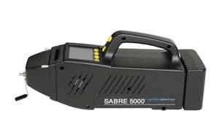
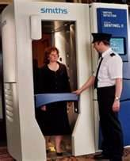
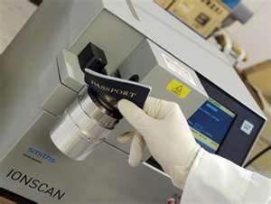
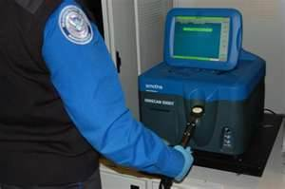
Types of ETD
Desktop
Handheld
Document Scanner
People Screening Portal

Slide 9
Market Drivers for HH-ETD
HE-50
Threat from “smart” explosive devices is real
Fast deployment process is required
1st responders and Mail rooms need effective technology
Current products and procedures deliver unsatisfactory performance
Moving Targets
Future Development
Increasing airport growth using ETD for alarm resolution
100% US Inbound Air Cargo (effective December 2012)

Slide 10
Market Direction for HH-ETD
Demand for use of ETD will increase at public venues, (public gathering locations, amusement parks, sports arena, mass public transport, and possible shopping malls)
The top selling systems are those:
  Which can simplify the operator interface, reduce training time and costs and minimize the human factor in assessing presence of potential risk
  Detection of all or many type of explosives
  Rapid warm up, sample acquisition (collection) and analysis time

Slide 11
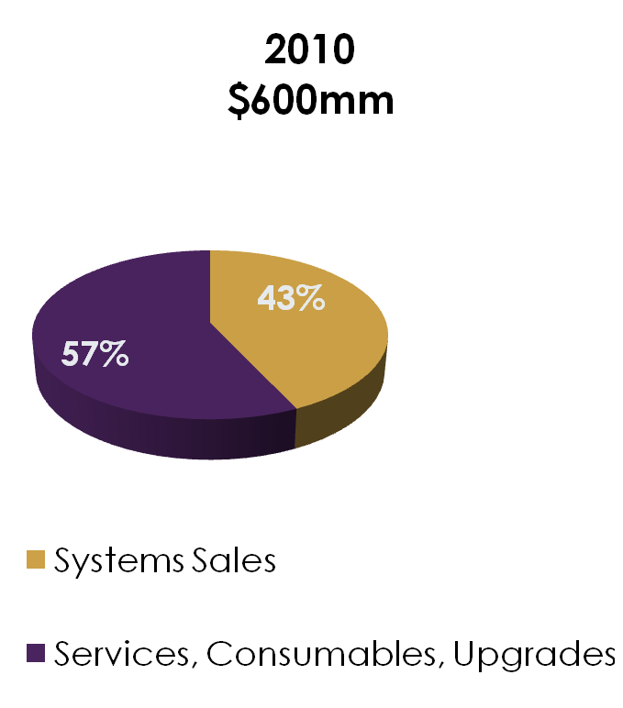
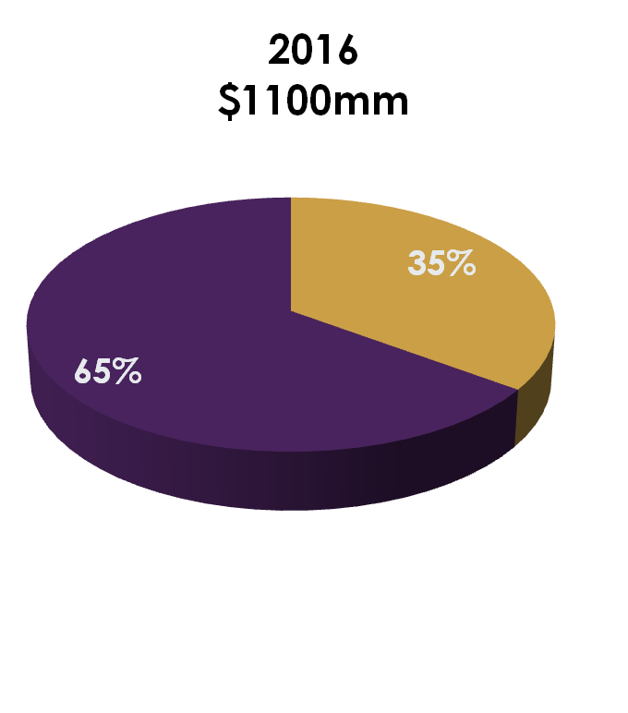
Global ETD Market (All System Types)
CAGR of over 10% from 2010-2016 Led by US, China and India
Source: HSRC

Slide 12
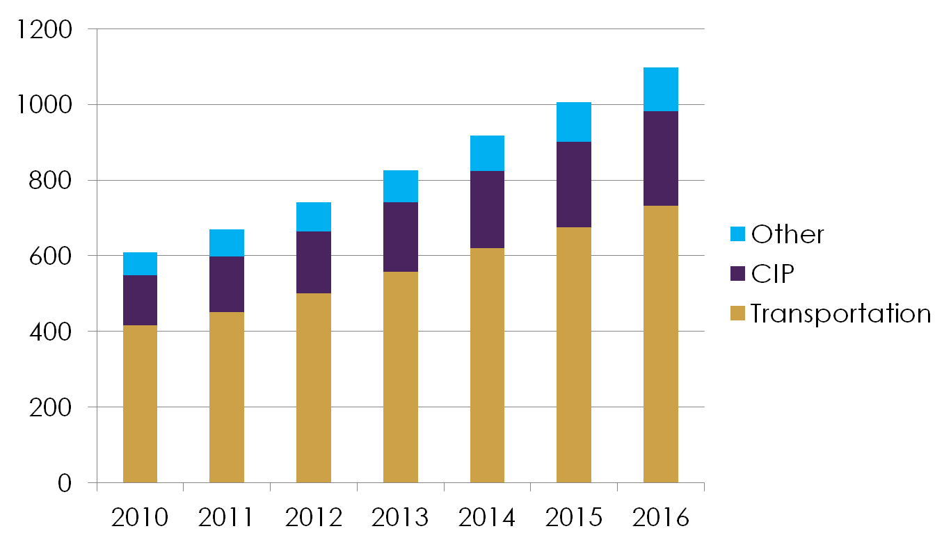
Global ETD Market by Application ($mm)
Source: HSRC

Slide 13
*Global* ETD Market by Application (%)
Source: HSRC

Slide 14
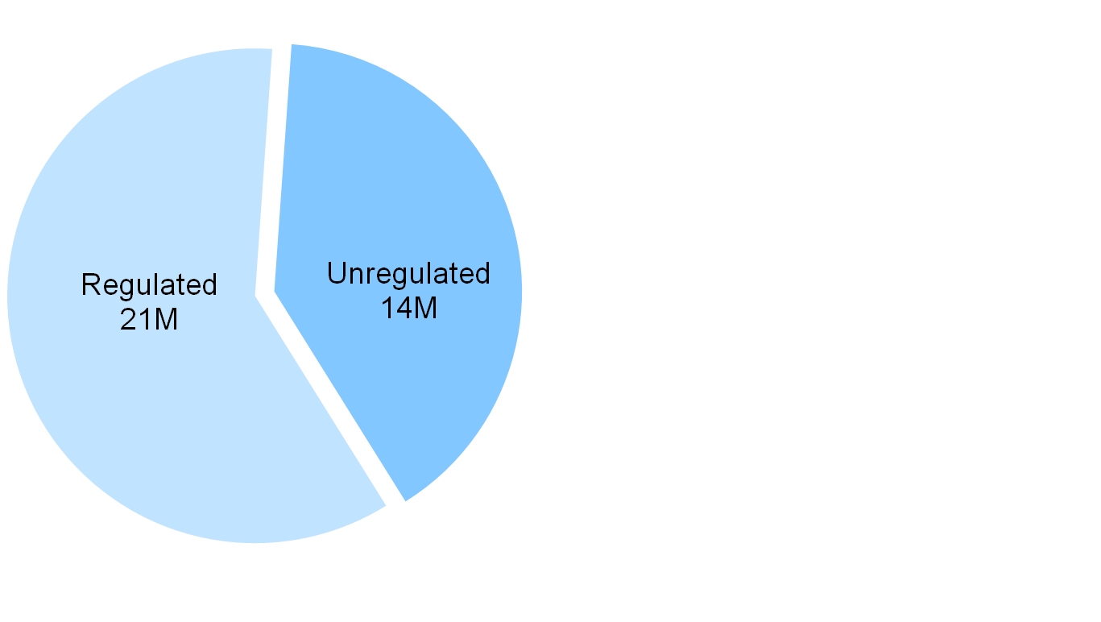
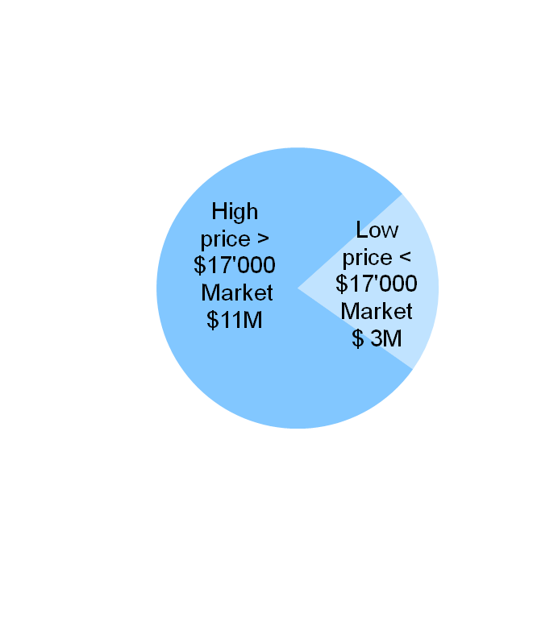
EMEA trace detection market size
EMEA Handheld market size (M USD)
Total 35M USD*
* Source : Frost & Sullivan, Homeland Security Research Corporation; Rapiscan estimations

Slide 15
EMEA trace detection market analysis
EMEA Trace Detection market* :
Approx. 70 M $, of which 50% approx. is handheld = 35M $
Regulated market 60% of handheld trade detection market in value** = 21M $
Unregulated market 40% of handheld trade detection market in value** = 14M $
EMEA Market segments
Aviation, air cargo (regulated)
Event and infrastructure security (non-regulated)
Military (non-regulated)
Police (non-regulated)
First responders (non-regulated)
Customs (non-regulated)
EMEA Competitors :
X-Ray systems competitors : Smiths, Morpho
* Source : Frost & Sullivan, Homeland Security Research Corporation
** Based on average price of handheld in regulated / unregulated market

Slide 16
Commercial targets
Focus on non-regulated markets (excludes aviation, air cargo):
Existing EMEA Rapiscan customers :
  Customs
  Military, police
  Events security
New customers :
  Event and infrastructure security
  First responders
  Military, police
  Customs

Slide 17
ETD principle of operation
Collect microscopic residue of the explosive compound
  Either in vapor or particulate
  Collection by inhaling (HE-50) or by swiping the surface
Concentrate the sample collected (Not required by HE-50)
Feed into trace analyzer (various technologies, IMS for HE-50)
Generate electrical signal
Analyze the electrical signal
Results are shown (type of explosives and concentration) on display
The difficultly with any ETD is usually the collection (acquisition) of the sample and not its analysis
Notes:
Vapor Collection involves the use of vacuum cleaner like device to collect particles. Does not require direct contact
Particulate Collection Particulate is the microscopic particles of solid material that stick to surfaces and have directly or indirectly come into contact with an explosive material

Slide 18
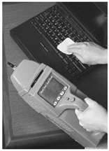
Two Types of Sample Collection (Acquisition)
Inhalation Mode
  Involves the use of vacuum cleaner like device to collect particles
  Does not require direct contact
  No Operator action required
Direct Sampling Mode
  Acquisition of samples via using a special swab
  Requires swiping interrogated object with direct physical contact
  The conops requires operator action

Slide 19

Ion Mobility Spectroscopy (IMS) Technology
Ambient air from proximity of tested object is drawn into intake port, transferred into ionization chamber
Radiation interacts with incoming sample molecules to form positive and negative ions
Source of radiation is a radioactive material (Ni63 or AM241)
The ions pass into the drift region of the spectrometer
Time is takes for ions to travel the length of drift region depends on specific explosive ion mobility (drift time)
From drift time it is possible to calculate the exact specific identity of the tested explosive chemical agent
Ionization Source
Detector
(Faraday plate)
Dopant
Air Inlet
Air Outlet

Slide 20
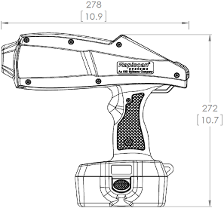
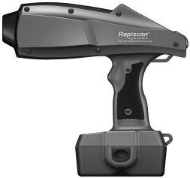
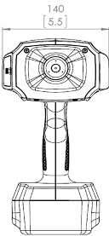
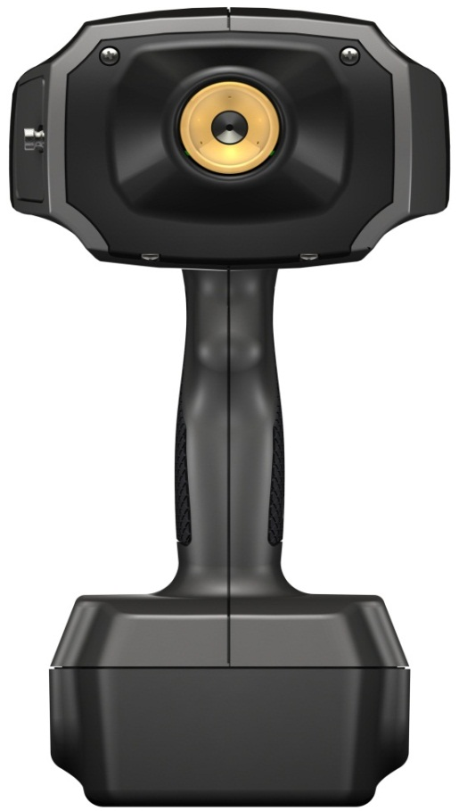
HE50 Overview
Touch-free inhalation sampling
Swipe sampling capable
Visual and/or audible alarm
Large LCD screen, all light conditions
Easy dopant replacement
High thermal and impact resistant
Compact
Light weight
Easy to use and operate
Competitively priced
Low cost of ownership
High throughput Design
NRC exempt (US)
No calibration required

Slide 21
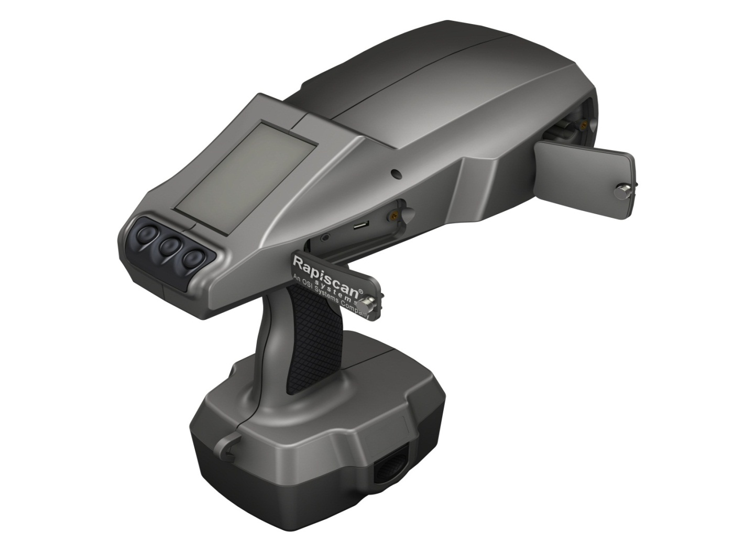

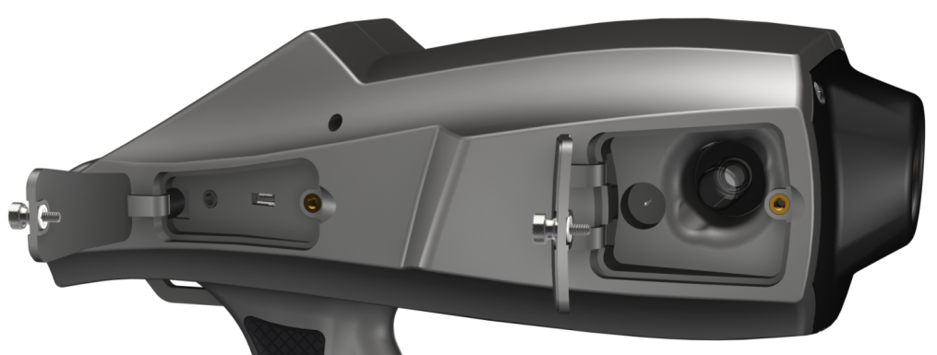
HE50
Ergonomically Designed, Easy To Use
76mm (3”) LCD
Air Pump Nozzle (3)
Inlet Nozzle (Inhaler)
Dopant Access Panel
Micro USB access port
Function Buttons (3)
Dopant Bottle
Puncture Tool
Dopant Bottle
Micro USB access port
6 hours rechargeable
Lithium battery pack
Sure Grip handle with
non-slip rubber insert
Notes:
21

Slide 22
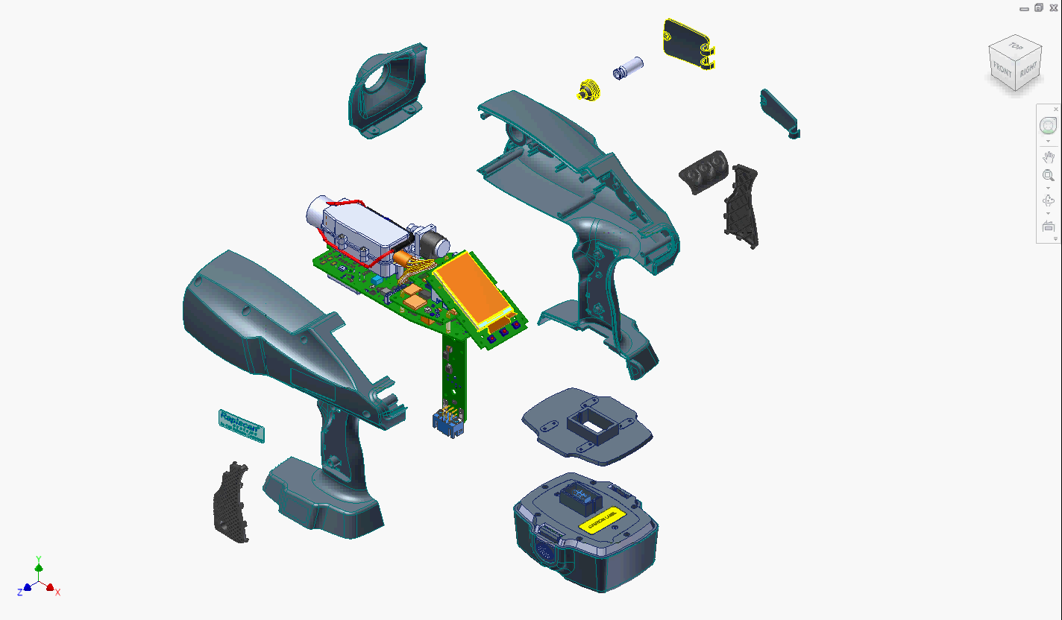

Slide 23
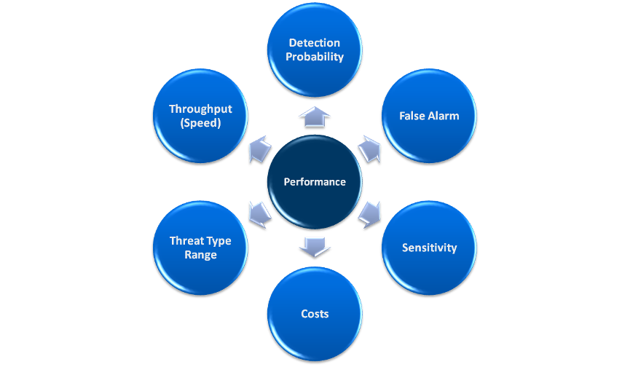
ETD Performance Criteria

Slide 24
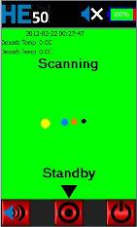
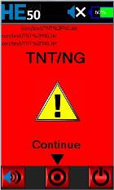
HE50 Detection Specifications
 | Rapiscan HE-50
Sensitivity | In picogram range
Scan Time | From 3 to 30 seconds
Calibration | No operator calibration required – automatic
Explosive Identification | Specifies detected explosives by name (optional encrypted name)
False alarms | Less than 2%
Explosive types | TNT, C4 / RDX, Semtex, Nitroglycerin / Dynamite, PETN, EGDN, DNT, HMX, Black Powder, Smokeless Powder, ANFO /Ammonium Nitrate), TATP

Slide 25
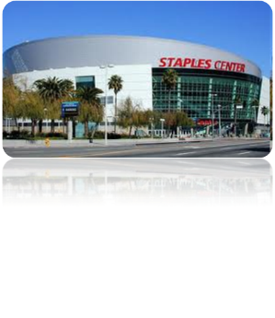

HE50 Sensitivity:
Detection of Explosives at Picogram Level
Gram | 1000 grains of table salt
Milligram | 1 grain of table salt
Microgram | 1000 times smaller than a grain of table salt
Nanogram | 1 million times smaller than a grain of table salt
Picogram | 1 billion times smaller than a grain of table salt
Detecting a picogram is like finding a red ping pong ball in a stadium filled with white ping pong balls.

Slide 26


HE50 Physical Specifications
 | Rapiscan HE-50
Battery | 6hrs continuous operation at 20ºC (meets CE and UL requirements) Full recharge lithium ion battery in 2.5hrs
Cold Startup Time | under 10 minutes
Operating Temperature | -20°C to +55°C
Relative Humidity | 0 to 100%
Altitude | Sea level to 2500 meters
Regulatory Testing /Certificate | UL/cUL 61010-1, 2nd Edition, CSA 61010-1, IEC 61010-1: 2005 CE - Standard(s): IEC 61326-1
In House Testing | Sealed radioactive source (low and high temp, drop, pressure) – NRC Std. Battery and HE50 unit (low and high temp recovery)
Independent Performance Report | ICTS Europe Lawrence Livermore National Laboratory

Slide 27
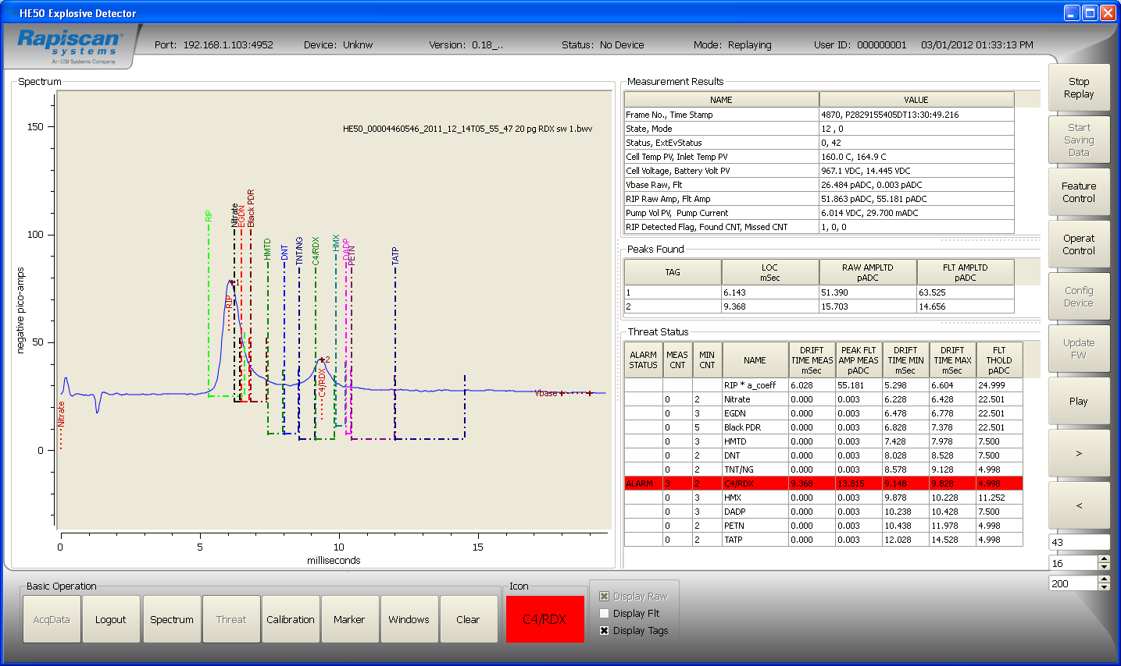
Software
Interface
Calibration and Threat Display
  Real time sampling and analysis
  Powerful microprocessor with multi-language capability
  4GB SD memory card storage of up to 200,000 samples
  Data automatically recorded for evidentiary requirements – download to external computer via Micro USB

Slide 28

Competition Landscape

Slide 29
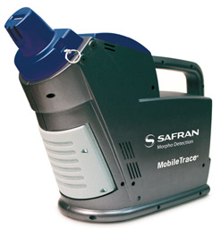
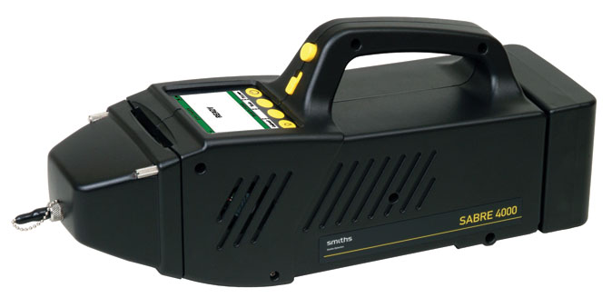
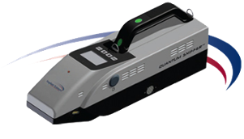
Handheld ETD Top Competitors
 | Morpho | Mobile Trace | ITMS Dual Mode | $25K
 | Smiths | Sabre 4000 | IMS Dual Mode | $24K
 | Implant Sciences | QS-H150 | IMS | $30K

Slide 30
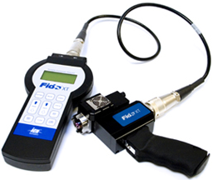
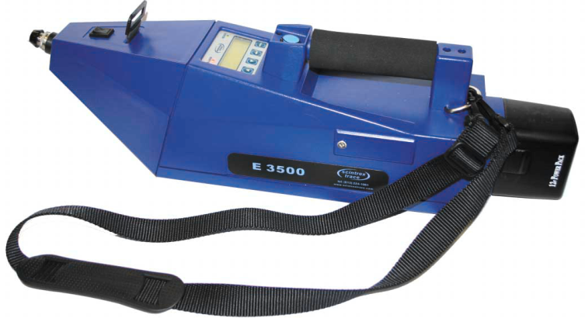
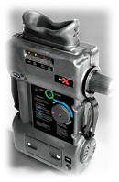
Handheld ETD Top Competitors
 | FLIR | Fido XT | AFP | $21K
 | Scintrex (Auto Clear) | E3500 | Luminal Chemilux | $22K
 | Red X | X-Pak | Fluorescence | $15K

Slide 31
Performance
ü Advantage
X Disadvantage
 | Rapiscan HE-50 | Morpho MobileTrace | Smiths Sabre 4000 | Implant Sciences QS-H150 | FLIR Fido XT | Auto Cl. Scintrex E3500 | RedX X-pak
Detection Probability | On Par | X | X | X | On Par | On Par | On Par
False Alarm* | ü | X | X** | X | ? | X | ?
Sensitivity* | ü | X | X | X | X | X | X
Costs | ü | X | X | X | ? | X | X
Threat Type Range | On Par | On Par | On par | On Par | On Par | On par | On par
Throughput | ü | X | X | X | X | X | X
*Inhalation Mode On Par in direct sampling mode **Sabre 4000 inhalation mode is used for Chemical Warfare Agent and Toxic Industrial Chemicals only

Slide 32
Cost of Ownership
ü Advantage
X Disadvantage
 | Rapiscan HE-50 | Morpho MobileTrace | Smiths Sabre 4000 | Implant Sciences QS-H150 | FLIR Fido XT | Auto Cl. Scintrex E3500 | RedX X-pak
Calibration Traps* | ü | X | X | On Par | On Par | On Par | X
Carrier (Dopant HE-50) | X | On Par | On Par | ü | ü | ü | ü
Membranes, Grids | ü | X | X | On Par | On Par | On Par | On Par
Swipe Traps* | ü | X | X | On Par | On Par | X | X
Preventive Maintenance | ü | X | X | On Par | On Par | X | X
* Direct Sampling Mode

Slide 33
Throughput
ü Advantage
X Disadvantage
 | Rapiscan HE-50 | Morpho MobileTrace | Smiths Sabre 4000 | Implant Sciences QS-H150 | FLIR Fido XT | Auto Cl. Scintrex E3500 | RedX X-pak
Calibration Time | ü | X | X | On Par | On Par | On Par | On Par
Battery Life | On Par | X | X | X | X | X | X
Operation Ergonomics (Single Hand Operation) | ü | X | X | X | X | X | X
Modes of operation (Inhalation, Direct Sampling) | ü | Both | Both* | Swipe Only | Both** | Both** | Swipe Only
Swipe Time * | ü | X | X | On Par | X | X | X
Time Between sampling | ü | X | X | X | On Par | X | X
Maintenance Time | ü | X | X | On Par | X | X | X
Cold Start up time | ü | X | On Par | On par | ? | On Par | No start up time
Weight | ü | X | X | X | On Par | X | X
*Inhalation mode is used for Chemical Warfare Agent and Toxic Industrial Chemicals only ** Different Conops

Slide 34
Traditional vs. HE-50
Ion Mobility Spectrometry (IMS) Technology Comparison
 | Traditional IMS | HE-50 IMS
Source | Ni63 ionization source. Requires radiation officer and proper NRC documents at all times | Am241 ionization source NRC exempt in US. No RSO nor paperwork required
Consumables, Calibration, Maintenance Cost | ~$3,000 / year | < $500* per year
Membranes, Grids | Membranes reduce sensitivity and increase service frequency | No membrane required (Low Costs)
Swipes | Requires swipes / contact to achieve required sensitivity | Non-contact sampling (inhalation)
Calibration | Calibration is required | No calibration required (High Throughput)
Sampling Speed between screens | 2 to 3 step min requirement at all times | 1 step, only if threat detected (High throughput)
*actual consumable cost will vary with operational usage

Slide 35
In conclusion: Why HE-50
Rapiscan HE-50 is the only Handheld Explosive Trace Detection System that:
Provides the highest throughput
  Longest battery life
  Continuous sampling
  No calibration
  Single hand operation
With the Lowest cost of ownership
  No Membranes, Swipes, Calibration traps
  No preventive maintenance
And Is NRC Exempt (in US)

Slide 36
THANK YOU

