Slide 1
Z Portal® II Sales Training
September 2015
D. Gaetani and C. Roth

Slide 2
Agenda
Product Overview
  Positioning
  Features / Benefits
Competition
  Competitive Analysis
  Competitive Overview
Market Introduction Strategy & Calendar
Technology Overview
Product Structure
Software Features
System Options
Options / Availability

Slide 3
Positioning

Slide 4
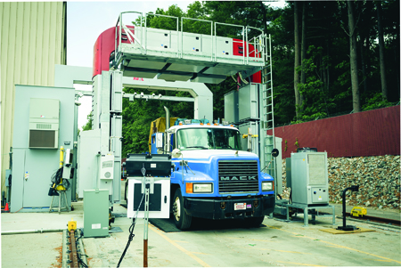
Z Portal® II Overview
High throughput, drive-through screening system
  250 trucks or 400 passenger vehicles per hour
  Scan speeds of 2 – 20 kph (1.2 to 12.4 mph)
Available in two sizes
  Larger size for trucks, buses and cargo containers
  Compact size for passenger vehicles
Multi-Technology
  Z Backscatter technology (Bx)
  Forwardscatter technology (Fx)
  Dual-energy (DE) Top-down transmission imaging (option)
Multiple Views of Scanned Cargo
  Up to six (6) views of scanned object
  Left and right side Bx images, top-down Bx and DE images, left and right side Fx images
Low cost of ownership and Increased Uptime
  No civil works construction required for installation
  Unique serviceability features decrease downtime

Slide 5
Z Portal II Benefits
The Z Portal system gives operators more visibility into scanned objects
  Stop threats from crossing borders
  Recoup lost customs revenue from trade fraud
At congested borders and vital entry control points, security efforts must be balanced with the flow of commerce and operations
  The compact system fits into existing traffic lanes
  High throughput inspection is suitable for primary or secondary screening applications
Low cost of ownership and Increased Uptime
  No civil works construction required for installation
  Unique serviceability features decrease downtime
The Z Portal system X-ray technology ensures a low radiation dose that conforms to globally accepted standards for radiation exposure. The system is safe for operators, drivers, and the environment.

Slide 6
Z Portal II Naming Strategy
Internal
  Z Portal II is used internally to distinguish between the previous and current design
  All Z Portal II official documentation is labeled “Z Portal”
External
  When product introduction press release is announced, the website imagery and copy will shift to Z Portal II messaging
  Promotional materials will describe the product as the ‘next generation’ or ‘newly redesigned’

Slide 7
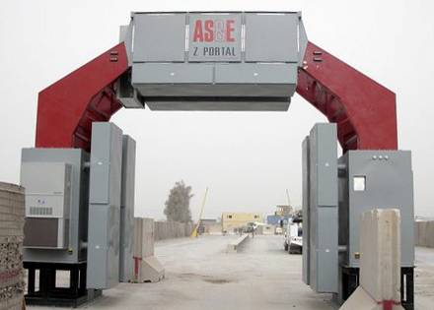
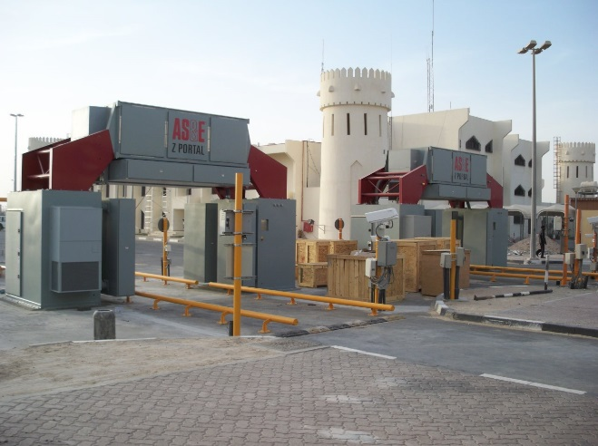
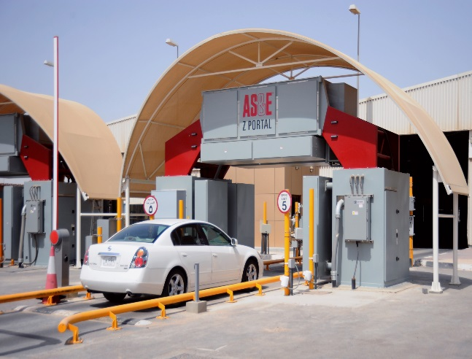
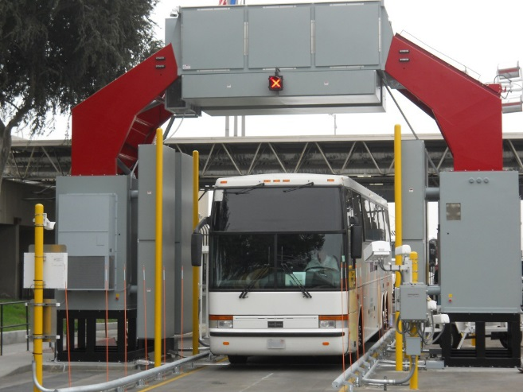
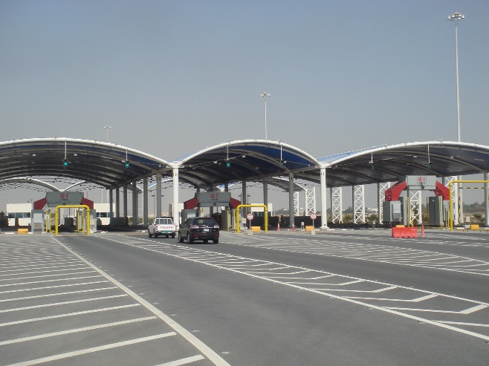
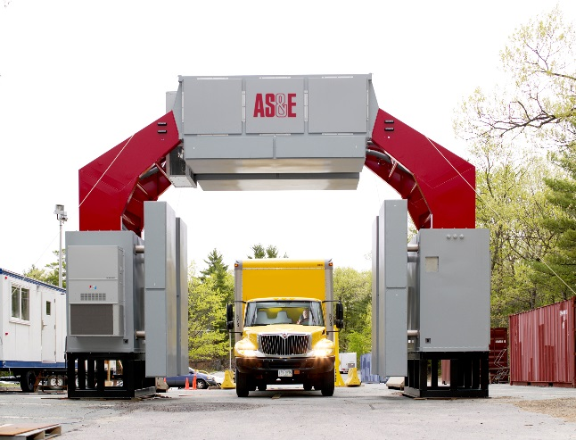
Z Portal System Installations
More than 100 Systems Sold to Date
Notes:
Talk about Z Portal I to Z Portal II transition. Maintain seizure and install rep of Z Portal I.

Slide 8
Target Applications
Port & Border Security
  Commercial and Government Agencies
Critical Infrastructure Protection
Military
  Force Protection, Checkpoints
Security Agencies
  Government Security, High Threat Facilities
  Commercial Event or Location Management
Police departments
  State and Local Forces
  Bomb Squads

Slide 9
Market & Competition

Slide 10
Competitive Analysis
Strengths
  Only multi-technology portal on the market
  Only portal giving up to 6 views of scanned cargo/vehicles
  3-color Dual-energy material discrimination
  High throughput system / High scan speeds
  Low radiation dose and tight exclusion zone
Weaknesses
  Low dual-energy penetration, compared to truck portal competitors
  High price compared to other low-energy car portal competitors

Slide 11
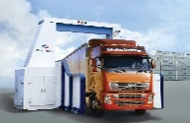

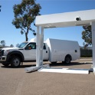
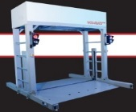
Major Portal Competitors
The following competitive analysis focuses on low-energy systems that offer scanning of both passenger vehicles and trucks. For high-energy Portal competitors, see the Sentry Sales Training presentation and the Z Portal II Competitive Analysis spreadsheet.
Nuctech FS Series
Smiths CIP-300
Leidos VACIS XPL
Teleradio VX-Ray
Notes:
Ask for information about Helios CRX02.

Slide 12
Passenger Vehicle Portal Competitors
Product | Z Portal I | Z Portal II | CIP 300 Compact | VACIS XPL | VX-Ray*
Vendor | AS&E | AS&E | Smiths | Leidos | Teleradio
Penetration | 6mm Bx, 45mm Tx | 6mm Bx, 48mm DE - car | 70mm steel | 25 – 30mm (?) | Likely <30mm
Organic Discrimination | Bx | Bx, DE – 3 color | DE – 3 color | DE – 2 color | DE– 2 color
Energy/Source | 225 keV | 225 keV | 300 keV | 120 keV | 160 keV
# of Views | 3 Bx, 2 Fx, 1 Tx | 3 Bx, 2 Fx, 1 DE Tx | 1 top-down Tx | 1 top-down Tx | 1 top-down Tx
Throughput | 120 cars/hr | 400 cars/hr | 100 cars/hr | 150 vehicles/hr | 180 – 360 cars/hr
Scan Speed | 3 – 5 kph | 2 – 20 kph | 8 kph | 16 kph | 20 kph
Footprint | 7.8m W x 4.5m H x 2.8m L | 5.9m W x 4.1m H x 6.1m L | 6.1m W x 4.9m H x 2.5m L | 3.3m W x 3.2m H x 3.7m L
Relocatability | 3 weeks | 3 weeks | No stats available. Likely several days or weeks | Few hours, mobile option is 30 mins | Few hours (transportable option is minutes)
Radiation Dose | <0.05 µSv/scan | <0.05 µSv/scan | <0.1 µSv/scan | <0.2 µSv/scan | <0.05 µSv/scan; <0.01 µSv/scan with Passive Filter
Exclusion Zone | 3m W x 6m L with 1 µSv at boundary | At system boundary | 10m x 10m
Price | $1.6M and up | $1.6M and up | $700K | $1.04M w/options | $6 – 700K
*Stats on VX-Ray are unclear. Likely that the image quality greatly decreases at higher speeds, making high throughput unachievable in real world scenarios

Slide 13
Truck/Bus Portal Competitors (Low-energy)
Product | Z Portal I | Z Portal II | FS Series | Portal VACIS
Vendor | AS&E | AS&E | Nuctech | Leidos (formerly SAIC)
Penetration | 6mm Bx, 45mm Tx | 6mm Bx | 110mm | 152mm w/Cobalt 90mm w/Cesium
Organic Discrimination | Bx | Bx, DE – 3 color | Option for 6 MeV systems only
Energy / Source | 225 keV | 225 keV | 1.5 MeV | 0.75 Ci Cobalt-60 or 1.0 Ci Cesium-137
# of Views | 3 Bx, 2 Fx, 1 Tx | 3 Bx, 2 Fx, 1 DE | 1 Tx side view | Single or dual-source
Throughput | 80 trucks/hr | 250 trucks/hr | 120 units/hr | 120 units/hour
Scan Speed | 3 – 5 kph | 2 – 20 kph | 10 kph | 3 kph
Footprint | 8.9m W x 6.5m H x 2.9m L | 6.6m W x 6.0m H x 11.9m L
Relocatability* | 3 weeks | 3 weeks | Yes
Radiation Dose | <0.05 µSv/scan | <0.05 µSv/scan |  | 0.04 µSv
Exclusion Zone | 3m W x 6m L with 1 µSv at boundary | At system boundary? | 7m W x 7m L with 2.5 µSv dose | No exclusion zone outside scan area
Price | $1.6M and up | $1.6M and up
For Reference Only
*Systems with either a ‘Yes’ or ‘No’ for relocatability, list this as a system feature

Slide 14
Market Introduction Strategy

Slide 15
Release Strategy
Release to sales – September 2015
  Administer sales training and provide collateral
Product Introduction Press Release– September 2015
  Presence at tradeshows. Datasheets, collateral, and website update complete.
First Order Press Release – Fall 2015
  Will be promoting Z Portal II at fall trade shows
  Building on Z Portal I success
  Video release and promotion
Email Campaign – Late 2015
  Possible addition to release strategy. Would be a targeted campaign to current customers and leads gathered at fall shows

Slide 16
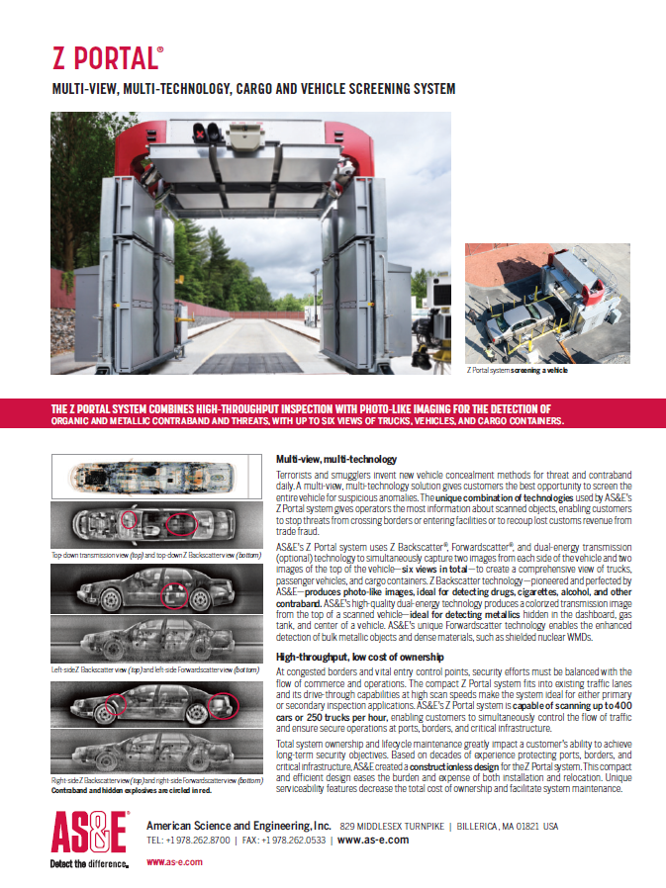
Available Marketing Materials
Currently Available
  Z Portal data sheet
  Z Portal product description
  Z Portal sales training presentation
  Photography of the system
  Product overview (customer) presentation
  Competitive Comparison
  FAQ document
  Positioning document
In Development
  Website Update (September 2015)
  Lockout specs (September 2015)
  Inclusion in the All Products Brochure (September 2015)
  Email Template (October 2015)
  Product Video (Fall 2015)
  Application animation (Fall 2015)

Slide 17
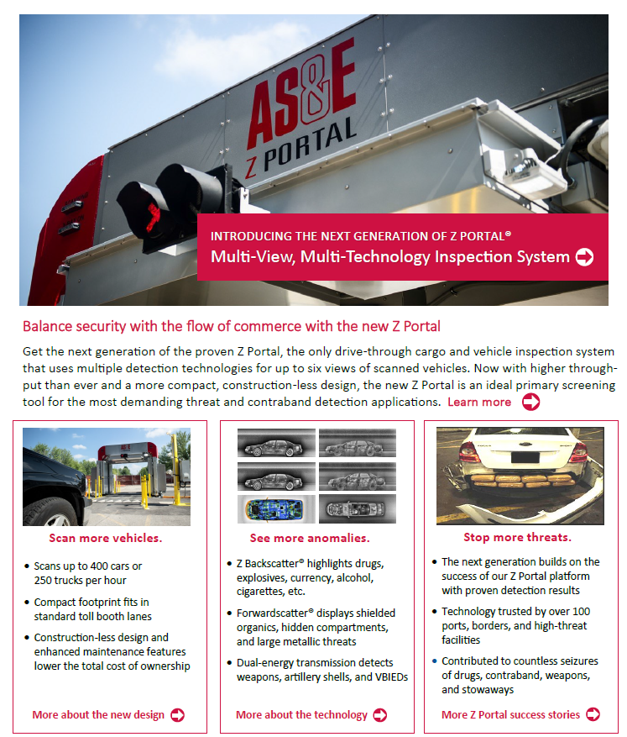
Email Template
To be distributed in October 2015
Simple Text Version will also be available
Notes:
Seizure Deck, Shortened Overview Deck (with specs), Technology deck (with system X-rays)

Slide 18
Technology

Slide 19
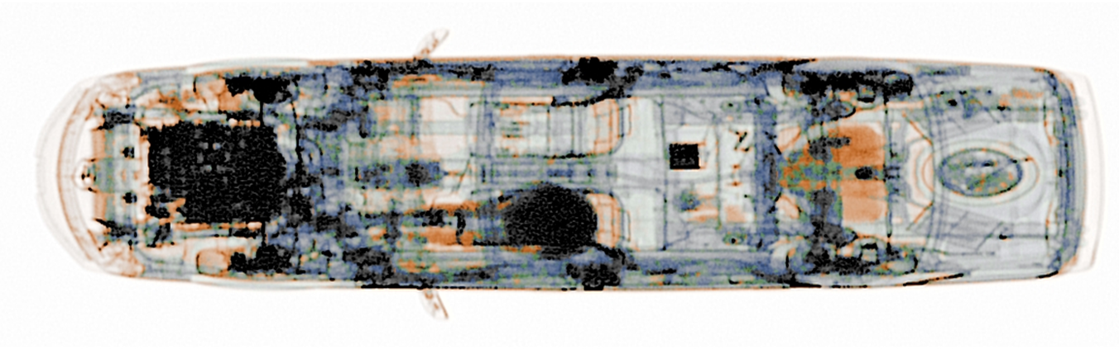
Dual-Energy Imaging
Optional
Dual-Energy Transmission Imaging creates an image using transmission X-rays and material discrimination technology.
Dual-Energy transmission imaging produces high resolution, colorized images, enabling analysts to visually differentiate classes of materials within uncluttered cargo. Materials are shown in one of three color categories: organics in orange, metallics in blue, and mixed materials in green.
For Reference Only

Slide 20
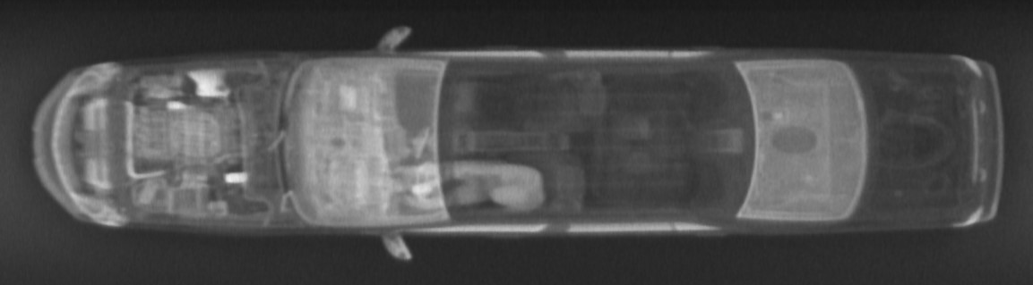
Z Backscatter X-ray Imaging
Z Backscatter X-ray Imaging creates an image by exposing a target to a “flying spot” of X-rays and collecting the resultant scattered x-rays with a detector on the near side.
Since the degree of X-ray scatter (Compton Scattering) is a function material type (Low Z_{eff}), the resultant image preferentially highlights organic materials while revealing the shape and form of the cargo.
For Reference Only

Slide 21
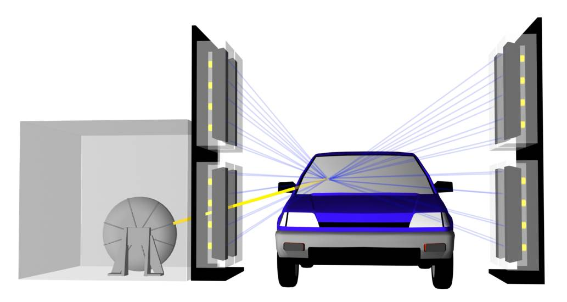
Forwardscatter Technology
Improved detection capability with no additional hardware
Employed as a supplementary detection technology to Z Backscatter
Detects X-rays scattered in a forward direction
Reveals large, dense objects
Depth of image performance particularly well suited for passenger vehicles or lightly loaded containers
Backscatter X-rays
Forwardscatter X-rays
For Reference Only

Slide 22
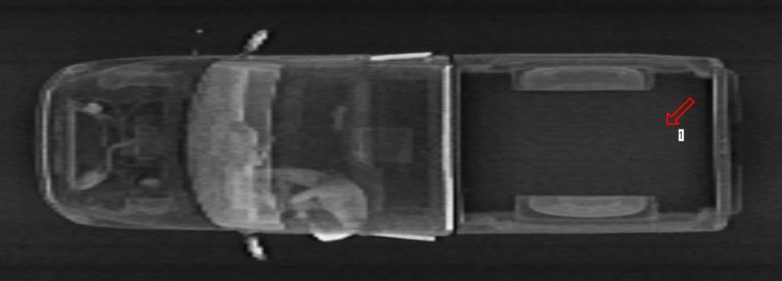
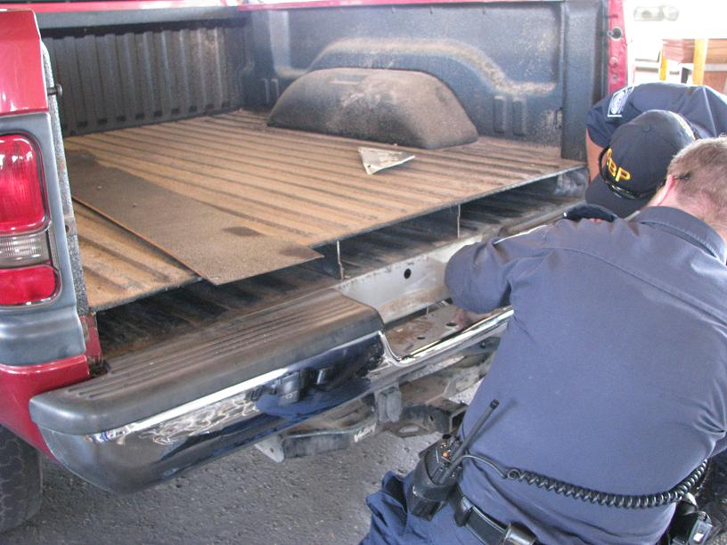
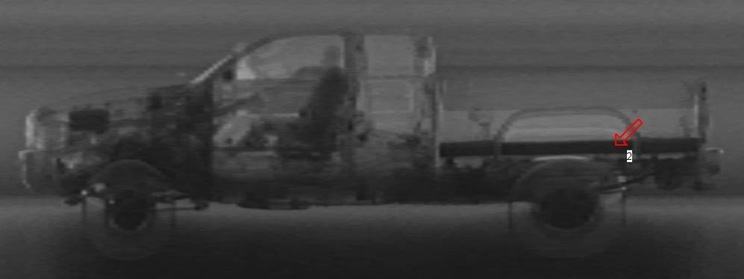
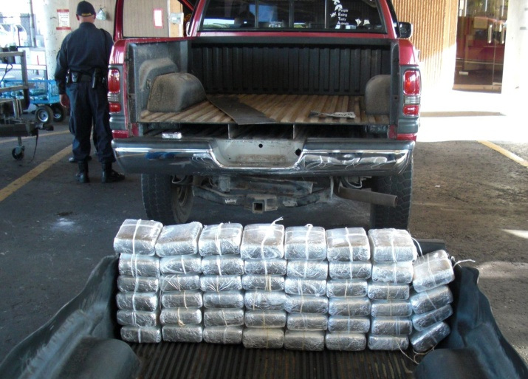
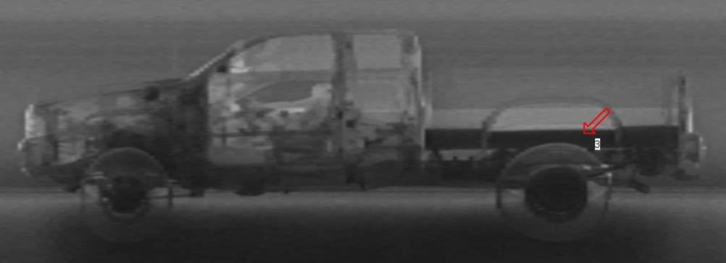
Forwardscatter Images Lead Lined Truck Bed
Fowardscatter detected lead lining in truck bed designed to conceal drugs
Top Down Z Backscatter
Drivers Side Fowardscatter
Passenger Side Fowardscatter
For Reference Only

Slide 23
Z Portal II Specifications

Slide 24
Z Portal I vs. Z Portal II
The new Z Portal system enhances the original design with:
  Higher throughput
  Improved image quality at higher scan speeds
  Decreased system footprint
  Increased tunnel size
  Constructionless design
  Increased operating temperature range
  Dual-energy top-down imaging (option)
  Longer preventative maintenance intervals
  Enhanced serviceability, decreased MTTR

Slide 25
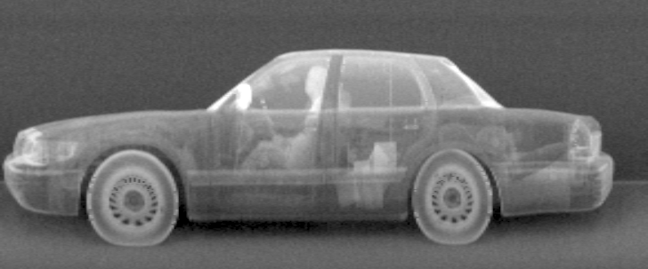
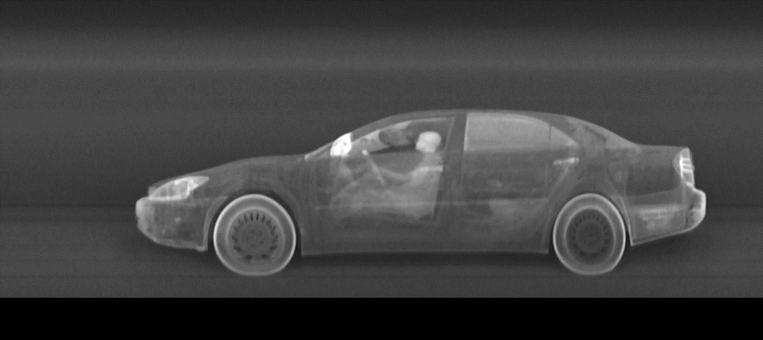
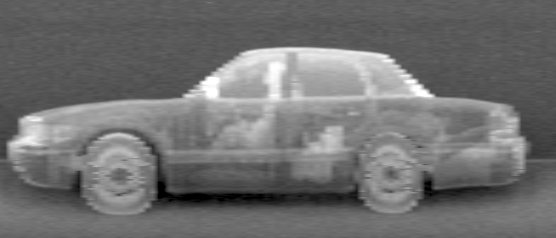
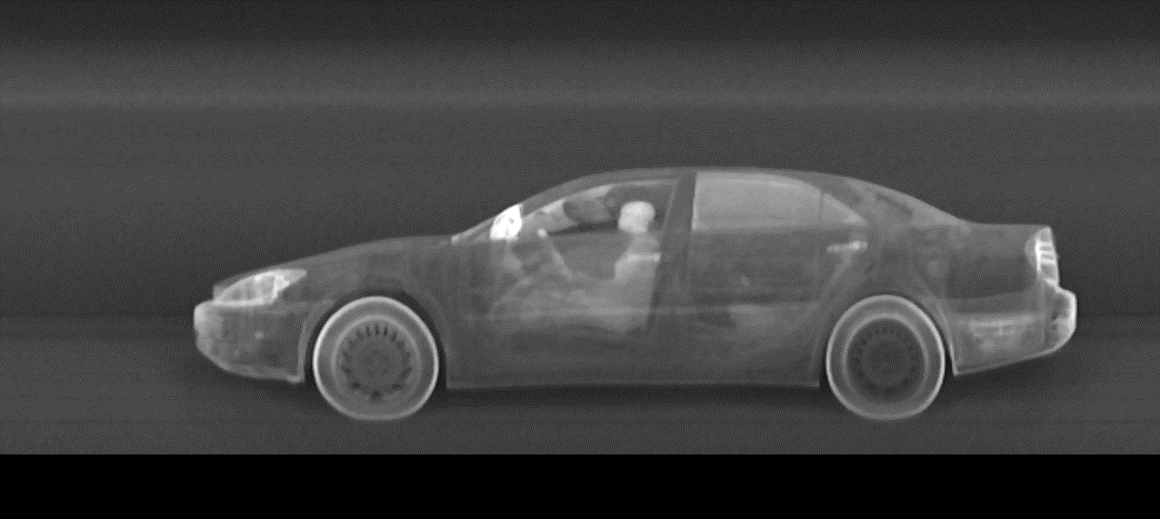
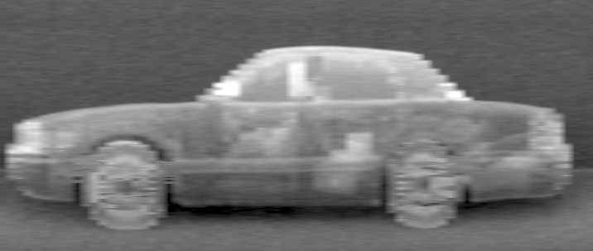
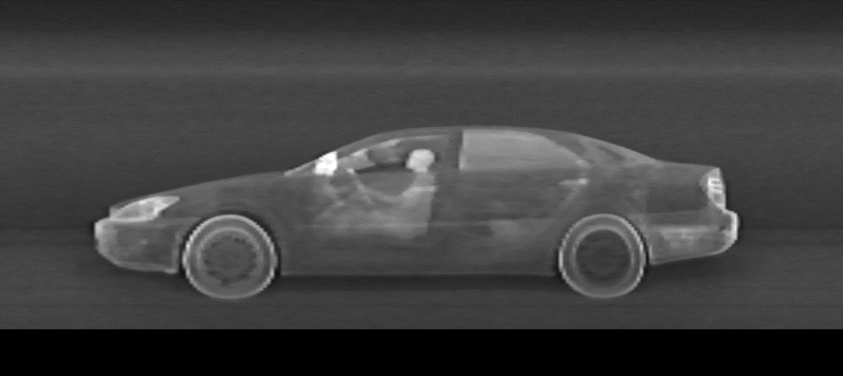
Image Quality Improvement
Z Portal I
3 KPH
Z Portal II
3 KPH
9 KPH
9 KPH
12 KPH
12 KPH

Slide 26
Z Portal II Specifications
X-ray sources: Three 225 keV Z Backscatter
Throughput:
  Up to 250 trucks or 400 passenger vehicles per hour
Scan speed: 2 – 20 kph (1.2 – 12.4 mph)
  Spatial correction software compensates for variations in vehicle speed
Radiation dosage: <0.05 µSv per scan (<5.0 µRem) at 8 kph (5 mph)
Operating Temperature: -30° C to 40° C (-22° F to 104° F)
  Cold Weather Temperature Option: -40° C to 40° C (-40° F to 104° F)
  Hot Weather Temperature Option: -5° C to 60° C (23° F to 140° F)

Slide 27
Throughput Specifications
Standard Operating Mode:
Continuous Scan Mode:
*Note: Throughput of 250 trucks or 400 cars per hour is reached in Continuous Scan Mode at 8 kph and with 0 seconds for Image Analysis (assuming networked and remote analysis)
Scan Speed (kph) | Analysis Time (seconds) | Throughput - Car | Throughput - Truck
5 | 7 | 184 | 125
8 | 7 | 211 | 155
12 | 7 | 227 | 180
Scan Speed (kph) | Analysis Time (seconds) | Throughput - Car | Throughput - Truck
5 | 5 | 224 | 140
8 | 5 | 266 | 185
12 | 5 | 292 | 220

Slide 28
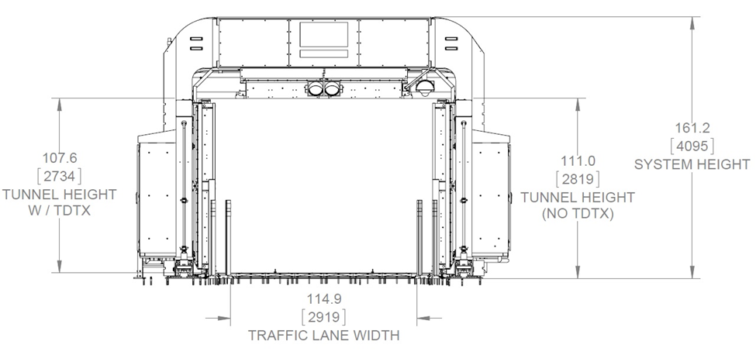
Z Portal II Specifications
 | Truck Configuration | Car Configuration
Maximum Vehicle Dimensions
Width | 3.5 m (11.5 ft) | 2.7 m (8.8 ft)
Height | 4.6 m (15.1 ft) | 2.7 m (8.8 ft)
Overall System Dimensions (Without Second Chiller or DE TDTX ramp)
Width | 6.6 m (21.7 ft) | 5.9 m (19.4 ft)
Height | 6.0 m (19.7 ft) | 4.1 m (13.5 ft)
Depth | 6.7 m (22.0 ft) | 6.1 m (20.0 ft)
Weight (including second chiller) | 12,247 kg (27,000 lbs.) | 9,979 kg (22,000 lbs.)
Power Requirements
 | 50 Hz | 60 Hz (option)*
Volts | 400 +/- 10% | 480 +5/-10%
Amp | 60A | 50A
Phase | 3 | 3
Frequency | 50 +/- 3Hz | 60 +/- 3Hz
Passenger Vehicle Configuration
*Requires additional transformer

Slide 29
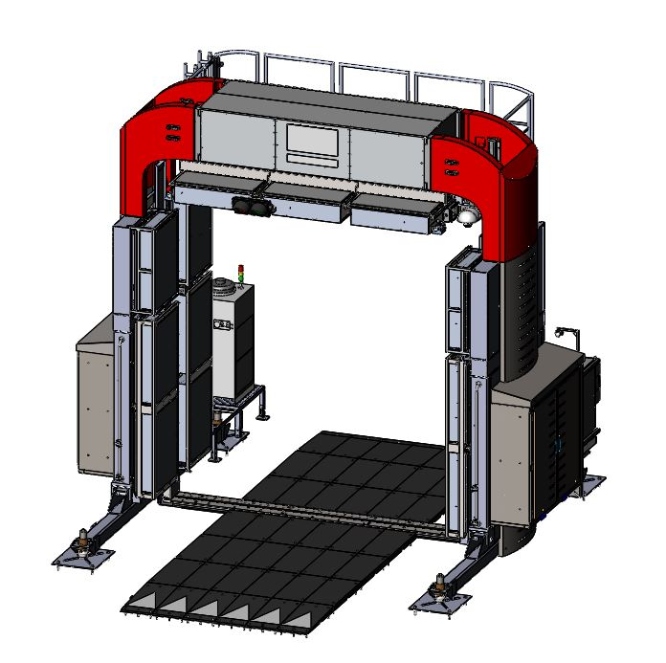
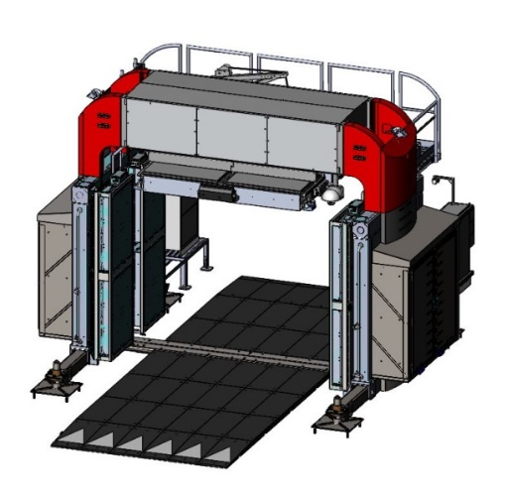
Z Portal II Configurations
Available in two sizes
  Larger size for trucks and cargo
  Compact size for passenger vehicles
Scan Activation (Z Portal for Trucks only)
  Driver side scan activation station
  Officer scan activation station
  Automatic Cab Exclusion
Continuous Scan Mode
Bi-Directional Scan Mode
  Ability to manually switch the traffic flow
  In development, not yet released
Note: Z Portal II is NOT available in a two-sided configuration

Slide 30
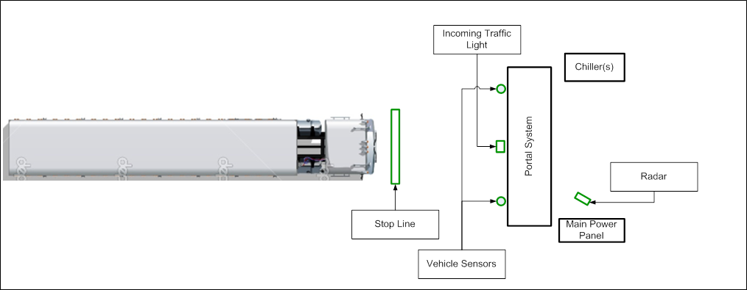
Brief Concept of Operations (CONOPS)
System operator activates the scan by pressing the “Start Scan” button
When the X-rays reach scanning levels, the traffic light turns from red to green, and the driver begins driving through the portal at a nominal speed of up to 8 kph (5 mph)
  System has the ability to compensate for variations in vehicle speed
The portal detects the vehicle and begins scanning
System stops scanning after vehicle passes completely through the portal

Slide 31
Continuous Scan Mode CONOPS
Continuous Scan Mode allows the System Operator to activate the start scan sequence once.
System operator activates scan process by selecting “Continuous Scan Mode” and clicking the “Start Scan” button
Once the X-rays are powered up, the traffic light will turn from red to green, indicating to the vehicle driver to proceed through the scan tunnel
  Vehicle has 90 seconds to enter scan tunnel
Once the vehicle is through the scan tunnel and all peripheral data has been received, the traffic light will automatically turn from red to green, indicating to the next driver in the queue that it is safe to proceed through the scan tunnel
  Proceeding vehicle has 60 seconds to enter scan tunnel

Slide 32
Scan Activation Station CONOPS
Option – Truck Z Portal only
The Scan Activation option includes a scan activation kiosk (either the driver or officer version) and an additional exit traffic light in addition to the existing Z Portal II hardware
The standard scan sequence is followed up to the point where the vehicle enters the scan tunnel
Once in the scan tunnel, the driver pulls forward and slows to a second stop line, such that the cabin/passengers of the vehicle are past the X-ray beam
Once the activation button is pressed (either by the driver or by the officer), an exit-side traffic light will turn green to signal the driver of the vehicle to proceed through the system.
  If no vehicle motion is detected within five (5) seconds, the exit-side traffic light will turn red and the driver/officer will need to repress the scan activation button
Upon movement of the vehicle, image acquisition will begin and the area behind the driver will be scanned
The system automatically senses the end of the vehicle and ends image acquisition after the entire vehicle has been scanned. The exit-side traffic light turns red.
The system then enters a standby mode, ready to scan the next vehicle

Slide 33
Automatic Cab Exclusion CONOPS
Option – Truck Z Portal Only
This option modifies the operation of the system to automatically avoid scanning the cab of a tractor trailer.
  There must be a gap between the cab of the vehicle and the cargo trailer to use this option.
  This option adds a laser based scanning gap sensor to the standard Z Portal hardware.
The standard scan sequence described above is followed up to the point where the vehicle enters the scan tunnel.
Once in the scan tunnel, the vehicle is sensed but X-Rays remain off until the truck passes the gap sensor and the system recognizes that the cab (and vehicle operator) have passed the X-ray beam plane.
The system then automatically starts the scan of the cargo trailer.
The system automatically senses the end of the vehicle and ends image acquisition as in the normal scan sequence.

Slide 34
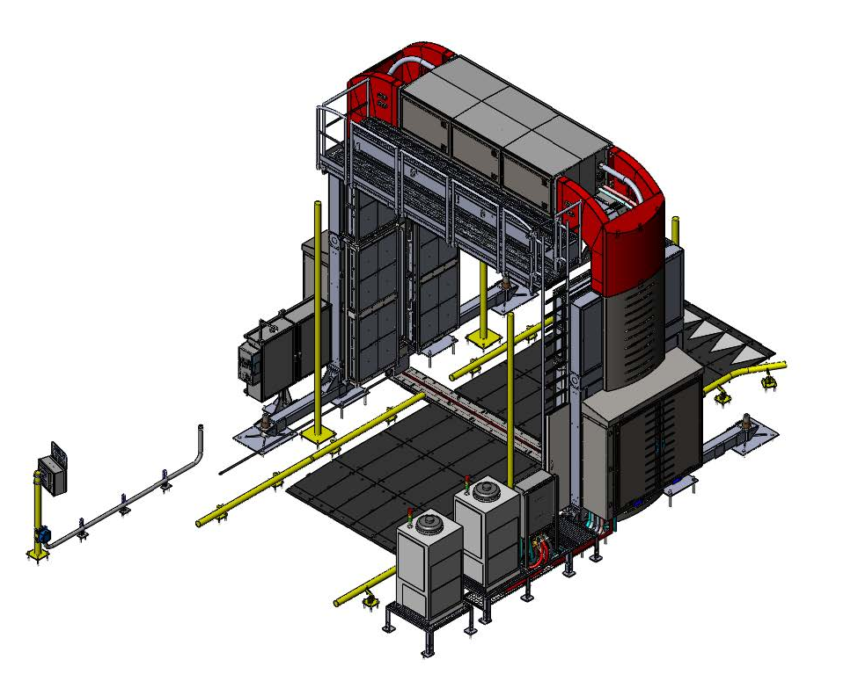
Truck Portal Major Assemblies
TOP IMAGING MODULE
STANDARD EQUIPMENT
SERVICE PLATFORM
OPTIONAL EQUIPMENT
POWER ENTRY / PERIPHERALS ENCLOSURE
RAMP
LEVELING FOOT
SPEED DISPLAY
SIDE IMAGING MODULE
TRANSMISSION DETECTOR
LADDER GUARD
VEHICLE GUIDE
CHILLER
HIGH TEMP CHILLER

Slide 35
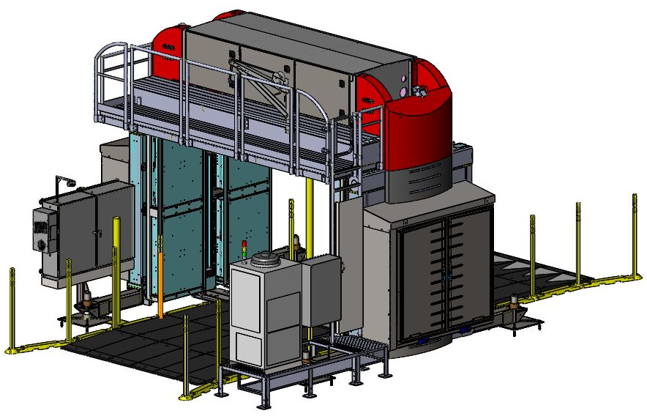
Car Portal Major Assemblies
TOP IMAGING MODULE
SERVICE PLATFORM
STANDARD EQUIPMENT
OPTIONAL EQUIPMENT
POWER ENTRY / PERIPHERALS ENCLOSURE
RAMP
TRANSMISSION DETECTOR
SIDE IMAGING MODULE
VEHICLE GUIDE “FLAGS”
LADDER GUARD
CHILLER
Notes:
Not necessary to include both car and truck?

Slide 36
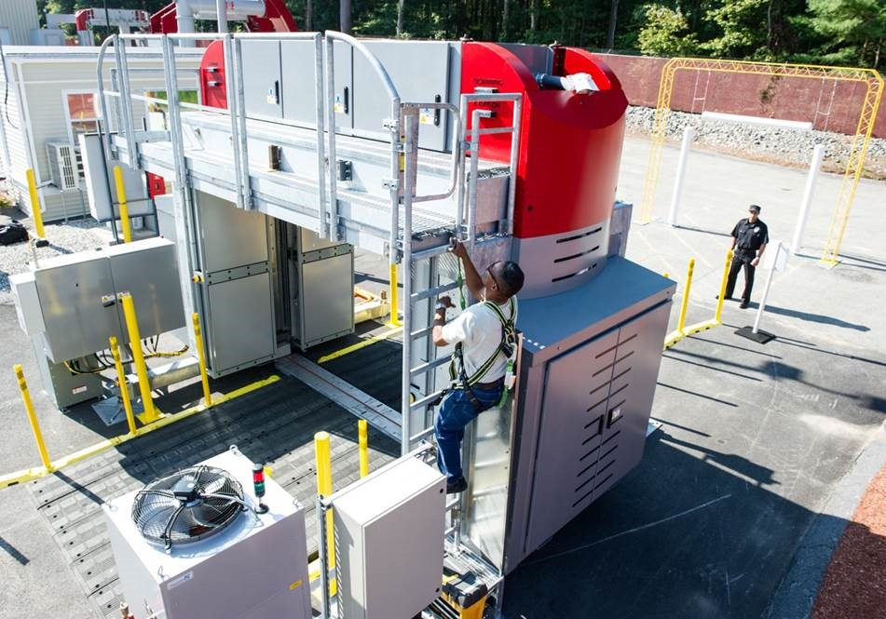
Z Portal II Enhanced Serviceability Features
Catwalk allows for ease of access to top source module
Service access from inside the tunnel
Standard LED tunnel lights
Automatic Limp mode
  System will continue to image in the presence of 1 – 2 source failures
  Enhanced remote monitoring for field service
Built-in Self Test (BIT)
  Runs in background to help identify failed or compromised components

Slide 37
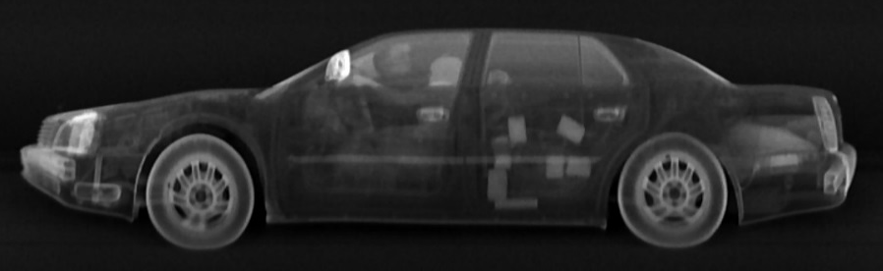
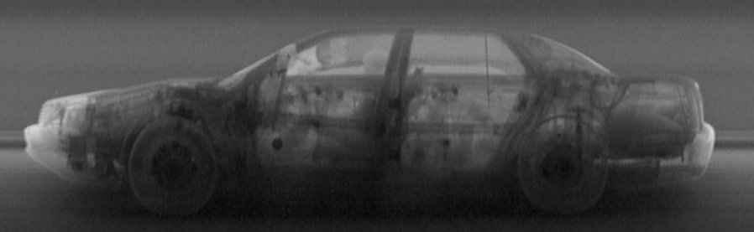
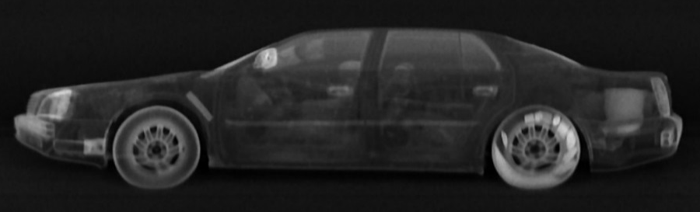
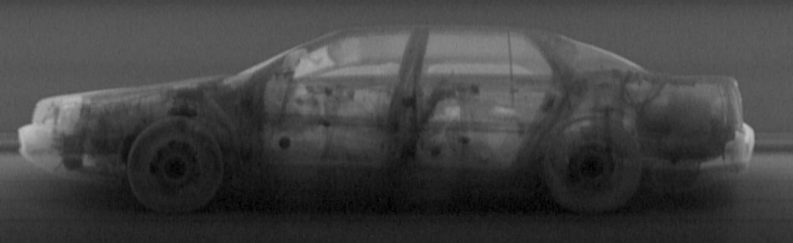

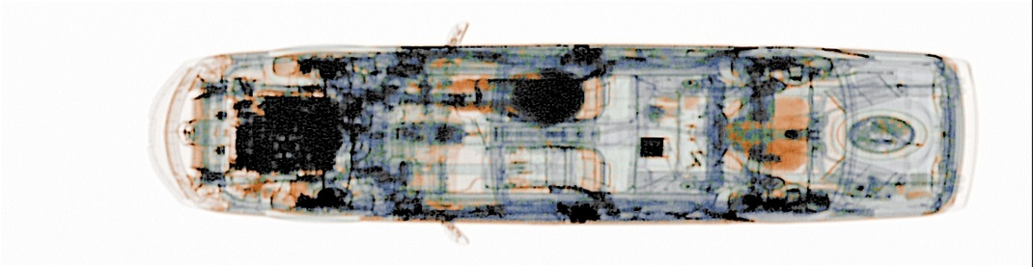
Z Portal Full Image Set – Car Portal
Left Side Bx
Left Side Fx
Right Side Bx
Right Side Fx
Top Bx
Top DE

Slide 38
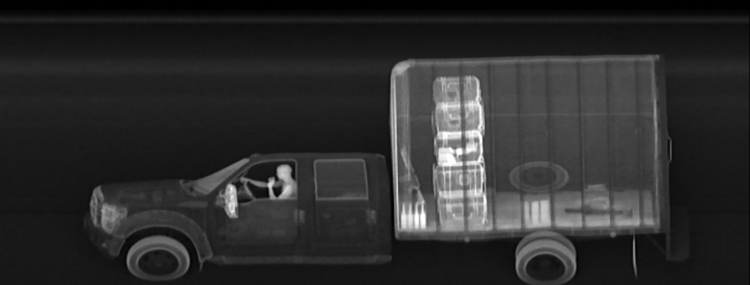
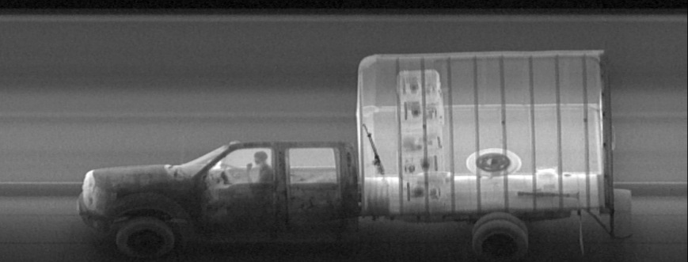
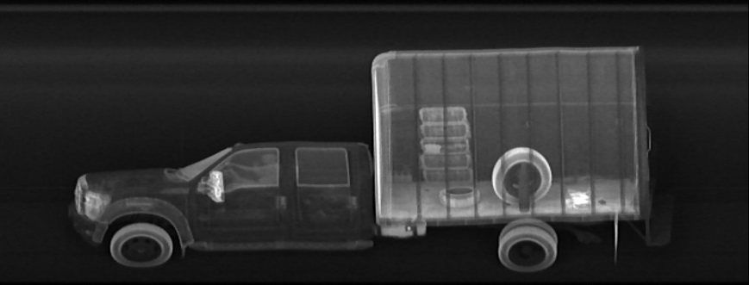
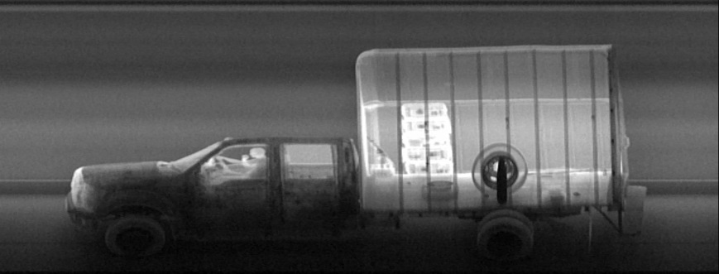
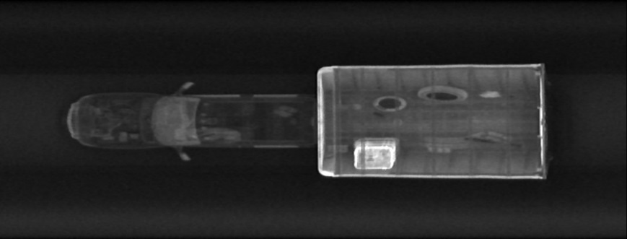
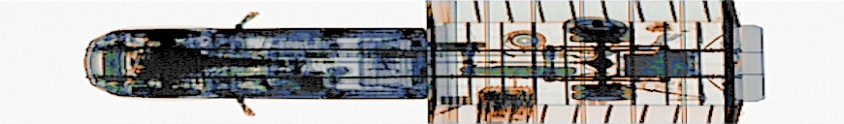
Z Portal II Full Image Set – Truck Portal
Left Side Bx
Left Side Fx
Right Side Bx
Right Side Fx
Top Bx
Top DE

Slide 39

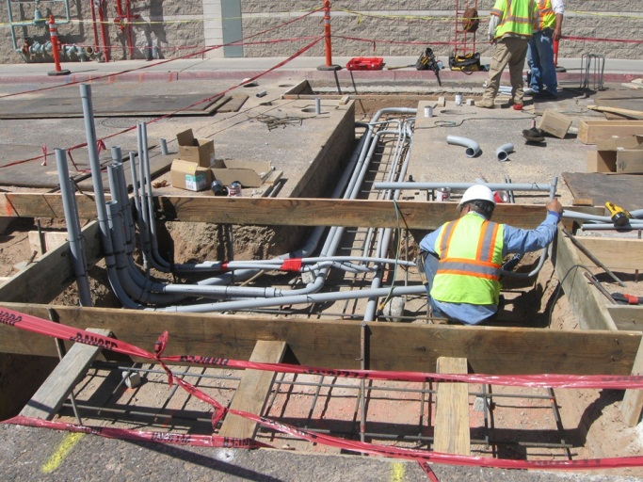
Z Portal Constructionless Design
Installed on existing road, vehicle travel lane, parking lot, etc.
Surface-mount Transmission Detector
Eliminates trenching, below ground conduit runs and cabling installation
  Surface mounted bollards/posts
  Optional LPR runs on power feed from system
  Optional surface mount UVIS
  Single Interface for Electric Power
  Reduced installation time

Slide 40
Z Portal I vs Z Portal II Site Requirements
Feature / Option | Z Portal I | Z Portal II
Vehicle Height Gauge | Civils Scope | Surface Mount
Vehicle Guides | Rub Rails | Plastic Guides
Vault | Required | Not Required
Foundation | Required | Not Required
Underground Conduit | Required | Not Required
Speed Display / Radar | In-ground | Surface Mount
TDTX | In-ground | Surface Mount or In-ground
Vehicle Sensors / Cameras | In-ground / Bollards | On system
Travel / Lane Grade | Requires level grade | 2% Grade
UVIS | In-ground / Conduit | Surface Mount or In-ground
LPR | In-ground / Conduit | Surface Mount

Slide 41
Z Portal II Options

Slide 42
Z Portal II Options
Dual-energy Top-Down Transmission
Scan Activation Station (Truck only)
Automatic Cab Exclusion Scan Activation (Truck only)
Radiation Portal Monitor
Integrated License Plate Reader system
Integrated Container Code Recognition system (Truck only)
Integrated Under Vehicle Inspection System
Integrated Manifest Scanner (Truck only)
Networking with ASE Connect
Vehicle Protection Kit
  Vehicle guides and flags to direct traffic through the tunnel and decrease vehicle collisions with the system
Vehicle Gauge Kit
  Vehicle height and width gauges to prevent oversized vehicles from entering the scan tunnel
Vehicle Speed Display
CCTV perimeter cameras
Foundation Mount
  Mounts the Z Portal system on concrete
Local Language Kits
  Arabic, Chinese, English, French, Polish, Portuguese, Russian, and Spanish available
Peripheral Data Interface
  Allows integration of data from third-party devices into system database
150 m (500 ft.) Operators Kit
  Extends the distance between the system and operator’s control station from 90m (300 ft.) to 150m (500 ft.)
Transformer (needed for 60 Hz installations), Generators, Power Conditioners
Operator Alert Image Analysis Tools
Operator Booth
Extreme Temperature Kits
Sentry® Portal Co-location (Truck only)

Slide 43
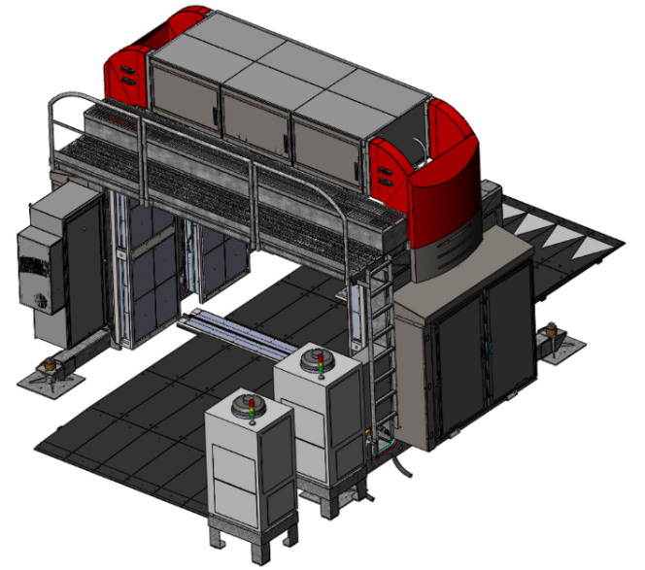

Dual-energy Top-Down Transmission Imaging - Option
Produces a three color image highlighting different material types
  Metallics in blue
  Organics in orange
  Mixed materials in green
The DE TDTX option is housed in a surface mount enclosure which does not require any civil works construction for installation
Provides improved detection
  Weapons, handguns and rifles
  Smuggling in fuel tanks
  Items on the floor or concealed under seats & in trunk
Transmission Detectors
Dual-Energy Top-Down Transmission Image

Slide 44
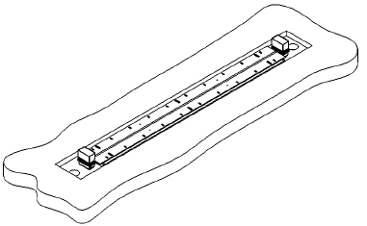
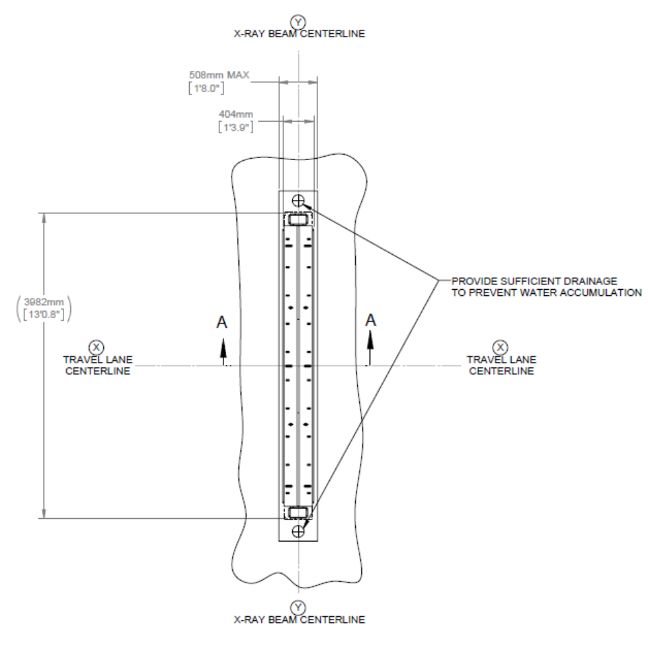
Vaulted TDTX Site Requirements
Car Z Portal flush mount (vaulted) TDTX
  Vault Dimensions
    508mm (1’ 8”) width
    86mm (3.4”) height (deep)
    Detector enclosure is 3982mm (13’ 0.8”) wide, must provide room for appropriate drainage on each side and power connection
    331-0026-1 Vaulted TDTX for Car Site Requirements Drawing
Truck Z Portal flush mount (vaulted) TDTX
  Vault Dimensions
    508mm (1’ 8”) width
    86mm (3.4”) height (deep)
    Detector enclosure is 4845mm (15’ 10.8”) wide, must provide room for appropriate drainage on each side and power connection
    331-0025-1 Vaulted TDTX for Truck Site Requirements Drawing
  Surface Mount TDTX Site Requirements Drawing
  331-0028-1
Power connection made here. Use Liquatite above ground to electronics panel.

Slide 45
Scan Activation Station
Z Portal for Trucks only
Option for scanning only the cargo of a large truck – avoids scanning the cab and driver
Two configurations allow scanning to be initiated by an officer or by the vehicle driver
  Officer Scan Activation – A kiosk allows an officer to initiate scanning
  Driver Scan Activation – Driver of the vehicle initiates scanning with a push button
Valuable option in regions where local regulations do not permit personnel scanning

Slide 46
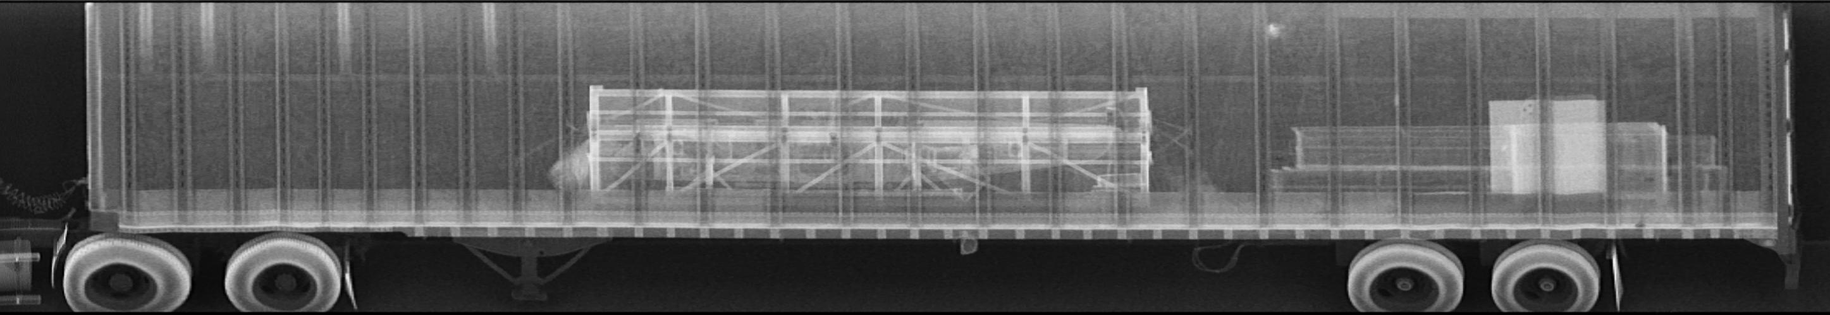
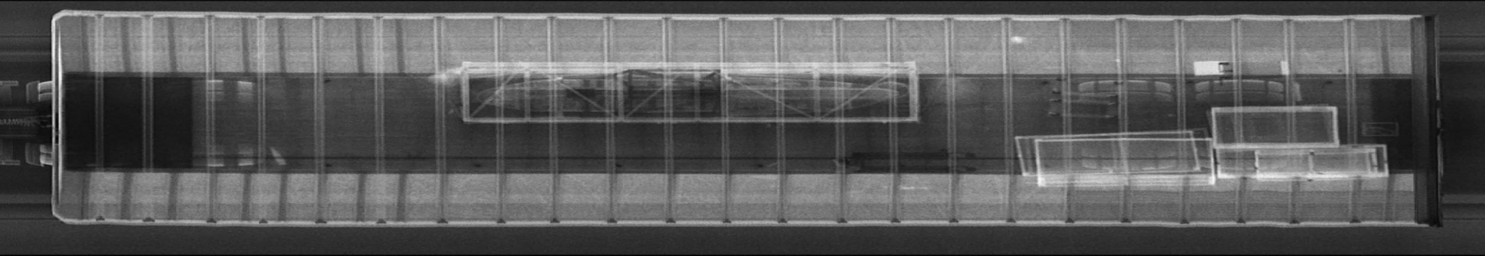

Example Images with Scan Activation Station Option
From Z Portal I

Slide 47
Automatic Cab Exclusion
Z Portal for Trucks only
This option modifies the operation of the system to automatically avoid scanning the cab of a tractor trailer.
  There must be a gap between the cab of the vehicle and the cargo trailer to use this option.
  This option adds a laser based scanning gap sensor to the standard Z Portal hardware.

Slide 48


Radiation Portal Monitor
Detection of gamma and neutron radiation to low levels
Real-time high-sensitivity alarming in dynamic mode without stopping traffic
Hi-quality NORM identification and rejection capability to limit Nuisance Alarms
Low cost of ownership
Remote diagnostic capabilities
Operating temperature range -40 °C to +60°C
For Reference Only

Slide 49



License Plate Reader (LPR) System
Integrated with ASEInspection Software
License plate information is automatically entered into image database via Optical Character Recognition System
  Large install base with proven License Plate Reader performance
Captures front and rear license plates
  Multiple images captured for each plate ensures high recognition rate
Reading of reflective or non-reflective plates supported
Integrated Scene Camera for view of approaching vehicle; useful to obtain images of the driver, as well as make and model vehicle information
Operates in a wide range of weather conditions
>95% average read accuracy rates. Data varies by country
For Reference Only

Slide 50


Container Code Recognition (CCR) System
Analyze, integrate, and archive container ID data with cargo X-ray system images and subsystem data
CCR system auto adjusts for changes in scene illumination for optimum container recognition
Performance optimized for the full range of Intermodal Containers defined in ISO 668
  Covers all types of containers (20, 40, 45, 20/20 feet and combinations). Performance guaranteed for single conveyances, tandem conveyances, and dual containers mounted on a single conveyance
Optional integrated License Plate Reader to capture the front and rear license plates of the truck and trailer
Optional integrated Scene Camera for view of approaching vehicle; useful to obtain images of the driver, as well as make and model vehicle information
Both LPR and Scene camera images and character text strings are attached to the X-ray record along with the CCR images/ text strings
Large install base with proven Container Code Recognition performance
    >95% accuracy
For Reference Only

Slide 51



Under Vehicle Inspection System (UVIS)
Safe, rapid, and thorough method of examining the undercarriage of passenger and commercial vehicles
Capture a single seamless high resolution image for accurate detection
Provides 12X zoom capability, contrast and brightness adjustment
For Reference Only

Slide 52

Integrated Manifest Scanner Option
Z Portal for Trucks only
Scan paper manifests and save as PDF files
Automatically saved in scan record
Uses a standard document scanner
Manifest preview window
  Delete pages
  Move page order
  Rotate pages
Manifest viewer window
  View manifest
  Adjust contrast and brightness
  Compare historical manifests
  Print manifest
For Reference Only

Slide 53

ASE Connect™ Networking Solution - Option
Allows for the centralized management of equipment, images, and data by a common software application
Scalable and customizable to meet specific security requirements
Allows for networked image viewing and analysis at a secondary or remote analysis station
Web enabled browser allows supervisors to run reports, view equipment status, manage users, and manage the database
For Reference Only
Notes:
NEW

Slide 54
Z Portal II Image Analysis

Slide 55






Z Portal Display
Standard 1x4 Monitor Display
Driver Backscatter
Driver Forwardscatter
Top Backscatter
Top Transmission
Passenger Backscatter
Passenger Forwardscatter
LPR Display
UVIS
Monitor 1
Monitor 2
Monitor 3
Monitor 4
Optional 2x2 Quad Monitor Display

Slide 56

ASEInspection Operator Console
Operator Station
  Four, 21-inch LC monitors, one keyboard, and mouse
Standard Image Analysis Tools
New Dual-energy Image Analysis Tools
Auto Enhance
Clear/Suspect Tagging
Colorize
Decrease Density
High Contrast
Histogram
Histogram EQ
Historical Compare
Increase Density
Mark and Annotate
Region of Interest
Reset All
Reset Density
Reverse Video
Ruler (object measuring)
Sharpen
Zoom In/Out/Reset
Show Grayscale
Show Metals
Show Mixed Materials
Show Organics

Slide 57

Operator Alert Image Analysis Tools
Automatic Historical Compare
  Uses vehicle identifier to detect if a vehicle has been previously scanned by the system
  Presents historical and current images in a side-by-side format
Reference Vehicle Compare
  Uses vehicle identifier to automatically compare current and historical scans
  Highlights anomalies
  Z Portal for Cars only
3D Viewer
  Creates a virtual 3D rendering of the vehicle from the Z Backscatter Images
Decreases Image Analysis time

Slide 58

Reference Vehicle Compare
Z Portal for Cars only
Compares current vehicle against most recent “reference” image of same vehicle
Visually displays the changes from scan to scan
Historical records identified by license plate number
Optionally include/exclude select regions
Note: Early customers will need to provide training images for algorithm optimization
Z Portal I Image
RVC: Object Removed
RVC: Object Added
Notes:
Include long lead time in customer facing document? Or just explain to sales?

Slide 59




Reference Vehicle Compare Automation
Dash

Slide 60

3D Viewer
3D Viewer displays a 3D surface reconstruction of the current vehicle using the left, right and top Backscatter images.
Z Portal I Image

Slide 61
Z Portal II Safety

Slide 62

Z Portal II Exclusion Zone – Car Portal
At system boundary
The 0.5 µSv/hr controlled zone allows 100% occupancy for 2000 hr/yr (40hr/wk, 50wk/yr) with an accumulated annual dose of less than 1.0 mSv/yr which is the ICRP/NCRP recommended limit for the “general public and minors."
7.6m (24.8 ft)
5.9m (19.4 ft)
5.1m (16.8 ft)

Slide 63

Z Portal II Exclusion Zone – Truck Portal
At system boundary
The 0.5 µSv/hr controlled zone allows 100% occupancy for 2000 hr/yr (40hr/wk, 50wk/yr) with an accumulated annual dose of less than 1.0 mSv/yr which is the ICRP/NCRP recommended limit for the “general public and minors."
7.9m (26.0 ft)
6.6m (21.7 ft)
6.7m (22.0 ft)

Slide 64

CE Marking
The Z Portal system has CE marking and is conformance with the following directives:
  Machinery Directive 2006/42/EC
  Electromagnetic Compatibility Directive 2004/108/EC
  Low Voltage Directive 2006/95/EC
For Reference Only

Slide 65

Health & Safety – Z Portal
One Z Portal scan = <0.05 µSv (5 µRem)
Some comparisons:
One Z Portal Scan | <0.05 µSv (5 µRem)
2.4 hours in Denver | 1 µSv (100 µRem)
One hour on an airplane | 3 µSv (300 µRem)
Background radiation per day | 10 µSv (1,000 µRem)
Dental X-ray | 10 µSv (1,000 µRem)
Trans-continental flight (round trip) | 50 µSv (5,000 µRem)
Chest X-ray | 100 µSv (10,000 µRem)
CAT scan (Head and Body) | 1,100 µSv (110,000 µRem)
Average radiation dose per year | 3,600 µSv (360,000 µRem)
It would take 60 Z Portal scans to equal the amount of radiation received in one hour on an airplane at altitude
For Reference Only

Slide 66
Safety Design Elements
Visual warnings
  Flashing yellow lights when X-rays ON – FULL
  Flashing red lights when X-rays ON – EMITTING
X-ray emergency stops (e-stops) and interlocks
  Effect when activated:
    Turns X-rays OFF (shutter is closed; X-ray power turned off)
    Powers down subsystems (except for computer system)
  Safety stops located at:
    Portal entry and exit and on sides
    Operator console
  Interlocks located at:
    X-ray tube housing
    Access panels
X-Ray Mode | Shutter Status | Power Status
OFF | Closed | No power
IDLE | Closed | Voltage maintained but current ramped down
ON – FULL (Yellow light) | Closed | Full
ON – EMITTING (Flashing red light) | Open | Full
For Reference Only

Slide 67
Options and Availability

Slide 68
Quoting Rules
DE TDTX
  Surface mount with ramp
  In-ground without ramp
System Mounting
  Outrigger kit
  Foundation mount
OpCon Interface Kit
  90m (300 ft.)
  150m (500 ft.)
Environment Options (standard range: -30°C to 40°C (-22°F to 104°F))
  Extreme Hot (extends to 60°C / 140°F)
  Extreme Cold (extends to -40°C / -40°F)
Service Platform is included in the base price
  Must also be selected as an option in the configurator
  Custom quote is needed to exclude this option from the base price

Slide 69
Z Portal Demo / Lead Time
Z Portal Demo
  Car and truck portal systems in Billerica available for customer demos – please contact Sales Operations for availability
Z Portal Lead Time – 5 months

Slide 70
Back Up Slides
Competition Overview Slides
Z Portal I vs. Z Portal II dimension comparisons
Safety Comparisons

Slide 71

Smiths Detection
CIP-300
  300 keV transmission only system
  Single, top-down views
  3 color material discrimination
  Conveyor option for safe scanning of passengers
  Throughput
    Conveyor: 30 vehicles/hr at 0.2 m/s (0.7 ft/s)
    Drive-through: 80 vehicles/hr at 8 kph (5 mph)
  60mm steel penetration
  Radiation Safety
    Drive through dose per scan: <0.1 µSv per scan
    Exclusion Zone: 10m x 10m (33ft x 33ft)
Product Video: https://www.youtube.com/watch?v=1-U21jfZBSU&feature=youtu.be

Slide 72

Smiths Detection
HCVL 40/35
  Scans cars, trucks, and busses
  4 MeV source
  Throughput
    60 cars/hr (conveyor system – HCVL 40)
    180 cars/hr (drive-through system – HCVL 35)
  Penetration
    260mm steel (conveyor system – HCVL 40)
    160mm steel (drive-through system – HCVL 35)
  Exclusion zone
    22m L x 6m W with walls (conveyor system – HCVL 40)
    8m L x 5m W with walls (drive-through system – HCVL 35)
Product Video: https://www.youtube.com/watch?v=VKEht1XJIz4

Slide 73

Leidos (formerly SAIC)
VACIS XPL
  120 keV transmission source
  Cars and light vehicles only
  Multiple Configurations available
    XPL – surface mounted portal
    XPL Mobile – surface mounted portal, transported on a truck
    Plaza – portal requiring civil works
  Throughput of 150 vehicles per hour at 16 kph (10 mph)
  Top-down view of vehicles up to 8 feet wide
  Easy Match Software: Manual comparison of images of previously scanned vehicles
  Relocation time: Few hours (Mobile option relocation time is 30 minutes)
  Continuous Operation Mode available
Product Video: https://www.youtube.com/watch?v=BR6bHjDuq_g&feature=youtu.be

Slide 74

Nuctech
FS Series
  1.5 – 6.0 MeV linac
  Dual-energy available on 6.0 MeV system
  Throughput of 120 units/hr at 10 kph
  Trucks only with Cab Exclusion software
  110mm steel penetration
  Dose to exclusion zone is 2.5 µSv
    Exclusion zone = 7m L x 7m W

Slide 75

Teleradio
VX-Ray
  160 keV single, top-down view
  Throughput is 180 – 360 vehicles per hour at 20 kph
  Dual-energy material discrimination (option)
  Screening of cars, vans
  Radiation Safety
    <0.05 µSv per scan
    <0.01 µSv per scan with Passive Filtering Technology
    Excessive radiation dose at slower speeds likely
    Slower speeds result in the best image quality
  Fixed and transportable versions (transportable setup time is less than one minute)

Slide 76
Z Portal I vs. Z Portal II
The latest enhancements to the Z Portal system maintain the successful and fundamental features of the original system, while offering improvements to the design, image quality, and serviceability to meet a broader range of customer applications.
All enhancements made to the Z Portal system are designed to extend the life and reach of the system.
  Innovative source and detector technologies improve the image quality and throughput of the system, resulting in enhanced threat detection at faster scan speed.
  A more compact system footprint meets the physical requirements for a wider range of customs and border applications.
  The construction-less design, increased throughput capability, and streamlined serviceability features decrease the total cost of ownership and facilitate system maintenance.
  New options, including dual-energy transmission imaging from the top down, also address customer requests for meeting real-world detection and operational challenges.

Slide 77

Z Portal I vs Z Portal II

Slide 78



Z Portal I vs Z Portal II

Slide 79

Top-Down Z Backscatter Improvements – Approx. 3 kph
Z Portal I
Z Portal II

Slide 80


Top-down Transmission Material Discrimination
Z Portal I
Z Portal II

Slide 81
Z Portal I vs. Z Portal II (Truck Configuration)
 | Z Portal I | Z Portal II
Footprint Decreased in ZPII | Truck: 8.9 m (29.2 ft.) W x 6.5 m (21.3 ft.) H x 2.9 m (9.5ft) L | Truck: 6.6 m (21.7 ft.) W x 6.0 m (19.7 ft.) x 6.7 m (22 ft. L)
Weight Increased in ZPII due to chiller & surface mounting | Truck: 11,368 kg (25,060 lbs.) | Truck: 12,247 kg (27,000 lbs.) – including second chiller
Maximum Vehicle Dimensions Increased in ZPII | Truck: 3.4 m (11.0 ft.) W x 4.5 m (14.9 ft.) H | Truck: 3.5 m (11.5 ft.) W x 4.6 m (15.1 ft.) H
Throughput Increased in ZPII | 80 trucks per hour at 5 kph. | 240 trucks per hour at 20 kph. (Continuous Operation Mode)
Technology Added DE in ZPII | Bx, Fx, Tx | Bx, Fx, DE
Operating Temperature Extended Operating Temperature in ZPII | -18C to +55C (0F to +131F) | -20C to +40C (-4F to +104F) Extended option: -40C to +60C (-40F to +140F)

Slide 82
Z Portal I vs. Z Portal II (Car Configuration)
 | Z Portal I | Z Portal II
Footprint Decreased in ZPII | 7.8 m (25.6 ft.) W x 4.5 m (14.8 ft.) x 2.9 m (9.5ft) L | 5.9 m (19.4 ft.) W x 4.1 m (13.5 ft.) H x 6.1 m (20.0 ft.) L
Weight Increased in ZPII due to chiller & surface mounting | 9,122 kg (20,110 lbs.) | 9,979 kg (22,000 lbs.) – including second chiller
Maximum Vehicle Dimensions Increased in ZPII | 2.7 m (8.9 ft.) W x 2.6 m (8.5 ft.) H | 2.9 m (9.5 ft.) W x 2.7 m (8.8 ft.) H
Throughput Increased in ZPII | 120 cars per hour at 5 km/hr. | 360 cars per hour at 20 kph (Continuous Operation Mode)
Technology Added DE in ZPII | Bx, Fx, Tx | Bx, Fx, DE
Operating Temperature Extended Operating Temperature in ZPII | -18C to +55C (0F to +131F) | -20C to +40C (-4F to +104F) Extended option: -40C to +60C (-40F to +140F)

Slide 83



System Operation
Traffic Coordinator (Optional)
Receives manifest
Checks area for unauthorized personnel
Clears area for loading of scan target vehicle
Ensures all conditions exist for safe operation
Provides directions to driver
Vehicle Driver
Drives scan target vehicle through portal
Maintains speed with feedback from speed indicator
Image Analyst/Operator
Views image generation as object is scanned
Analyzes images
Holds/Releases the scan target vehicle
(i.e. Controls exit gate)
Stores images and image data on server computer
Minimum Crew Requirements: One System Operator / Image Analyst is standard. Additional traffic coordinator is optional.

Slide 84

ANSI Standard N43.17-2009
New ANSI Standard allows up to 0.25 uSv per screening for general use systems
Establishes guidelines on the number of screenings allowed in one year
For Reference Only

Slide 85





Applicable Radiation Standards
Regulation | Dose Rates Allowed to General Public | Number of Equivalent Z Portal Scans
International Council on Radiological Protection (ICRP) | 1 mSv per year | 20,000 scans
Nuclear Regulatory Commission (NRC) | 1 mSv per year | 20,000 scans
ANSI/HPS N43.17-2009 | 0.25 µSv per screening or 250 µSv per year from any one source | 5,000 scans
EURATOM 96/29 | 1 mSv per year | 20,000 scans
Tested by F.X. Massé to be in compliance with ANSI N43.17-2009
For Reference Only

