Slide 1
Sentry® Portal Cargo Inspection System
Product Overview
June 2015

Slide 2
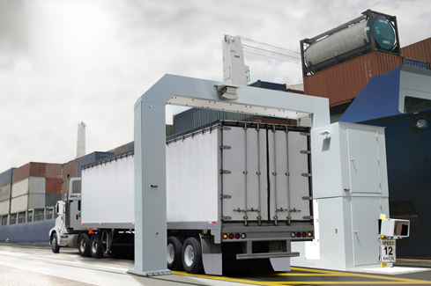
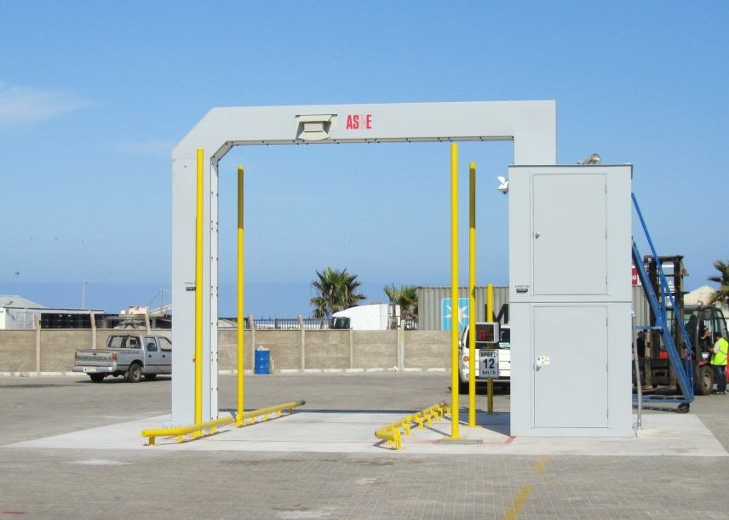
Sentry® Portal Cargo Inspection System
High throughput, drive-through inspection system using transmission X-rays
Penetrates densely loaded containers
  300 mm of steel penetration
High quality imaging with material discrimination
  3 mm single wire display
  Organics shown in orange, metallics in blue
Radiation Safe
  Advanced container locating subsystem begins imaging after the cab has passed
  Extremely low scattered radiation dose to driver
Integrated options to provide additional information about the cargo
  Container Code Recognition (CCR) System
  License Plate Reader (LPR) System
  Radiation Detection

Slide 3
Sample Images

Slide 4
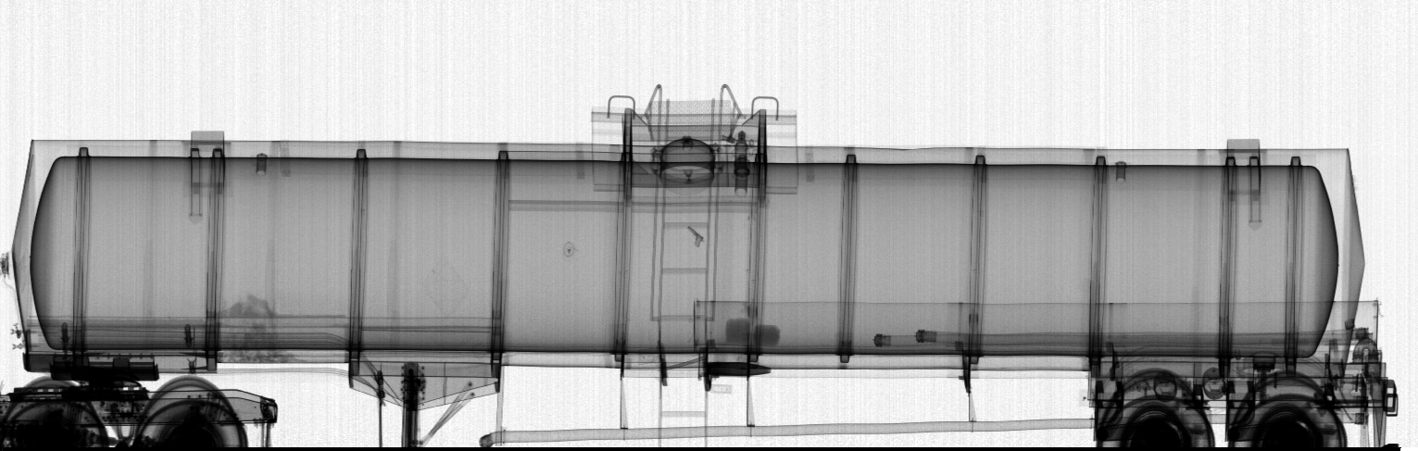
High Energy Image
Handgun and artillery shell

Slide 5
High Energy Image

Slide 6
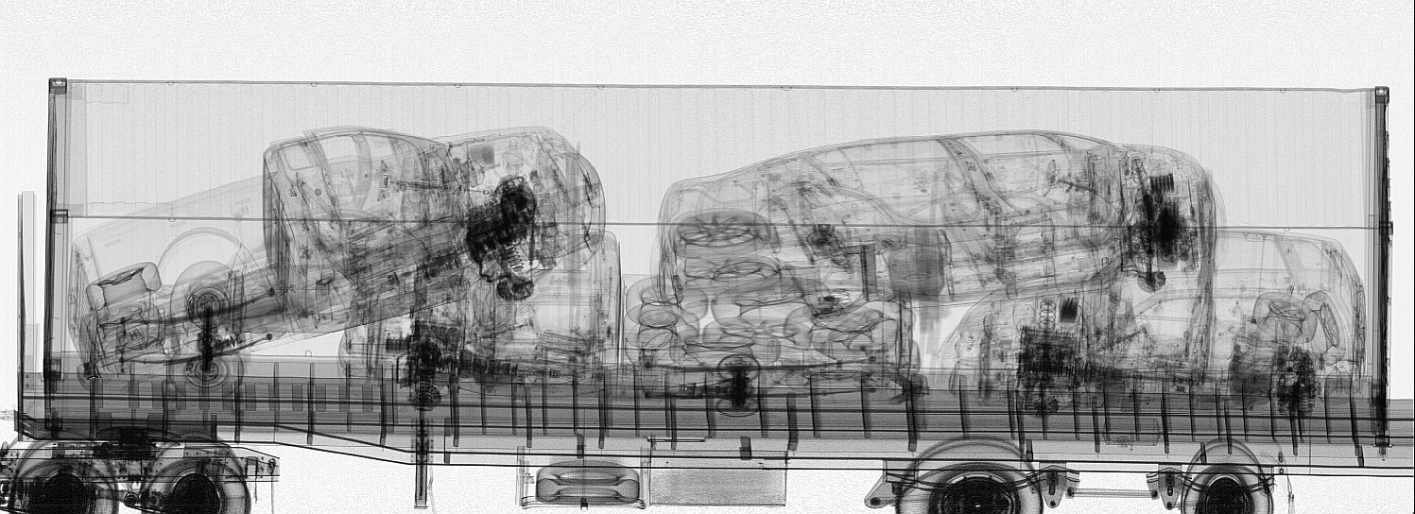
High Energy Image

Slide 7
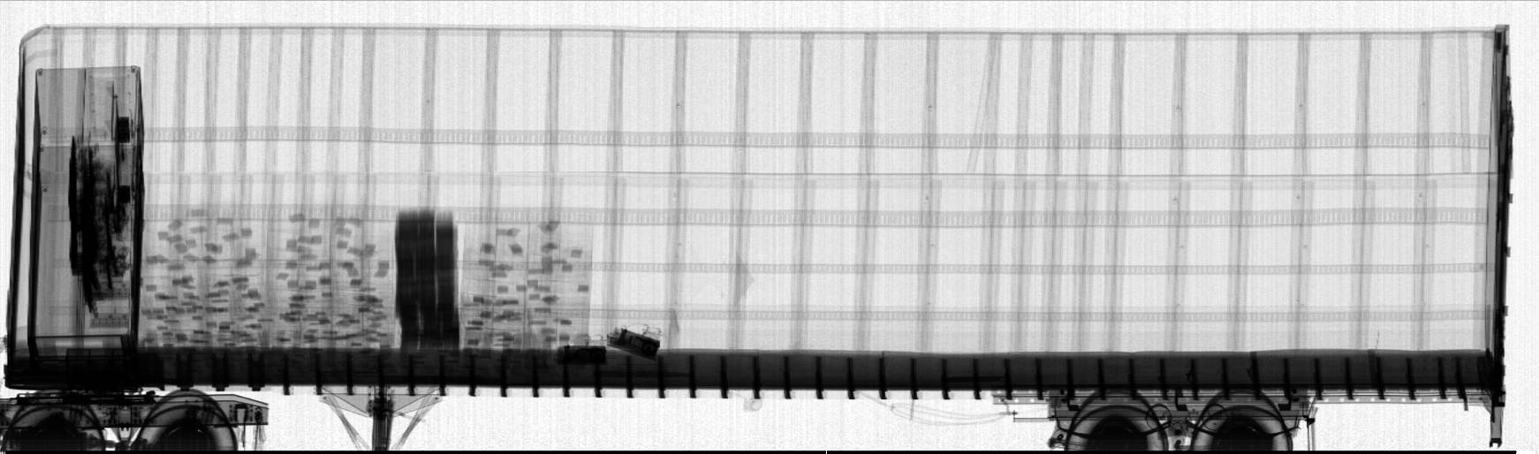
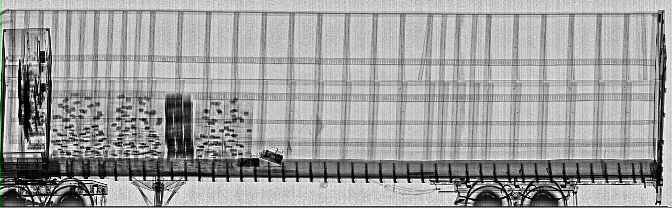
High Energy Images
Raw Image
Same Image with Auto Enhance Filter

Slide 8
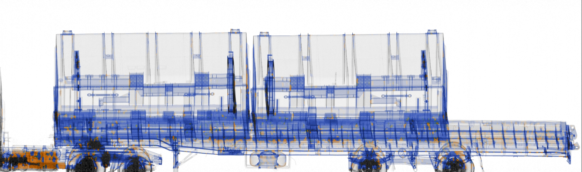
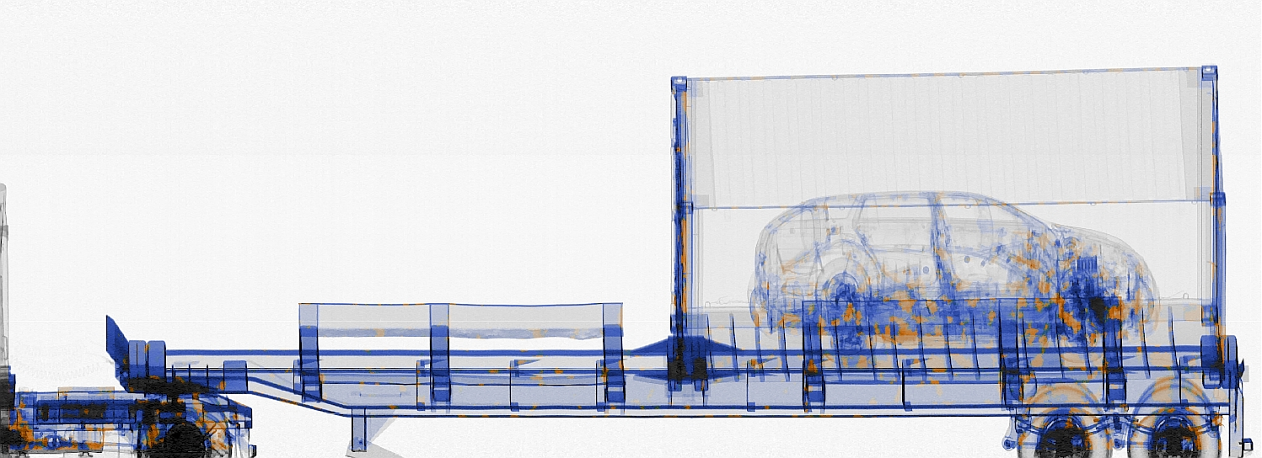
Dual-Energy Images

Slide 9
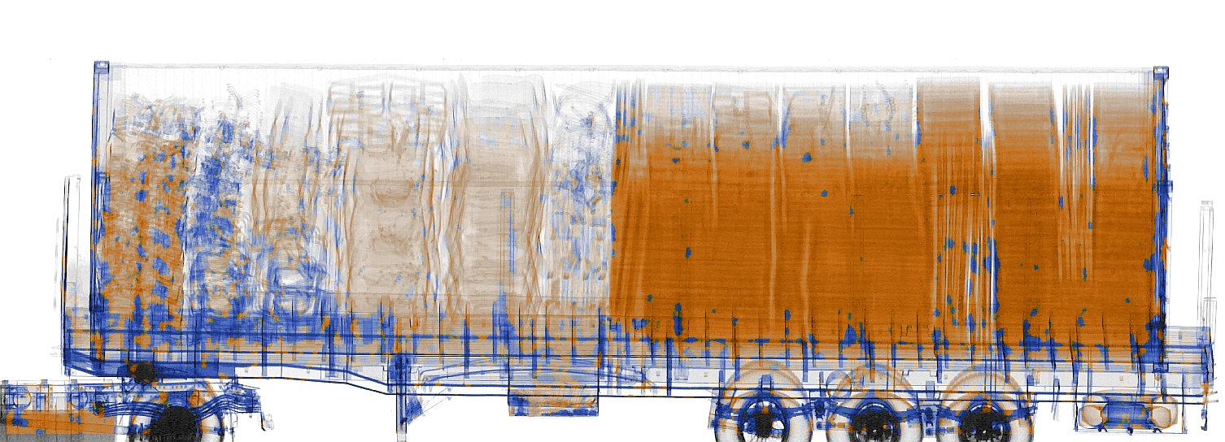
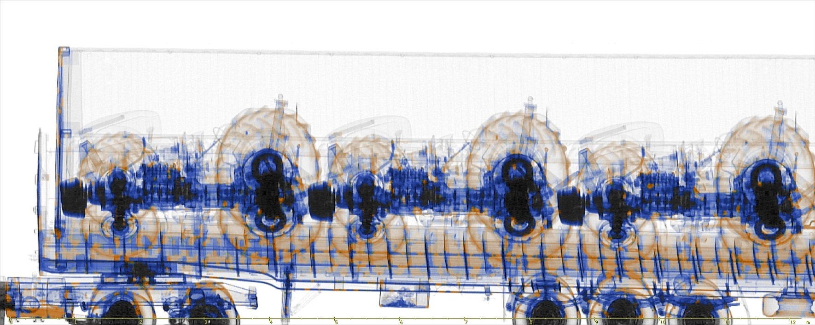
Dual-Energy Images
Mixed cargo
Tractors

Slide 10
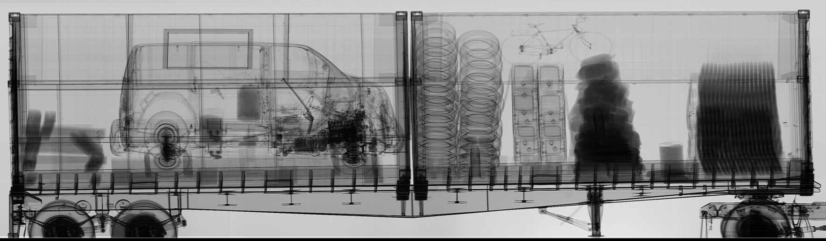
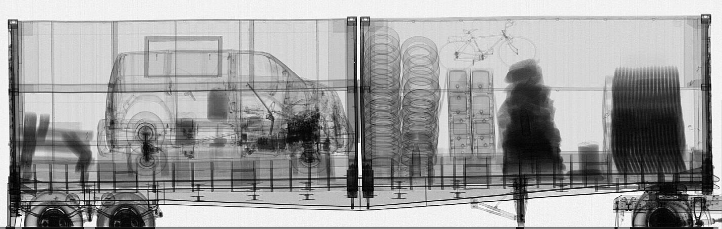

High Throughput Radiography
Sample X-Ray Images
High Energy Gantry at 0.3m/s (1.1km/hr)
Sentry Portal at 12 km/hr
Sentry creates excellent images even at more than 10X the speed of a typical gantry system

Slide 11
System Operation and Specifications

Slide 12
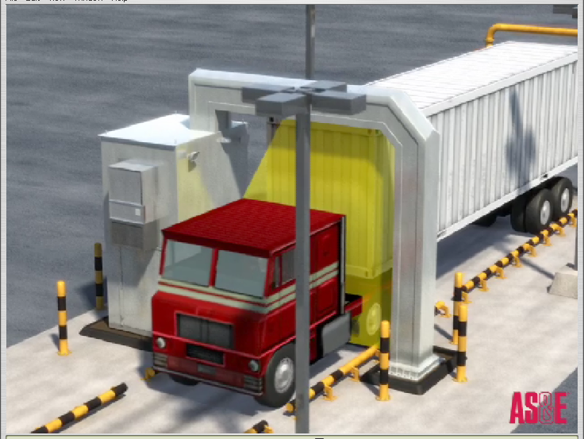
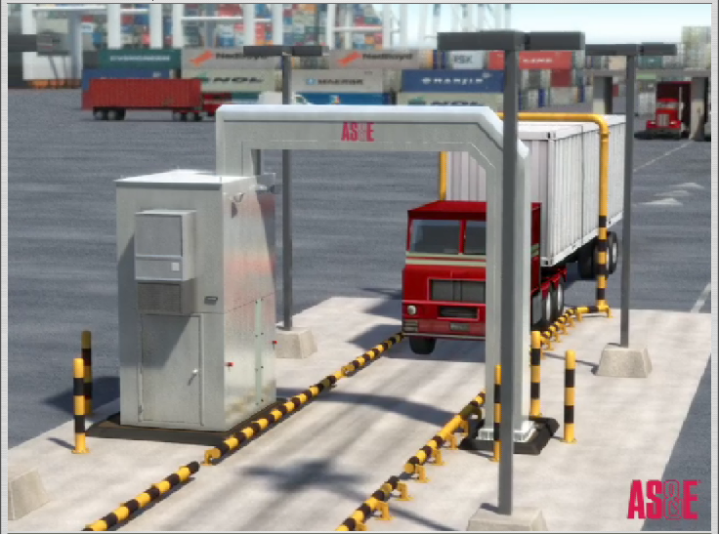
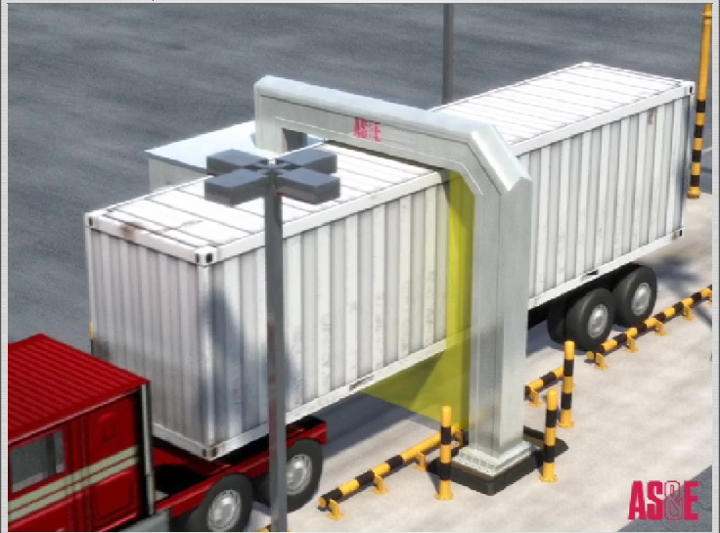
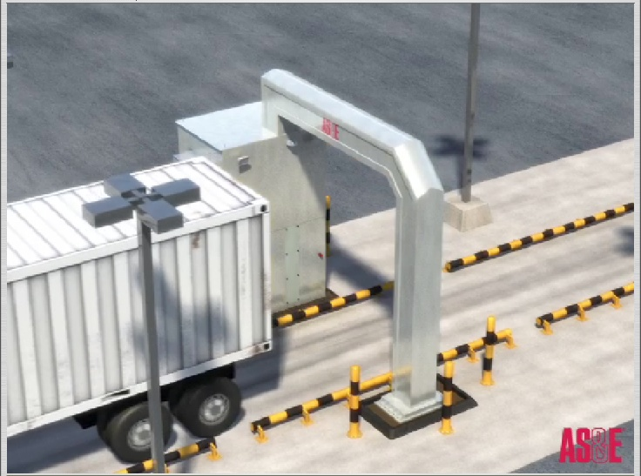
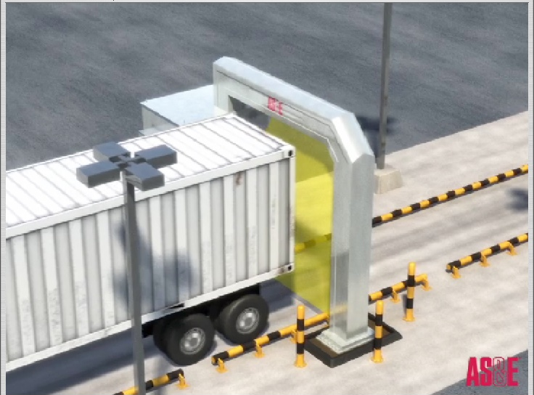
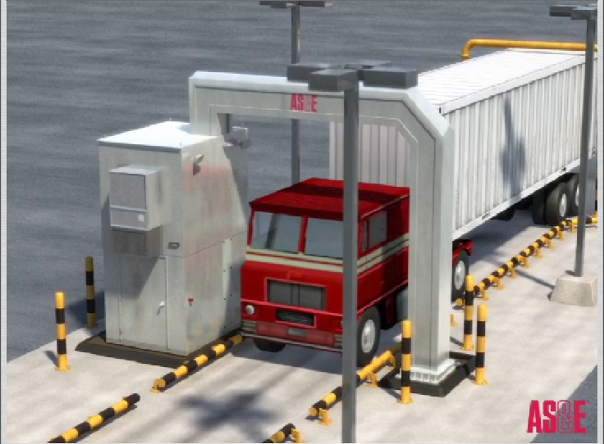
System Operation
Vehicle approaches the portal and proceeds through scan tunnel
  System has ability to compensate for variations in vehicle speed
Portal detects the truck and begins scanning after cab has passed to avoid scanning the cab and driver
Systems stops scanning after vehicle passes completely through portal

Slide 13
Sentry Portal System Specifications
Item | Specification
X-ray Source | 7.5/5 MeV X-ray Source
Penetration in High Energy (HE) Mode | 300 mm when measured per ANSI N42.46
Wire Sensitivity in HE Mode | 3 mm
Contrast Sensitivity in HE Mode | 2%
Throughput | Up to 200 containers/hr
Scattered Radiation Dose to Driver | ≤ 0.006 uSv/scan
Radiation Dose to Cargo | ≤ 0.5 uSv/scan
Standard Temperature Range | -20ºC to 50ºC

Slide 14
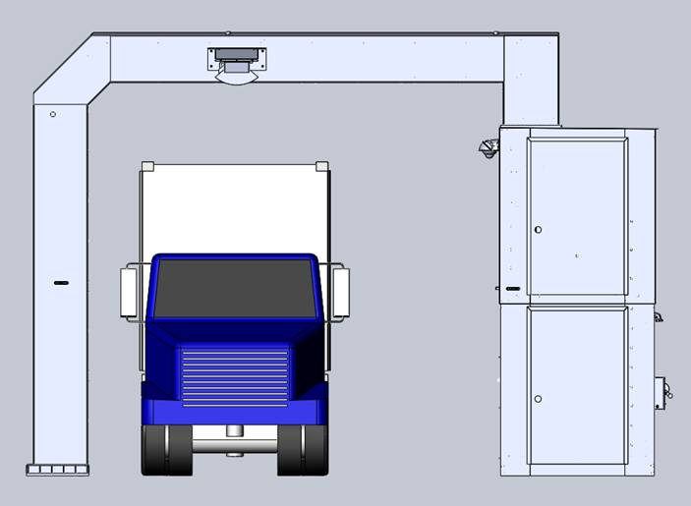
Sentry Portal System Dimensions
5.8 m (19 ft)
5.1 m (16.8 ft)
X-Ray Source
400 mm (1.25 ft)
5.3 m (17.4 ft)
8.2 m (27 ft)

Slide 15
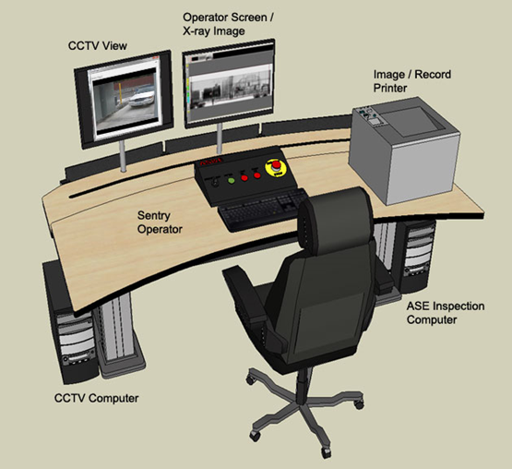
ASEInspection™ Operator Console
Windows 7 with ASEInspection software
21-inch LCD monitor, keyboard, and mouse
Operators console with emergency stop button
Printer
CCTV monitor, computer, keyboard, and mouse
Languages supported: English, Spanish, Arabic, French, Polish, Russian, and Portuguese

Slide 16

ASEInspection™ Image Analysis Features
  Density Expand
  High Contrast
  Auto Enhance
  Reverse Video
  Mark and Annotate
  Sharpen
  ½ to 16x Zoom
  Color Palettes/Grayscale
  Region of Interest
  Ruler (horizontal and vertical)
  Historical Compare
  Auto Historical Compare (option)
  Histogram
  Histogram Equalization
  Clear/Suspect Tagging
  Show Metals (dual-energy mode)
  Show Organics (dual-energy mode)
  Show Greyscale (dual-energy mode)
  Operator Alert for high-density anomalies (option)
  System Toolbar
  Image Analysis Toolbar

Slide 17
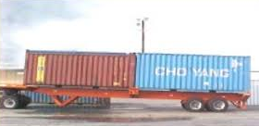
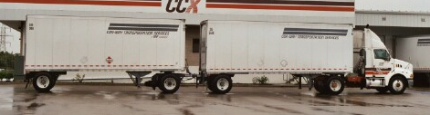
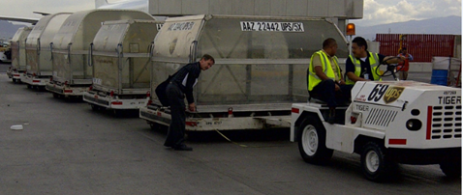
Automatic Image Segmentation
System software automatically separates into
separate inspection records:
  Two adjacent 20’ ISO containers
  Tandem trailers
  Up to 5 ULDs

Slide 18
System Safety

Slide 19
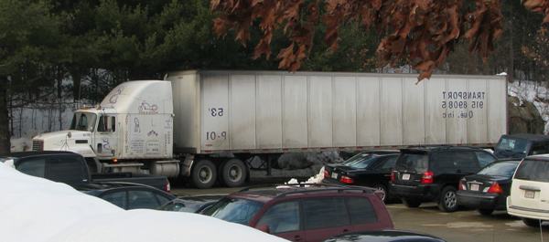
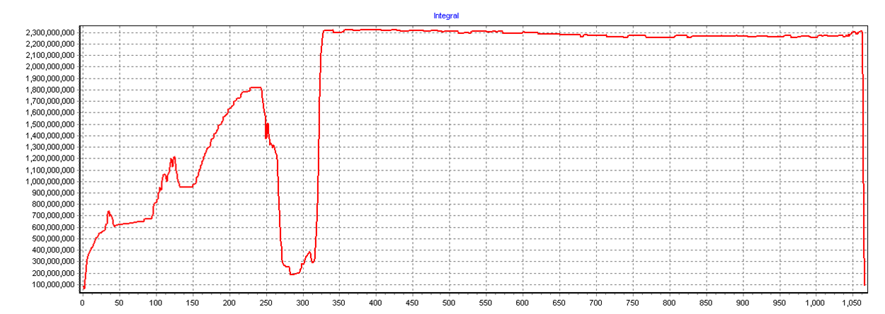
Container Locating Subsystem
System is designed to begin scanning after it detects a gap between the cab and the cargo
If a truck enters that does not have a gap, the system will not turn on X-rays
Acceptable vehicle types
  Cargo containers or large trucks
  Must have a minimum gap of approx. 20 cm between cab and cargo
Truck Profile
Start Scan

Slide 20
Sentry Portal System Safety
Speed sensor
  Monitors vehicle speed for safety
  Provides feedback to driver
  Corrects aspect ratio
Multiple checks before high energy
scanning is initiated
  Vehicle speed
  Gap length (~20 cm)
  Parameters are adjustable to meet specific customer requirement
  If parameters are not met, scanning does not begin
System operator
  CCTV to monitor tunnel
  E-Stop located on operator panel
  Four additional X-ray off buttons located on the system

Slide 21

Radiation Safety
Safe for drivers and operators
X-rays start after cab has passed
Utilizes a speed sensor to verify speed
Low speed cut off at 1 kph (0.6 mph) – dose to cargo is less than 6 µSv
Driver: <0.006 µSv per scan
Cargo: <0.5 µSv per scan at 12 kph

Slide 22
Health and Safety
One Sentry Portal scan = <0.006 uSv (0.6 microrem ) per scan
Some Comparisons:
One Sentry Portal Scan | <0.006 uSv (0.6uR)
2.4 hours in Denver | 1 uSv (100 uR )
One hour on an airplane | 3 uSv (300 uR)
Average radiation per day | 10 uSv (1,000 uR)
Dental X-Ray | 10 uSv (1,000 uR)
Trans-continental flight (round trip) | 50 uSv (5,000 uR)
Chest X-Ray | 100 uSv (10,000 uR)
CAT scan (Head and Body) | 1,100 uSv (110,000 uR)
Average radiation dose per year | 3,600 uSv (360,000 uR)
It would take 500 scans to equal the amount of radiation received in one hour on an airplane at altitude
Daily average radiation dose of 10 μSv …More than 1,600 portal scans
One trans-continental flight has a dose of 50 μSv…More than 8,300 portal scans
Whole body equiv. dose from a chest X-ray is 100 μSv …More than 16,500 portal scans

Slide 23
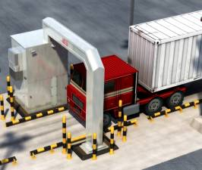



Applicable Radiation Standards for Drive Through Systems
Regulation | Dose Rates Allowed to General Public | Number of Sentry Scans
International Commission on Radiological Protection (ICRP) / NCRP | 1 mSv per year | 166,666 scans
U.S. Nuclear Regulatory Commission (NRC) | 1 mSv per year | 166,666 scans
EURATOM 96/29 | 1 mSv per year | 166,666 scans

Slide 24
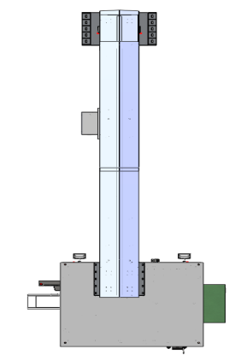
Sentry Portal System Exclusion Zone without wall or building
20 m
Assumptions
  0.5 uSv/h at boundaries
  12 km/h scan speed
  150 containers per hour
  Container loaded with organics
Radiation shielding can be added to reduce overall controlled zone
17 m
29 m
9 m
8.5 m
3.5 m

Slide 25
Sentry Portal System Exclusion Zone with wall or building
Assumptions
  150 containers per hour
  Each truck < 18 m
  10 km/h scan speed
  Gives duty cycle of 27%
  0.5 uSv/h at boundaries
  Container loaded with organics
  Wall height 10’ (3 m) everywhere
  regular concrete, 2.35 g/cc
Radiation shielding can be added to reduce overall controlled zone
9”
18”
9”
at least
3.5 m
at least
10 m
10 m
4 m
at least 10 m
at least 10 m
Non-shielding
fence
Non-shielding
fence
5 m
5”

Slide 26
System Options

Slide 27
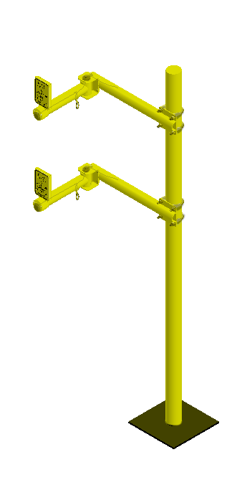
Driver Scan Activation (Option)
Allows scanning a wider variety of vehicle types by having the driver activate scanning after he/she has already passed through the inactive beam plane
  System has an entrance traffic light, which signals that the driver can enter the system, and an exit traffic light where they stop to press a scan activation button.
  Once the button is pressed, and the vehicle starts
  moving, then the transmission X-ray scan starts and
  continues until the complete vehicle has passed
  through the system.

Slide 28
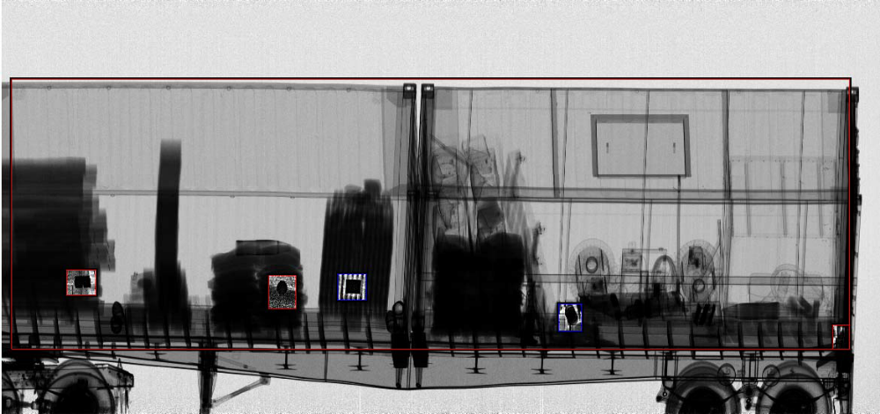
Operator Alert (Option)
Operator Alert automatically processes the X-ray data and provides visible cues to the operator to draw attention to parts of the image that are:
  Highly attenuating (shown in blue boxes)
  Impenetrable (shown in red boxes)

Slide 29
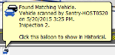
Automatic Historical Compare (Option)
Automatic Historical Compare (AHC) facilitates operator comparison of the current image with a recent image of the same vehicle in order to aid in detection of threats and contraband
AHC finds a reference image by searching the database based on a user defined field, such as vehicle license plate number
As a vehicle enters the Sentry and a scan is initiated, AHC automatically searches the local database for the most recent vehicle identifier match of the current vehicle
When a match is found, the operator is alerted with a pop-up window on the bottom of the screen and can choose to initiate a comparison, which opens the 2 images side-by-side so that the operator can analyze
  A comparison can also be manually initiated
  at any time

Slide 30
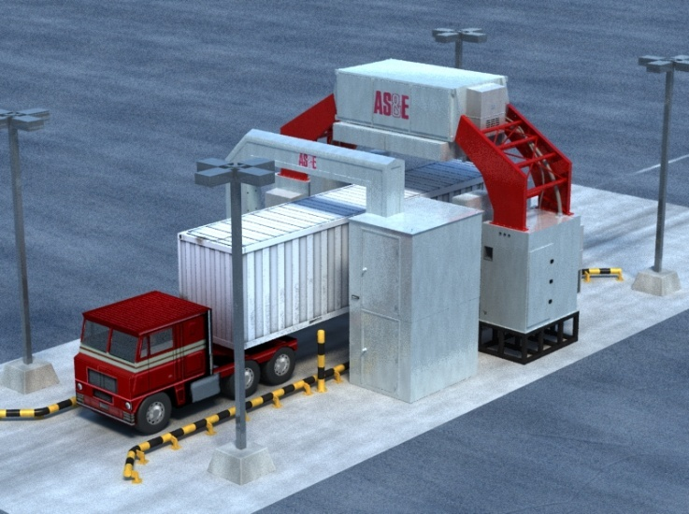

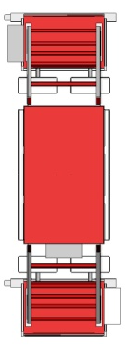
Co-Located Sentry and Z Portal Systems (Option)
Offers high penetration transmission X-rays of cargo along with Z Backscatter for photo-like images and highlighting of organics
  Multi-views offer images from top, left and right sides of
  cargo
  Images entire vehicle including tires
    Z Portal offers low radiation dose to allow scanning of cab
  Scan speed 5 km/h
  Ideal for manifest verification

Slide 31
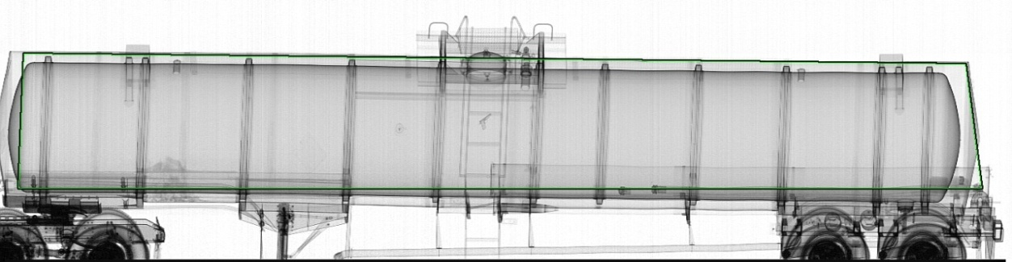
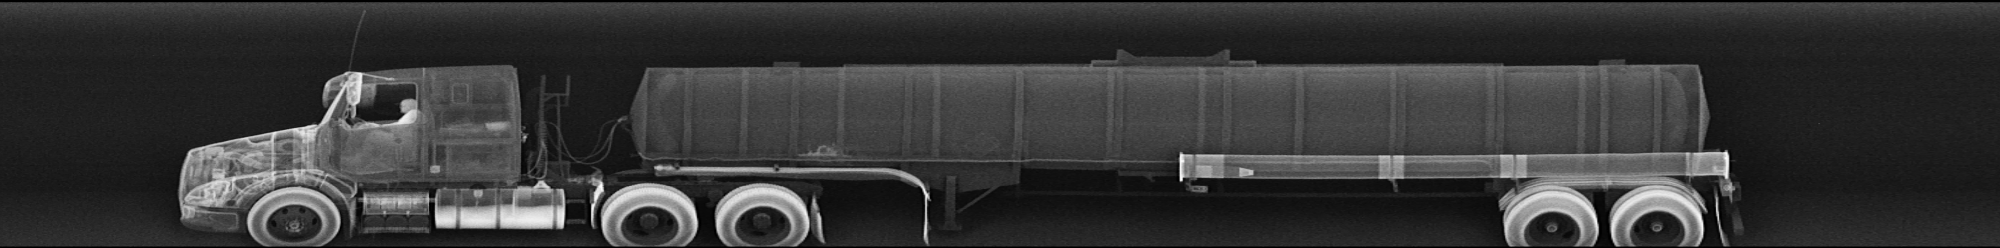
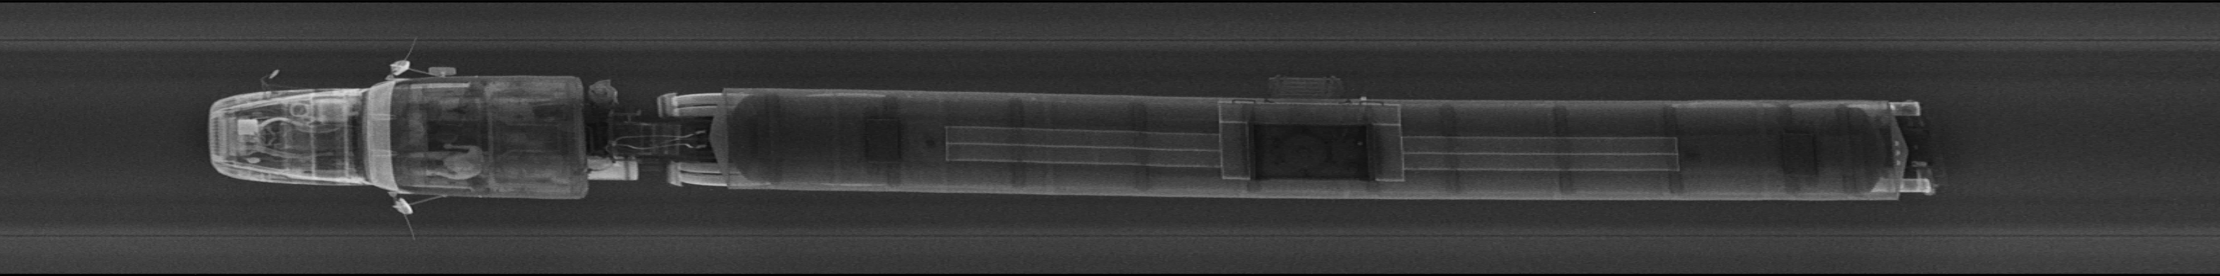
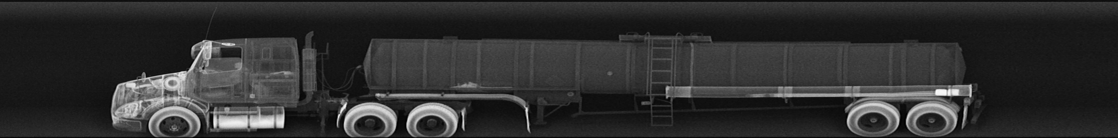
Transmission and Backscatter Images of Tanker

Slide 32
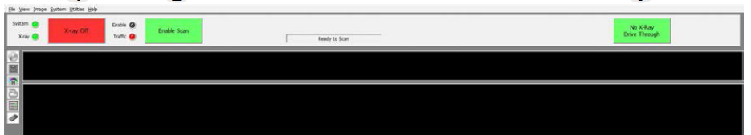
Pass-Through Mode (Option)
Pass-Through Mode allows the system operator the freedom to pass a vehicle through the system without a scan being performed on it
  When selected, it enables the green traffic light allowing the driver to drive through the system – but does NOT enable the X-ray scan
  This is particularly helpful for a Co-Located system, where the Z Portal low energy scan is desired, but not a high energy Sentry Portal scan
Disables X-rays with traffic control still working

Slide 33
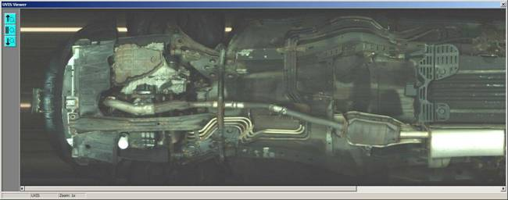
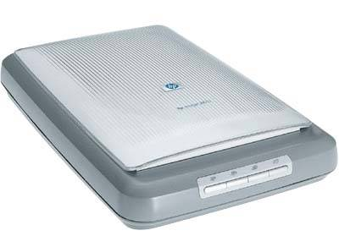
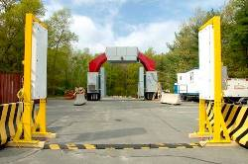
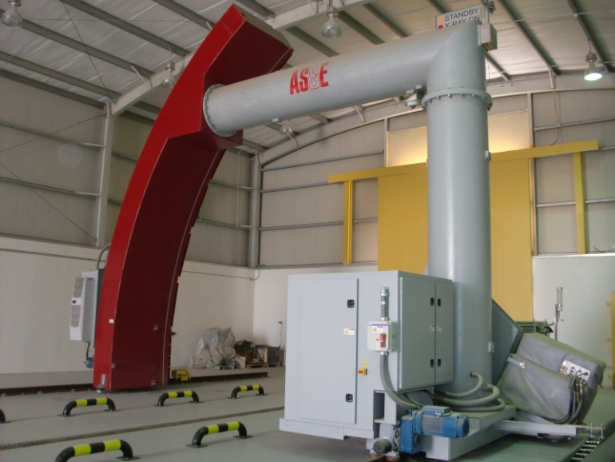
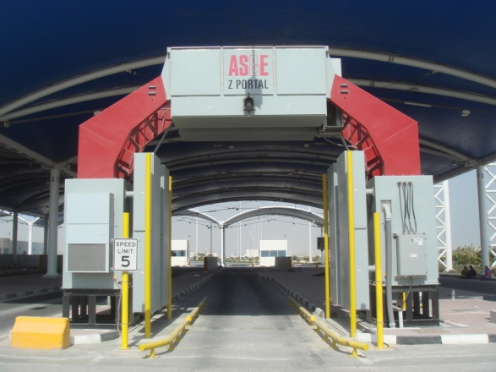
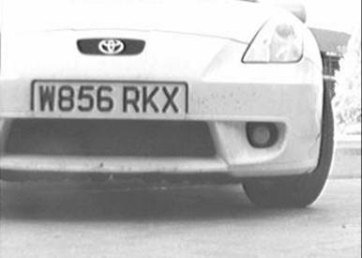
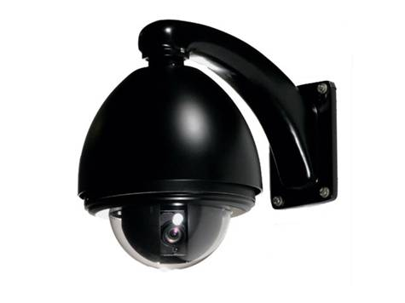
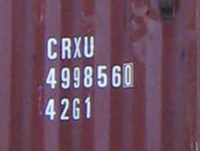
Cargo Sensor Options
Under Vehicle Inspection
Manifest Scanning
Radiation Detection
License Plate Reader
Perimeter CCTV Cameras
Container Code Recognition

Slide 34
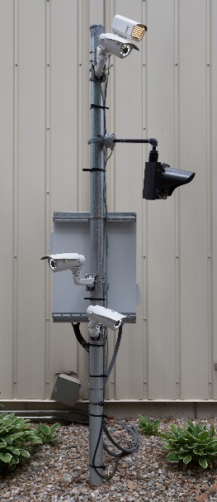
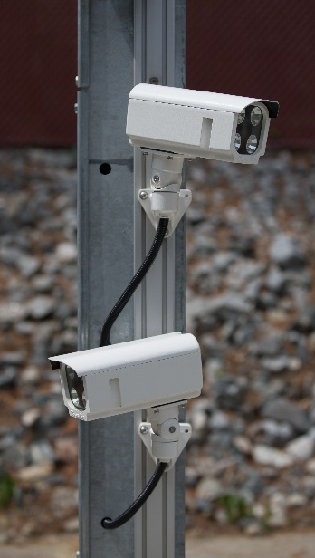
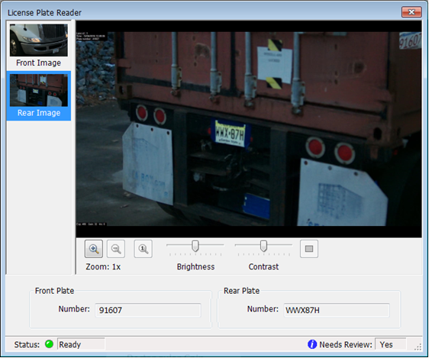
License Plate Reader (LPR) System
Integrated with ASEInspection Software
License plate information is automatically entered into image database via Optical Character Recognition System
  Large install base with proven License Plate Reader performance
Captures front and rear license plates
  Multiple images captured for each plate ensures high recognition rate
Reading of reflective and non-reflective plates supported
Integrated Scene Camera for view of approaching vehicle; useful to obtain images of the driver, as well as make and model vehicle information
Operates in a wide range of weather conditions
>95% average read accuracy rates. Data varies by country

Slide 35
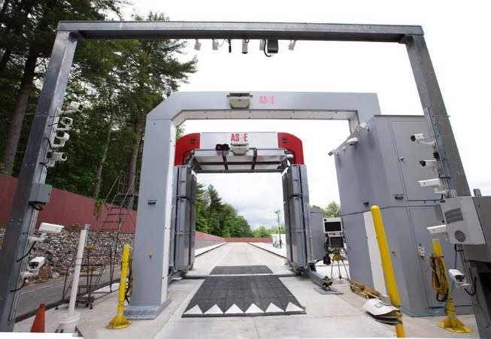
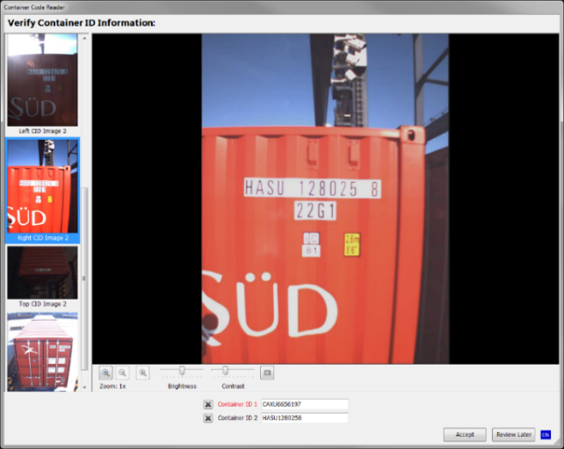
Container Code Recognition (CCR) System
Analyze, integrate, and archive container ID data with cargo X-ray system images and subsystem data
CCR system auto adjusts for changes in scene illumination for optimum container recognition
Performance optimized for the full range of Intermodal Containers defined in ISO 668
  Covers all types of containers (20, 40, 45, 20/20 feet and combinations). Performance guaranteed for single conveyances, tandem conveyances, and dual containers mounted on a single conveyance
Optional integrated License Plate Reader to capture the front and rear license plates of the truck and trailer
Optional integrated Scene Camera for view of approaching vehicle; useful to obtain images of the driver, as well as make and model vehicle information
Both LPR and Scene camera images and character text strings are attached to the X-ray record along with the CCR images/ text strings
Large install base with proven Container Code Recognition performance
    >95% accuracy

Slide 36

Under Vehicle Inspection System (UVIS) (Option)
Safe, rapid and thorough method of examining the undercarriage of passenger and commercial vehicles
Capture a single, seamless, high-resolution image for accurate detection
Provides 12X zoom capability, contrast and brightness adjustment
Image integrated into ASEInspection

Slide 37

Networking (Option)
ASE Connect™ Networking Solution
  Allows for the centralized management of equipment, images, and data by a common software application
  Scalable and customizable to meet specific security requirements
  Allows for networked image viewing and analysis at a secondary or remote analysis station
  Web enabled browser allows supervisors to run reports, view equipment status, manage users, and manage the database

Slide 38

Sentry Portal System Summary
High quality imaging with material discrimination
High throughput of up to 150 trucks per hour
Compact footprint due to small structure and low radiation dose
Radiation safe for cargo and drivers
Integrate with Z Portal for enhanced detection and imaging of entire vehicle
Notes:
NEW

