Slide 1
OmniView™ Gantry Cargo Inspection System
Product Overview
August 2015

Slide 2

OmniView™ Gantry Cargo Inspection System
Superior Imaging Performance
  High Penetration - 400 mm (15.7 in) of steel
  Excellent wire resolution – 0.8 mm
Configurable
  Standard Dual-Energy Linac with Single-Energy mode
  Optional 3-sided Z Backscatter imaging
  Operator Assist (High Density Anomaly)
Material Discrimination with Dual Energy
  Differentiate classes of materials based on atomic number
  High resolution images show organics in orange, non-organics in green, metallics in blue, and heavy metals in purple
Large Scan Tunnel
  Accommodates 5 m (16.4 ft) tall port trucks
The OmniView Gantry system offers superior imaging performance and optional multi-view imaging, providing superior detection capability and simplified image analysis for customs and security applications

Slide 3
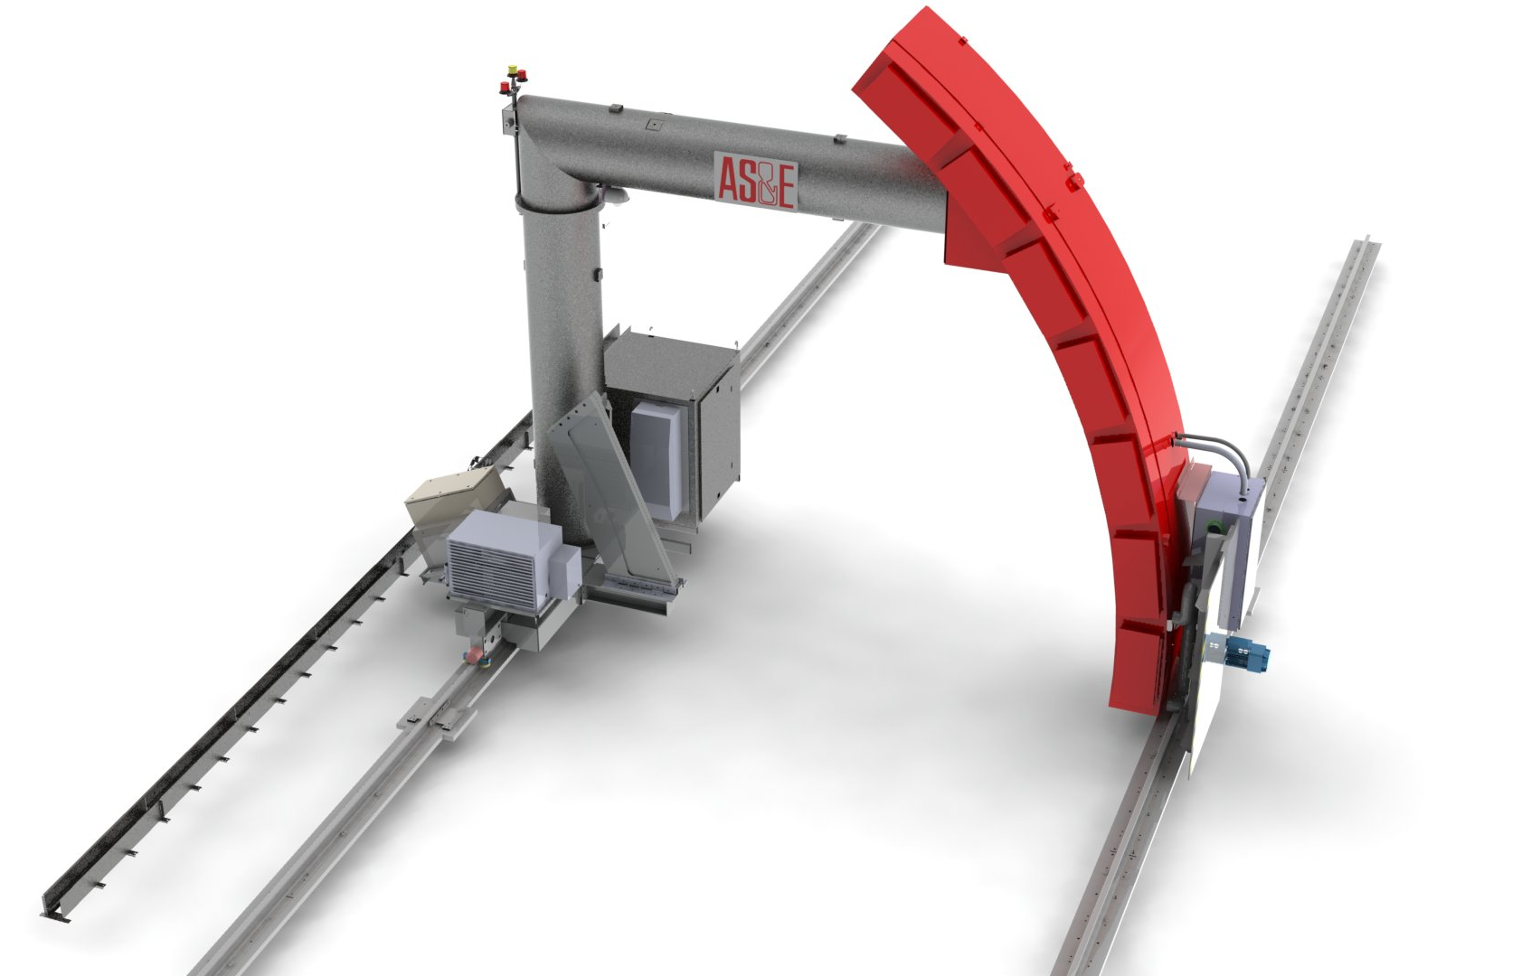

OmniView™ Gantry System
Arc structure minimizes scatter and creates superior images
Varian M6 or Mi6
Unique electronic beam alignment – Patent pending
Notes:
In typical gantry systems penetration is limited by unwanted scatter from system structures and components
Arc array of detectors minimizes scatter from other detectors
Detectors are off-set from supporting Arc structure to eliminate scatter into the detectors from the structure
Design of collimators, scatter shield and beam stop minimize scatter from all components of system.
Beam stop is substantially behind the detectors to minimize scatter.

Slide 4
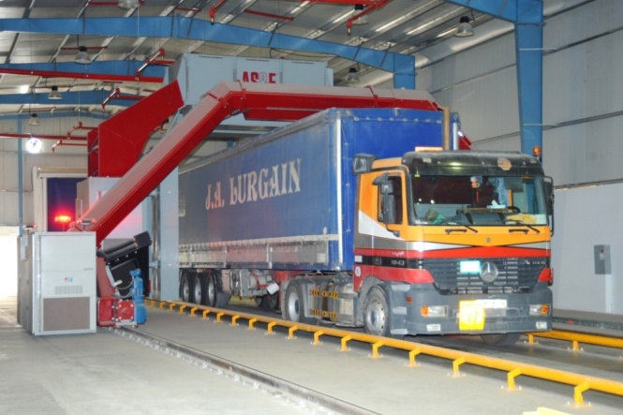
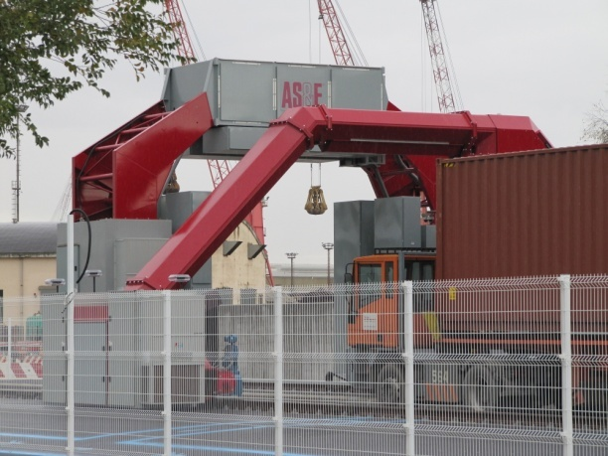
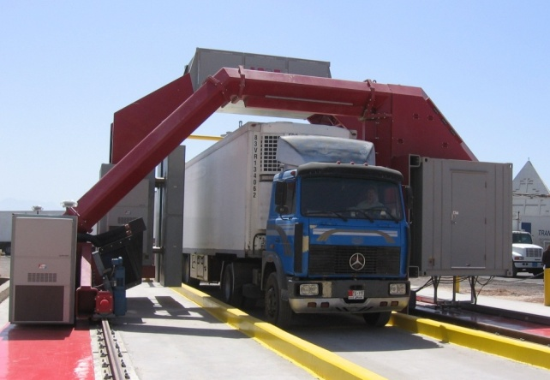
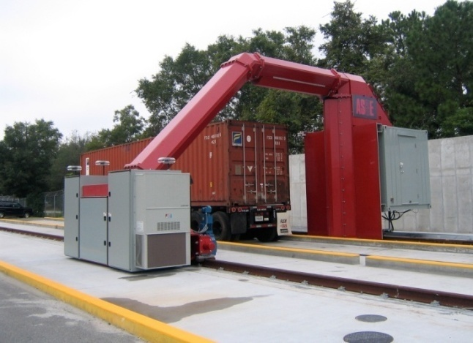
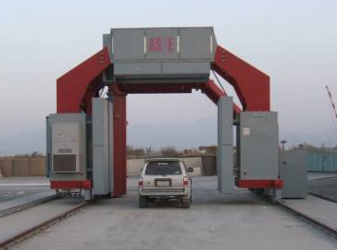
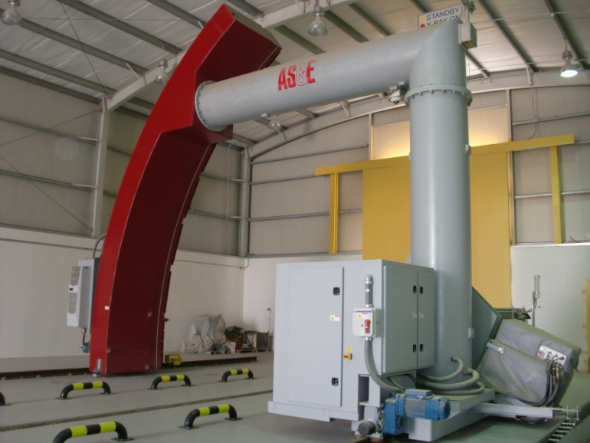
System Installations
More than 30 Systems Sold To Date
Abu Dhabi
Port of Venice
Egypt
Port of Charleston
NATO
Saudi Customs

Slide 5
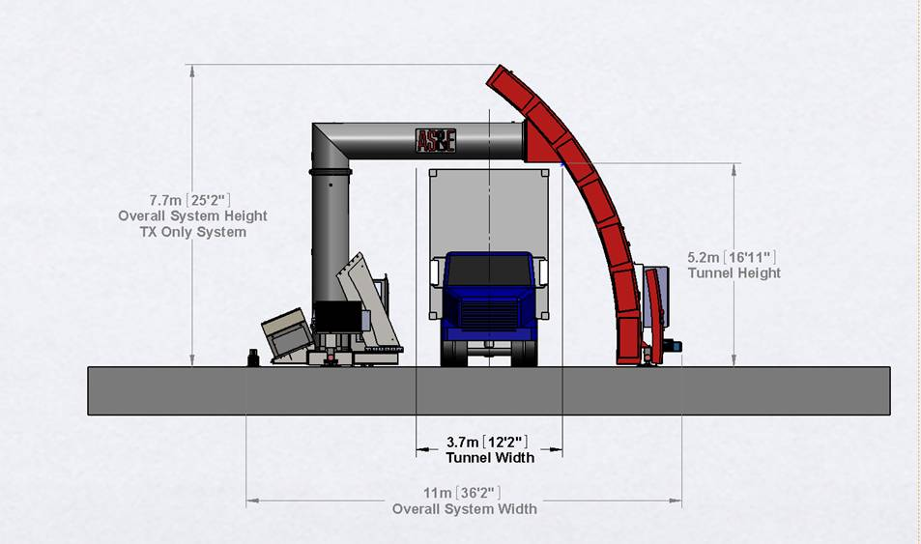
System Dimensions

Slide 6
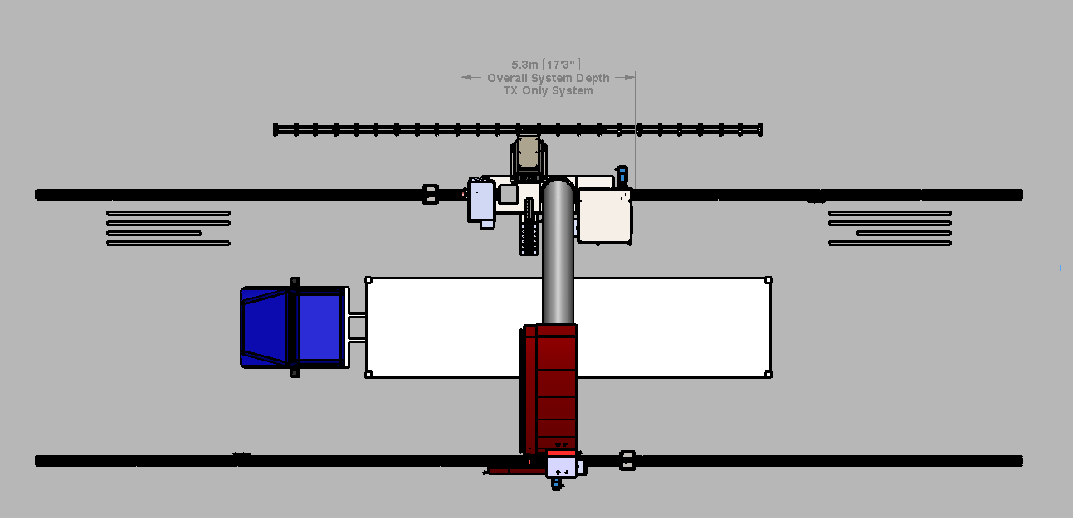
System Specifications
Tunnel size: 3.7 m W x 5.2 m H (12.1 ft W x 17 ft H)
Max vehicle size: 3.0 m W x 5.0 m H (9.8 ft W x 16.4 ft H)
System size: 11 m W x 7.7 m H x 5.3 m D (36 ft W x 25.3 ft H x 17.4 ft D)
Tunnel lengths:
  36.57 m (120 ft) rails: Accommodates scanning of one 19 m (62 ft) truck at 0.4 m/s or less
  54.86 m (180 ft) rails: Accommodates scanning of two 19 m (62 ft) truck at 0.4 m/s or less
Tunnel lengths with the optional Z Backscatter module:
  38.10 m (125 ft) rails: Accommodates scanning of one 60-ft truck at 0.4 m/s
  56.38 m (185 ft) rails: Accommodates scanning of two 60-ft trucks at 0.4 m/s
  62.18 (204 ft) rails: Accommodates scanning of two 60-ft trucks at 0.6 m/s

Slide 7
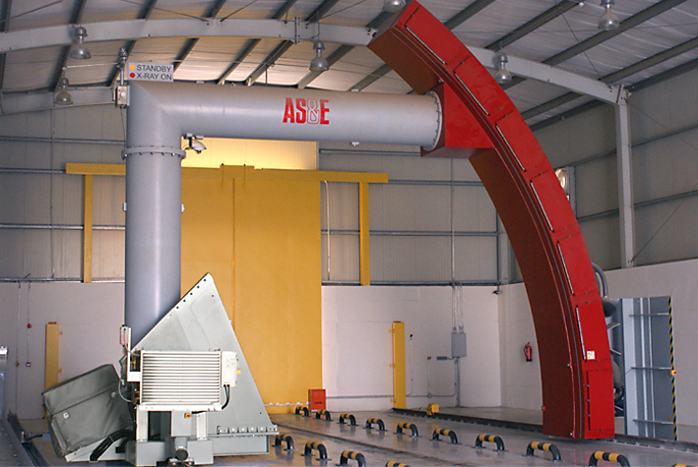
System Specifications
High-Energy mode penetration
  400 mm steel equivalent (at 0.2 m/s)
Dual-energy penetration
  375 mm steel equivalent (at 0.2 m/s)
Wire resolution
  0.8 mm wire in air
Operating temperature
  -18° to 55°C (0° to 131°F)
Scan speed
  0.2, 0.3, 0.4 m/s (8, 12, 16 in/s)
Throughput
  28 trucks/hour (2 trucks per scan) using 54.86 (180ft) of rail
Enclosed facility
  System is designed to be deployed in an enclosed facility to reduce the size of the radiation controlled zone

Slide 8
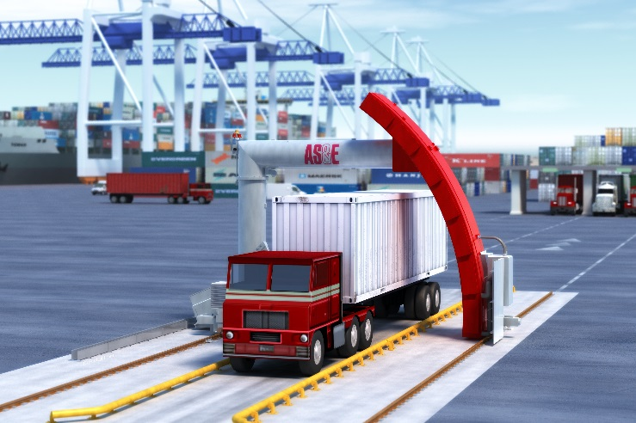
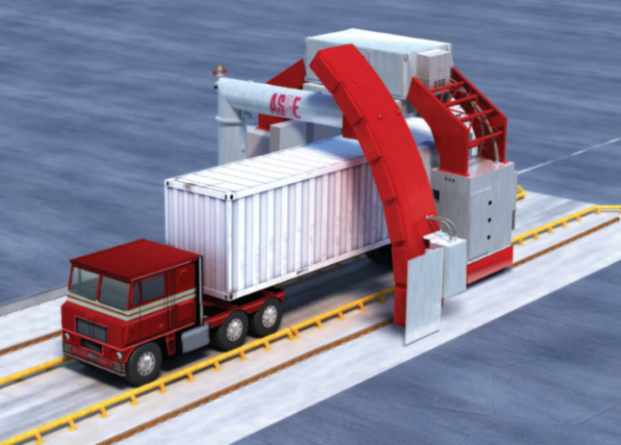
System Configurability
X-ray Source
  4/6 MeV Dual Energy LINAC
Multi-view technology add-ons
  Z Backscatter module
    3-sided backscatter imaging
    Future upgrade option
  Radiation Portal Monitor
    Gamma ray only or gamma/neutron detection
  Integrated Peripheral Devices
    Container Code Recognition
    License Plate Reader
    Under-Vehicle Inspection System
OmniView Gantry Standard Configuration
OmniView Gantry with optional Z Backscatter Module

Slide 9
Dual-Energy Imaging Performance
Interlaced 4/6 MeV Linac offers the ability to visually differentiate classes of materials
  Organic = Orange
  Inorganic = Green
  Metallic = Blue
  Heavy Metals= Purple
Offers the option to scan in dual-energy (4/6 MeV) or single-energy (6 MeV) mode
User friendly image analysis features
  Toggle between grayscale and color
  Add or remove individual colors in any combination
Portions of the image not able to be discriminated with high confidence remain in grayscale

Slide 10
OmniView Transmission Imaging
Set a new standard in the industry for transmission imaging performance
Greater than 400 mm steel penetration with a standard 6 MeV Linac
State of the art detector design for 0.8 mm wire resolution
Contrast Sensitivity of 0.27% at 10% penetration and 0.39% at 50% penetration
Unique arc structure minimizes scatter for overall improved performance
System easily images 0.8 mm wire

Slide 11
Dual Energy Imaging
Lead
Steel
Aluminum
Plastic
Increasing Material Thickness

Slide 12
Dual Energy Image
Lead Shielding
Steel Plates
Textiles
Aluminum Artillery Shell

Slide 13
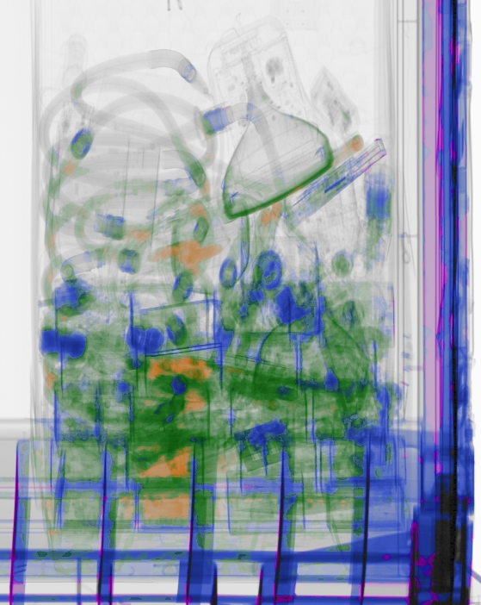
Pallet of Mixed Cargo
Explosive Simulant
Bag of Rice

Slide 14
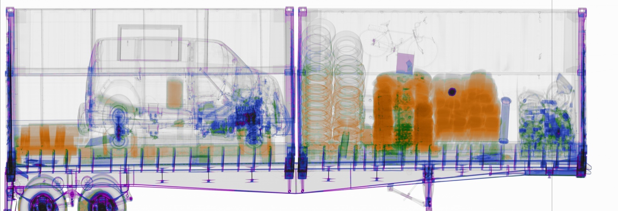

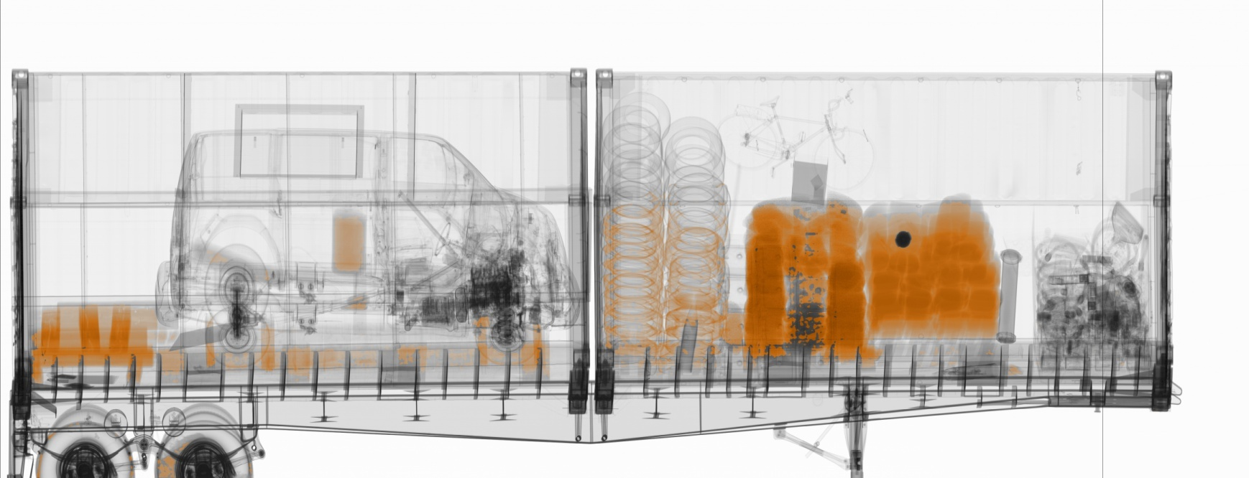
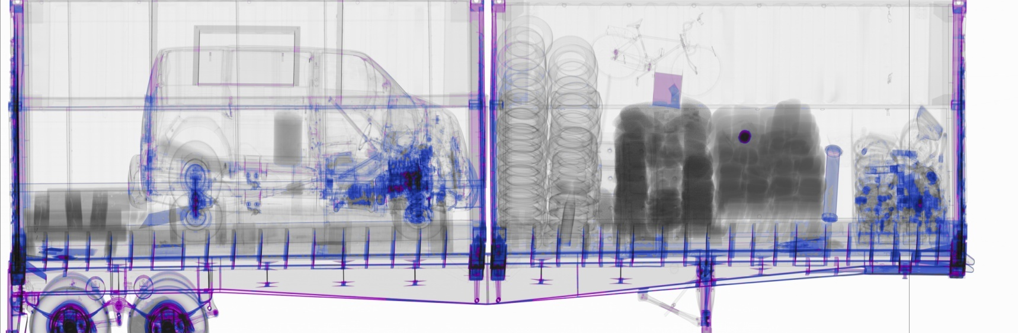
Dual Energy Features – Individual Color Stripping
Individual color stripping
  Allows individual colors to be applied in any combination
Show all colors
Toggle between all colors or grayscale
Show Organics
Show Inorganics
Show Metallics
Example: Show organics only
Show Heavy Metals
Example: Show combination of metallics and heavy metals

Slide 15
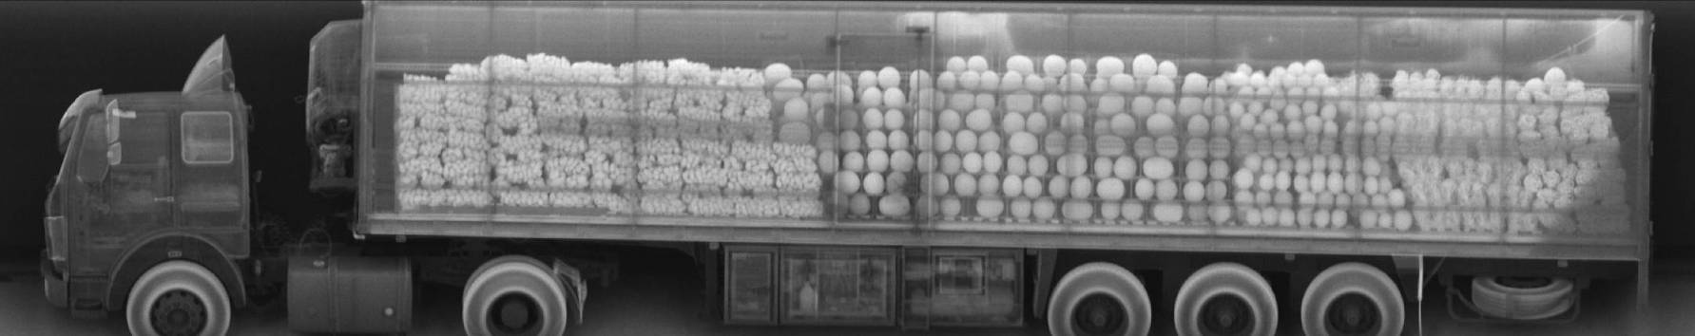
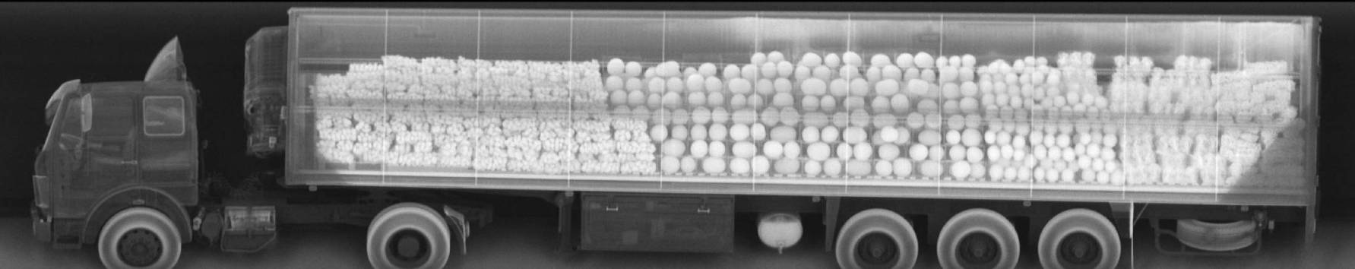
Z Backscatter Module (Option)
Multiple views for images of the right, left and top of cargo
Highlights organic material for easy identification
Photo-like images are ideal for manifest verification
Minimal bottom cutoff allows scanning of tires and gas tanks
Clarity of Z Backscatter image simplifies image interpretation and speeds cargo verification
Helps operators quickly identify contents and reduces operator fatigue

Slide 16
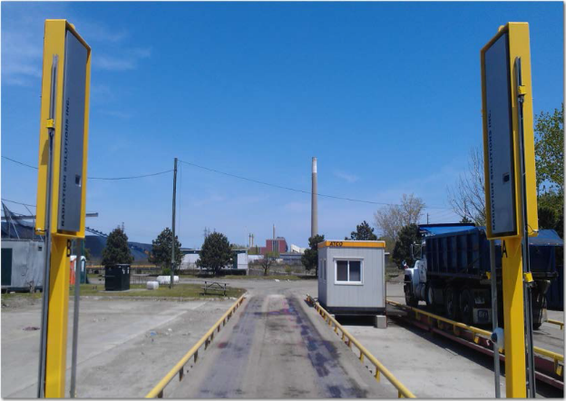
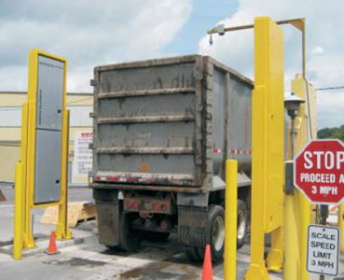
Radiation Portal Monitors (Option)
Detection of gamma and neutron radiation to low levels
Real-time high-sensitivity alarming in dynamic mode without stopping traffic
Hi-quality NORM identification and rejection capability to limit Nuisance Alarms
Low cost of ownership
Remote diagnostic capabilities
Operating temperature range -40 °C to +60°C

Slide 17
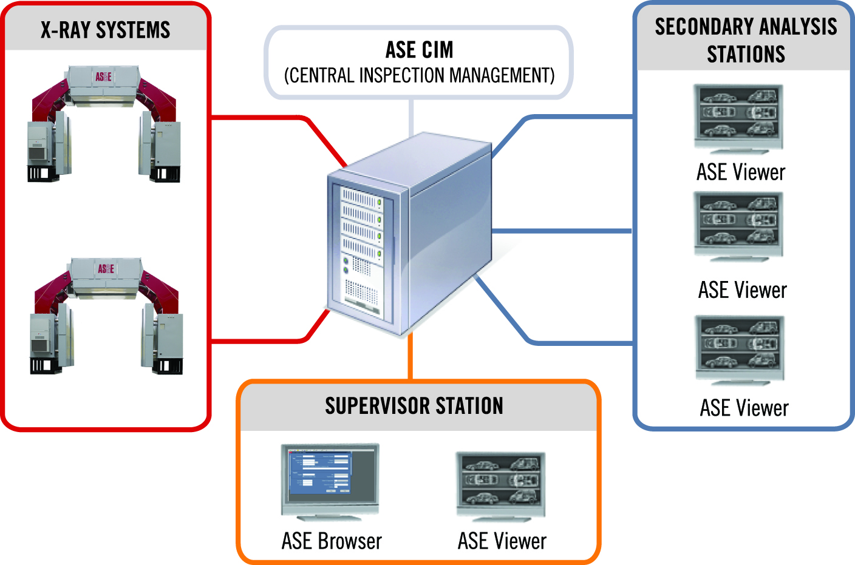
ASE Connect™ Networking Solution
Allows for the centralized management of equipment, images, and data by a common software application
Scalable and customizable to meet specific security requirements
Allows for networked image viewing and analysis at a secondary or remote analysis station
Web enabled browser allows supervisors to run reports, view equipment status, manage users, and manage the database
Notes:
NEW

Slide 18
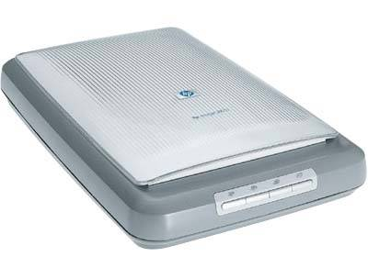
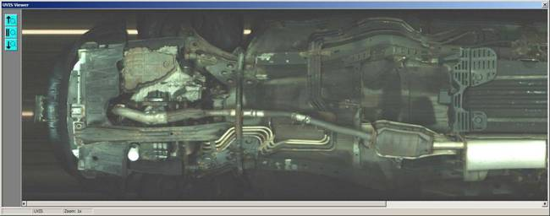
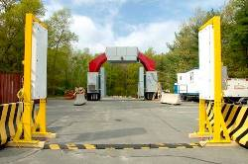
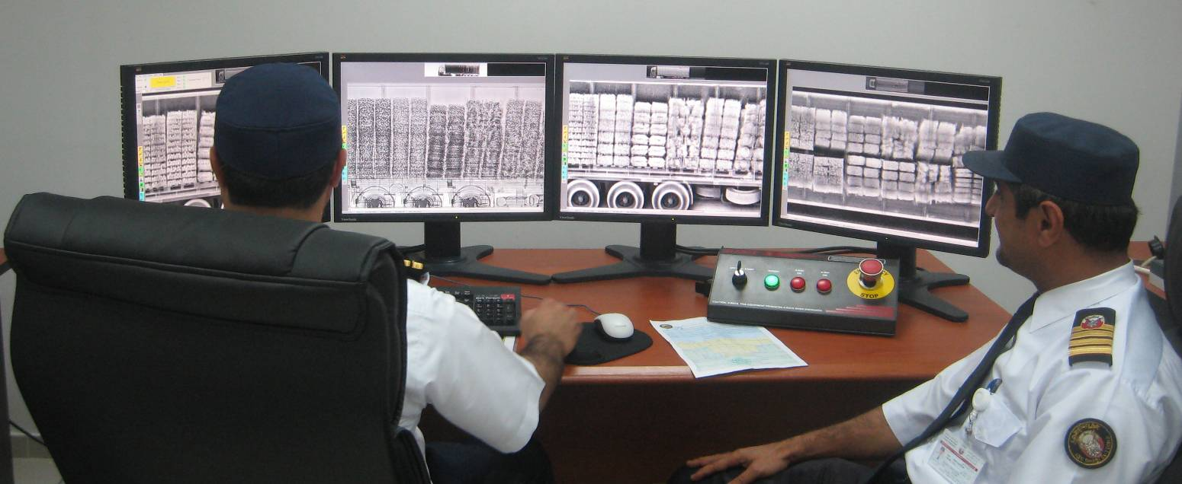
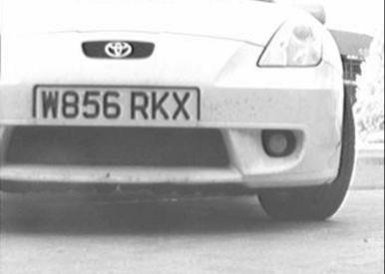
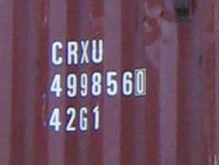
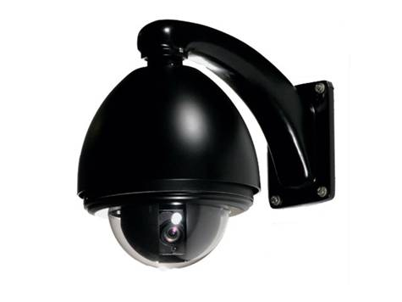
System Options
Manifest Scanning
Under Vehicle Inspection
Radiation Detection
License Plate Reader
Container Code Recognition
Digital Images

Slide 19
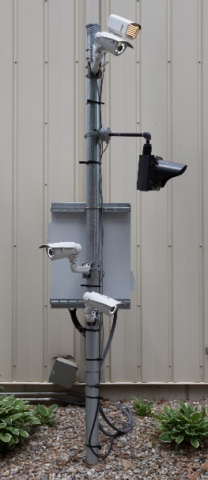
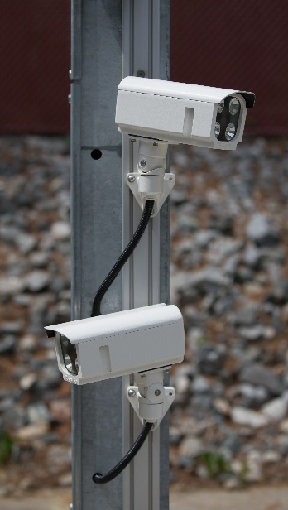
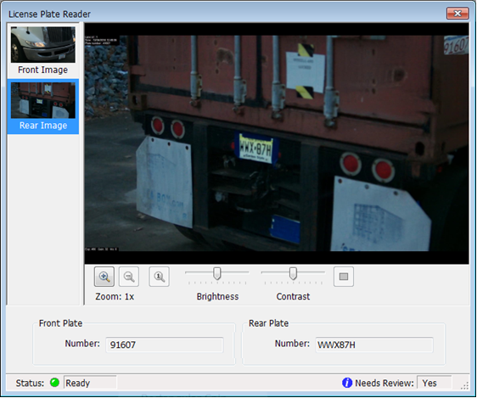
License Plate Reader (LPR) System
Integrated with ASEInspection Software
License plate information is automatically entered into image database via Optical Character Recognition System
  Large install base with proven License Plate Reader performance
Captures front and rear license plates
  Multiple images captured for each plate ensures high recognition rate
Reading of reflective and non-reflective plates supported
Integrated Scene Camera for view of approaching vehicle; useful to obtain images of the driver, as well as make and model vehicle information
Operates in a wide range of weather conditions
>95% average read accuracy rates. Data varies by country

Slide 20
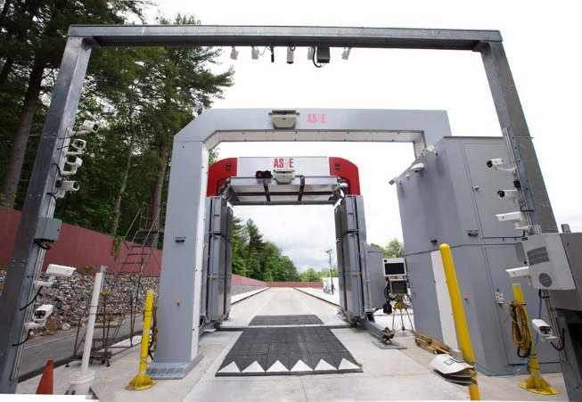
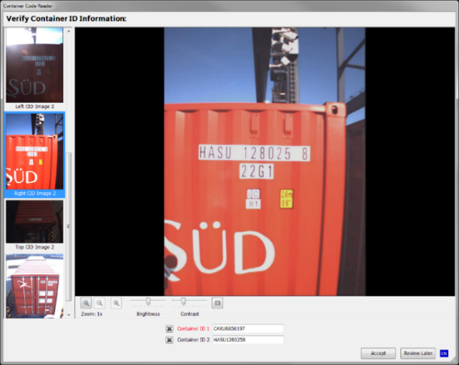
Container Code Recognition (CCR) System
Analyze, integrate, and archive container ID data with cargo X-ray system images and subsystem data
CCR system auto adjusts for changes in scene illumination for optimum container recognition
Performance optimized for the full range of Intermodal Containers defined in ISO 668
  Covers all types of containers (20, 40, 45, 20/20 feet and combinations). Performance guaranteed for single conveyances, tandem conveyances, and dual containers mounted on a single conveyance
Optional integrated License Plate Reader to capture the front and rear license plates of the truck and trailer
Optional integrated Scene Camera for view of approaching vehicle; useful to obtain images of the driver, as well as make and model vehicle information
Both LPR and Scene camera images and character text strings are attached to the X-ray record along with the CCR images/ text strings
Large install base with proven Container Code Recognition performance
    >95% accuracy

Slide 21
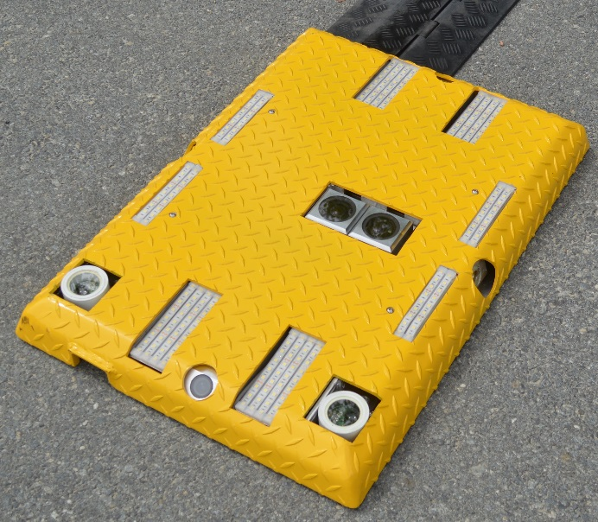
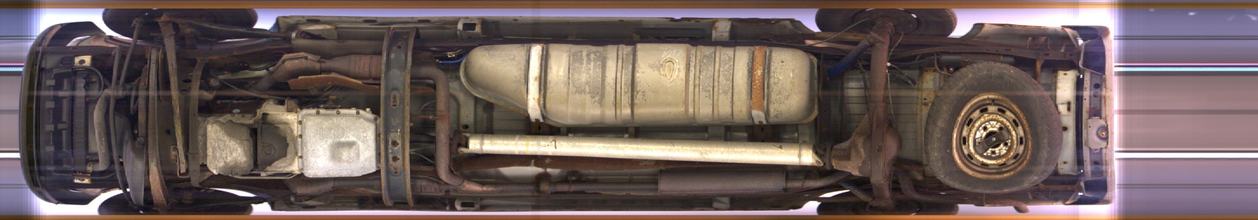
Under Vehicle Inspection System (UVIS)
Safe, rapid, and thorough method of examining the undercarriage of passenger and commercial vehicles
Capture a single seamless high resolution image for accurate detection
Provides 12X zoom capability, contrast and brightness adjustment

Slide 22
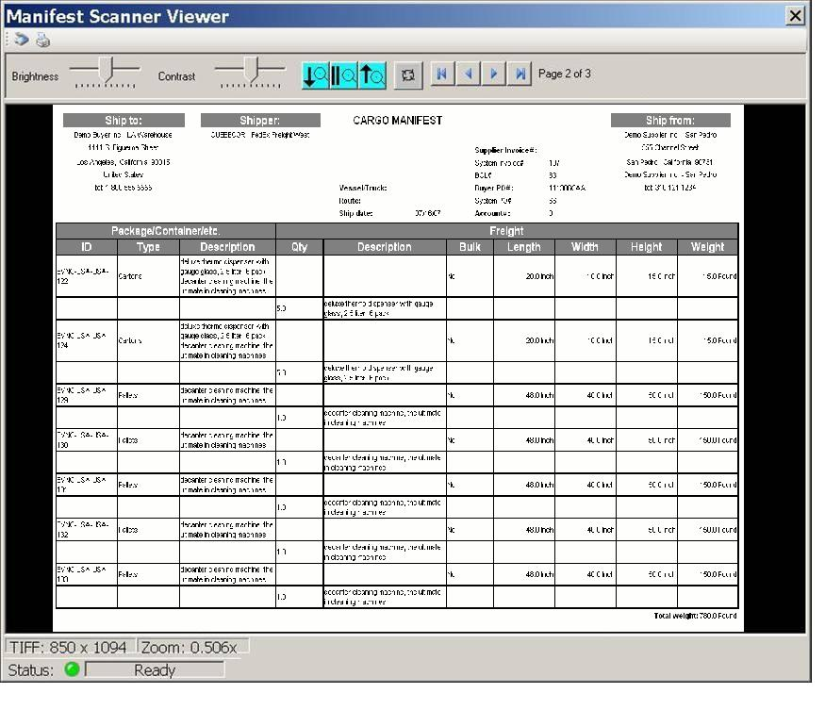
Integrated Manifest Scanner Option
Scan paper manifests and save as PDF files
Automatically saved in scan record
Uses a standard document scanner
Manifest preview window
  Delete pages
  Move page order
  Rotate pages
Manifest viewer window
  View manifest
  Adjust contrast and brightness
  Compare historical manifests
  Print manifest

Slide 23
X-Ray Image Analysis
Image Analysis Features
  Auto Enhance
  Clear / Suspect Tagging
  Colorize
  Decrease Density
  HAD Operator Assist
  High Contrast
  Histogram
  Histogram Equalization
  Increase Density
  Mark and Annotate
  Region of Interest
  Reset All
  Reset Density
  Reverse Video
  Ruler
  Sharpen
  Show Grayscale
  Show Heavy Metals
  Show Metals
  Show Mixed Materials
  Show Organics
  Zoom In
  Zoom Out
  Zoom Reset

Slide 24
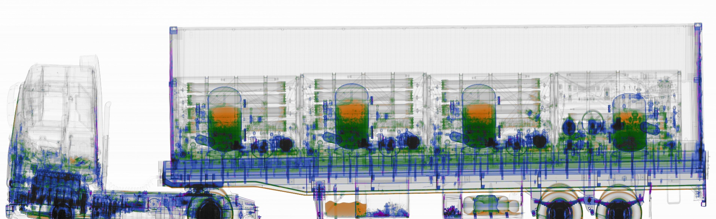
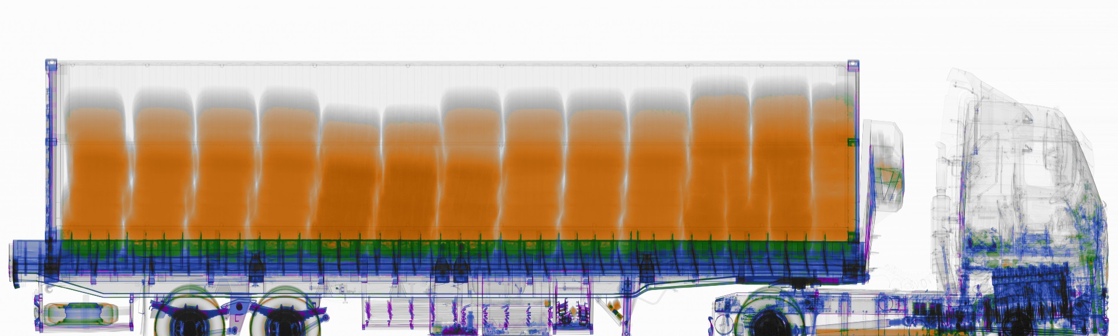
Example Images

Slide 25
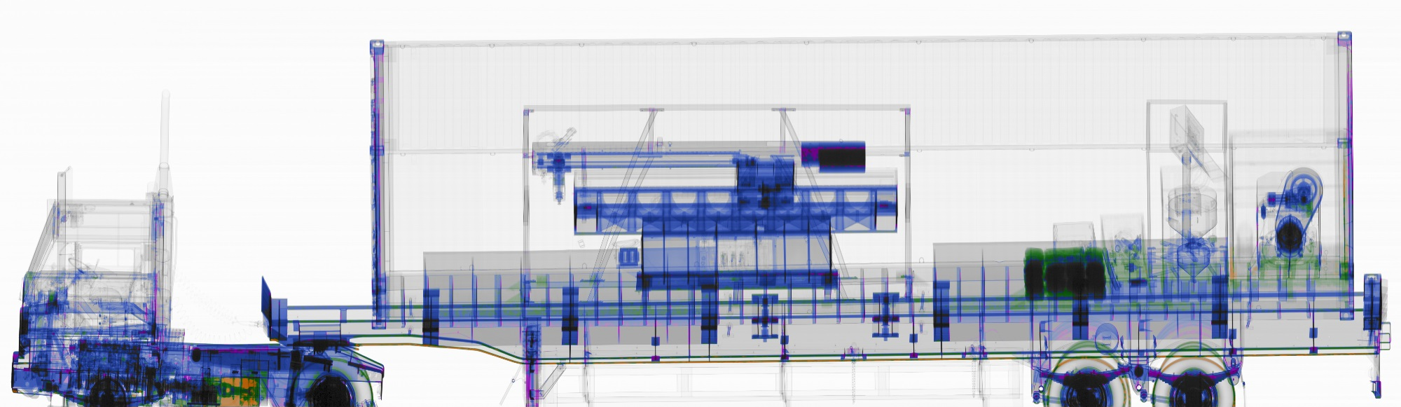
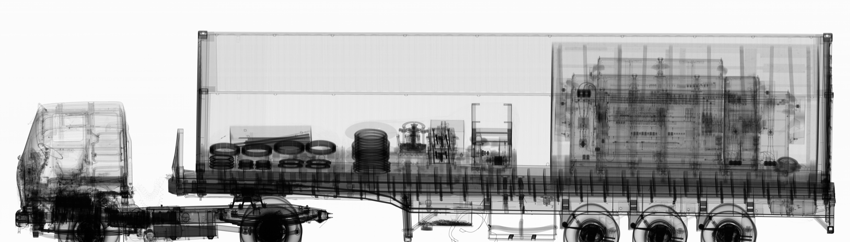
Example Images

Slide 26
Example Images

Slide 27
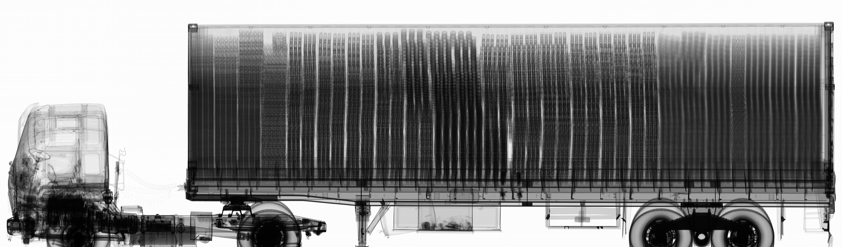
Example Images

Slide 28

Weapons in Container

Slide 29
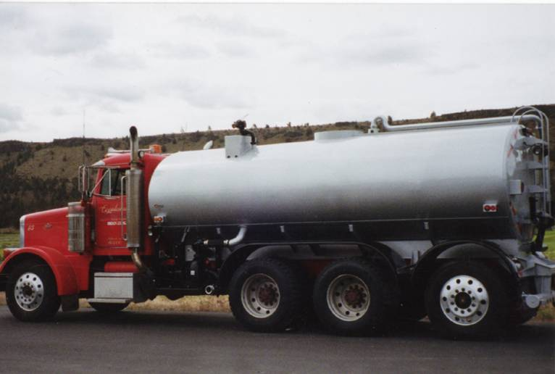
System Penetration
OmniView easily penetrates dense loads including water and oil tankers
Notes:
Two steel blocks suspended in water tanker

Slide 30
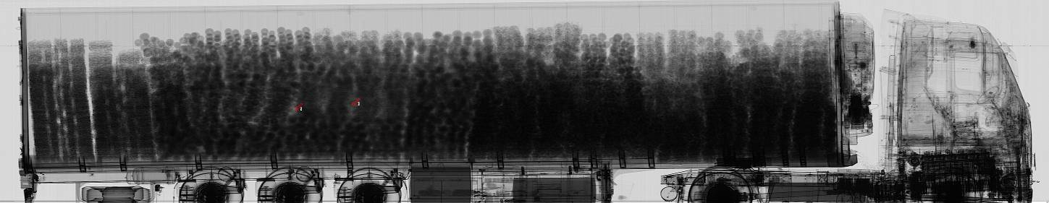
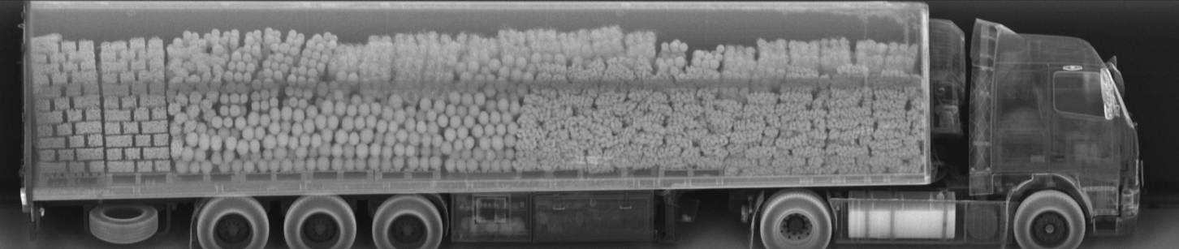
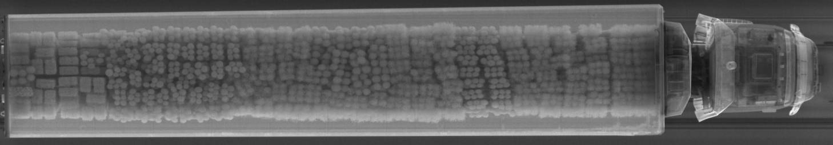
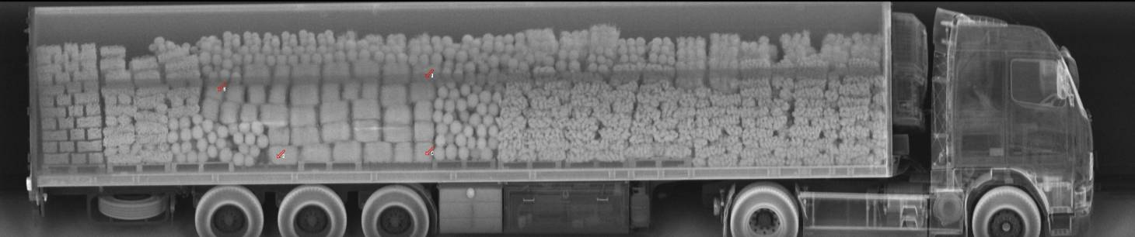
Example Images - Contraband Seizure
OmniView Gantry with Z Backscatter Module
Illegal Contraband
Backscatter assists in identifying anomalies not easily seen in the transmission images
Notes:
NEW

Slide 31

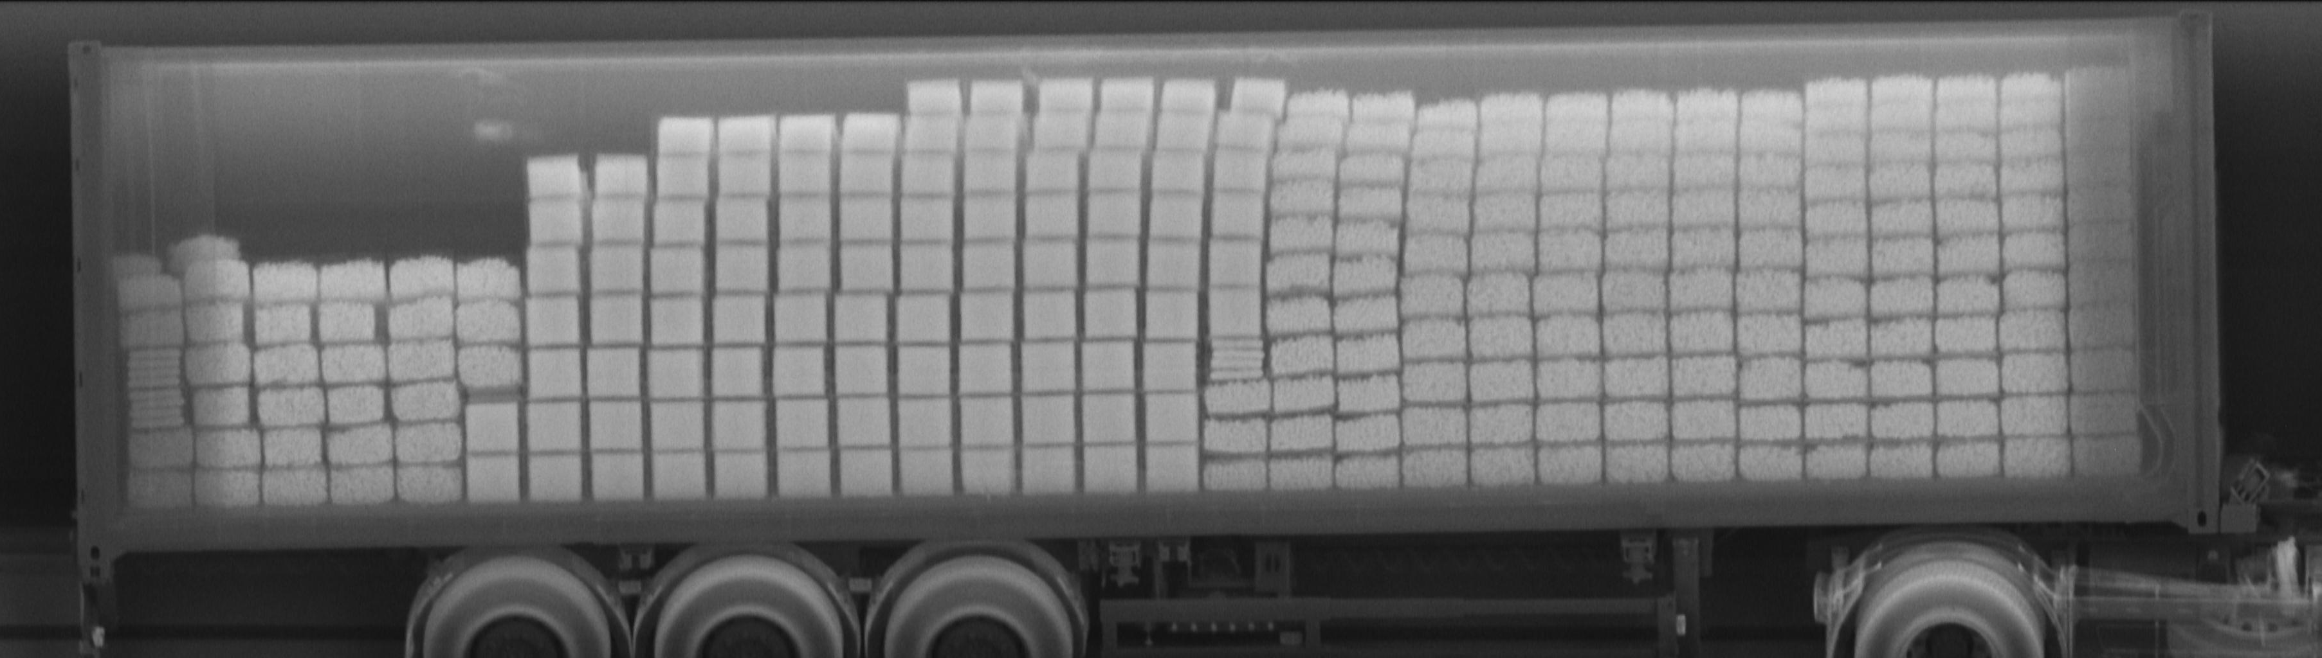
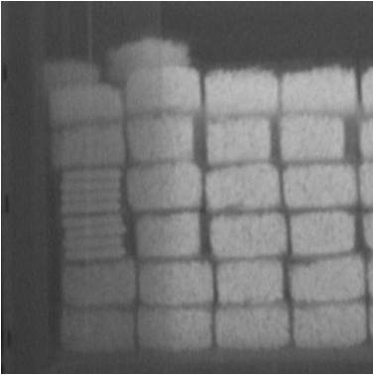
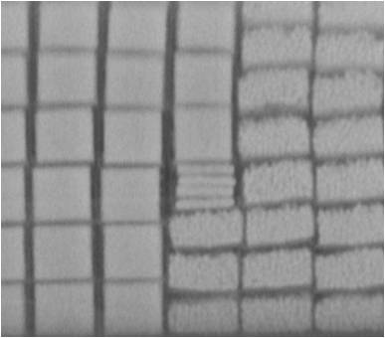
Example Images – Port of Venice
OmniView Gantry with Z Backscatter Module
Backscatter displays ‘photo like’ images which helps to locate anomalies within in the cargo.
© 2015 American Science and Engineering, Inc.

Slide 32
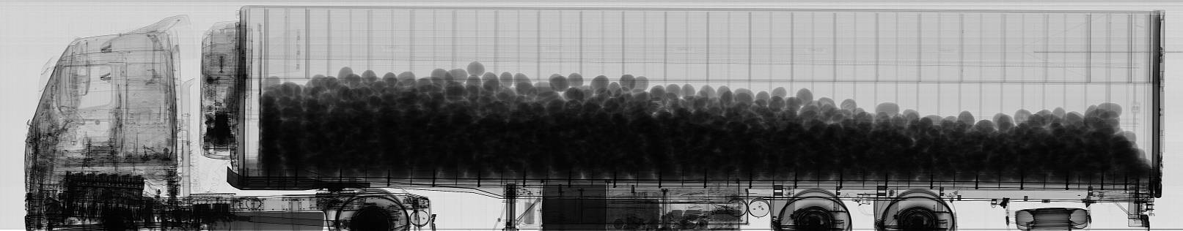



Example Images - Produce
Multi-View imaging shows cargo from
all sides
Z Backscatter creates images of cargo even if it is too dense to
be penetrated by transmission

Slide 33




Example Images - Pottery

Slide 34



Radiation Safety
OmniView™ gantry system’s operator dose is <0.5 μSv/hr outside of controlled zone
Controlled dose to cargo <80 μSv per scan
  Utilizes the minimum amount of radiation to achieve effective imaging
Certified to meet ICRP 60, EURATOM, ANSI N43.3
Competitors 9 MeV System
300 uSv (30 mR)
Chest X-ray
100 uSv (10 mR)
OmniView Dose to Cargo (1 Scan)
80 uSv (8 mR)
Trans-continental Flight (round trip)
50 uSv (5 mR)
Daily Background Radiation
10 uSv (1 mR)
Dental X-ray
10 uSv (1 mR)
OmniView Operator Dose (1 hour)
0.5 uSv (0.05 mR)

Slide 35
OmniView Gantry Summary
Superior Imaging Performance
  High Penetration - 400 mm (15.7 in) of steel
  Excellent wire resolution – 0.8 mm
Configurable
  Standard Dual-Energy Linac with Single-Energy mode
  Optional 3-sided Z Backscatter imaging
  Operator Assist (High Density Anomaly)
Material Discrimination with Dual Energy
  Differentiate classes of materials based on atomic number
  High resolution images show organics in orange, non-organics in green, metallics in blue, and heavy metals in purple
Large Scan Tunnel
  Accommodates 5 m (16.4 ft) tall port trucks
The OmniView Gantry system offers superior imaging performance and optional multi-view imaging, providing superior detection capability and simplified image analysis for customs and security applications

