Slide 1
Gemini Competitive Comparison

Slide 2
Conventional Parcel – Competitive Highlights
 | AS&E Gemini | Smiths 6046si | Rapiscan 620DV | Astrophysics XIS-6545DV
Tx imaging resolution | 40 AWG | 41 AWG | 40 AWG | 40 AWG
TX Penetration | 30mm | 37mm | 29mm (35mm option) | 30mm
TIP | Yes | Yes | Yes | Yes
TSA Approved | Air Cargo | Yes | Yes | Air Cargo
Organic Detection | Z Backscatter 3 Color Dual-Energy | 3 Color Dual-Energy | 3 Color Dual-Energy | 6 Color Dual-Energy
Gemini 6040 has the same transmission performance as the competitors
Gemini 6040 with its combination of transmission and Z Backscatter offers improved organic detection over Tx-only systems
Gemini 6040 has the same footprint as Tx-only systems

Slide 3
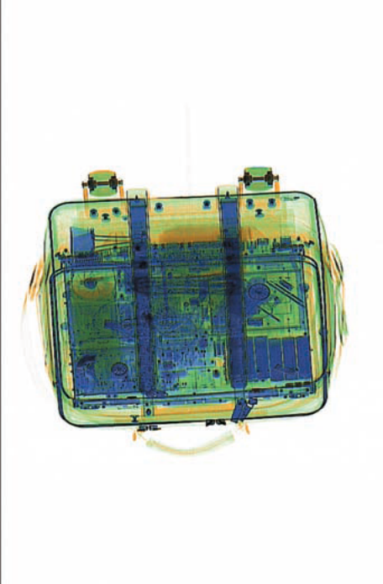
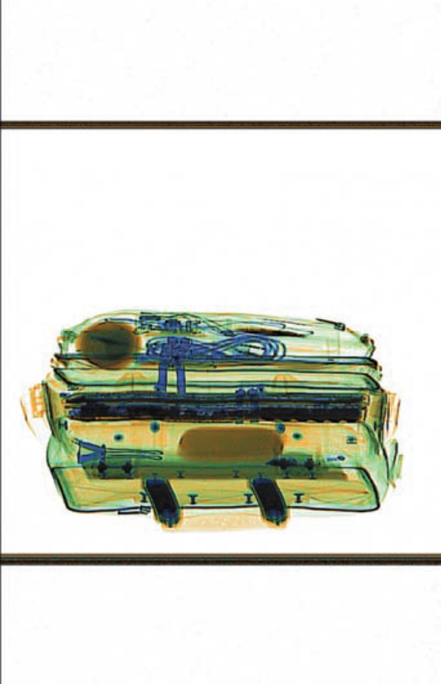
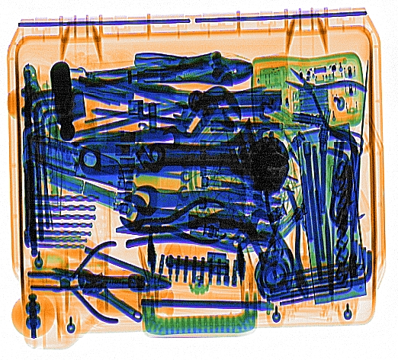
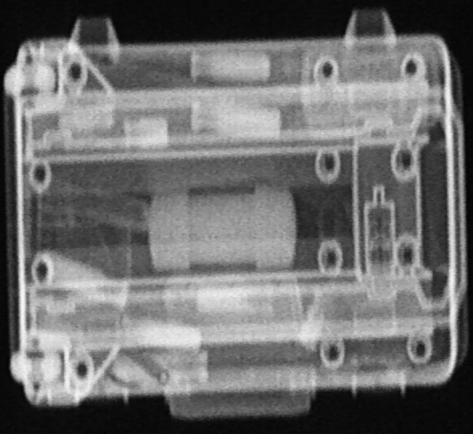
Gemini vs Dual-View Transmission Systems
Dual-view systems use two transmission images
2nd image is through the small side of a bag or package – difficult to differentiate objects
The 2nd view is still a transmission view and is easily defeated by clutter or electronic objects
Gemini provides a different kind of x-ray image as it’s second image – Backscatter
Backscatter improves detection
Helps the operator interpret images better
Dual-View Images from a Rapiscan 620DV-AT system
Dual-Energy Transmission and Z Backscatter Gemini Images

Slide 4
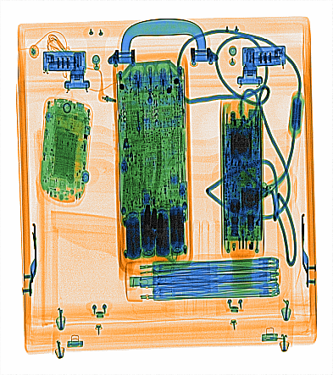
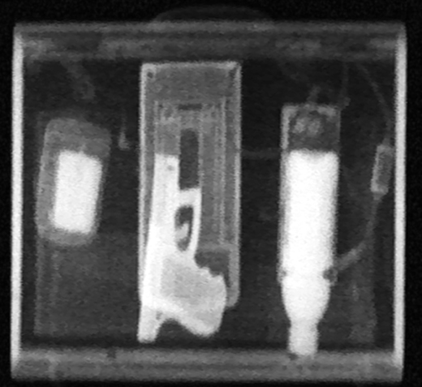
Combination of technologies provides superior threat detection
Electronics
PDA
Umbrella
Laptop Power Cord
Plastic Explosives
Glock Handgun
Liquid explosives
Dual-energy transmission’s image quality and ability to detect metallic objects
Z Backscatter’s superior ability to detect organics such as explosives, sheet explosives, drugs, and plastic weapons
Notes:
It is worth noting that it is the combination of these two images that helps find threats. It is by looking at the dual-energy image that the operator can see, for example, that the left object is a blackberry. With the backscatter image, the operator can see that there is a large organic object concealed by the blackberry. Putting the two images together, the operator knows that there should never be organic material in a blackberry – hence, there is a threat here.

Slide 5
Gemini has excellent transmission image quality
Electronics
Outstanding image resolution provides ability to detect fine details such as wires
  40 AWG wires visible (typical)
Excellent penetration:
  30mm of steel (typical) 6040
  34mm of steel (typical) 7555 and 100100*
Dual-energy algorithm gives some information about material type - especially in uncluttered environments
Image analysis features provide flexibility in resolving suspect items
PDA
Umbrella
Laptop Power Cord
* As measured by AS&E test fixtures

Slide 6
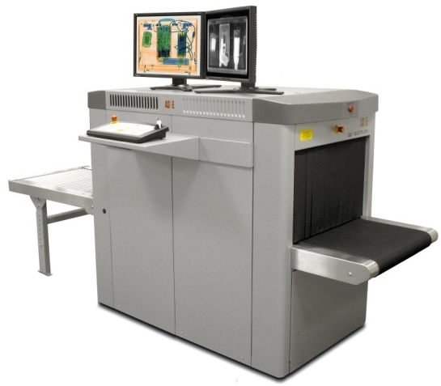
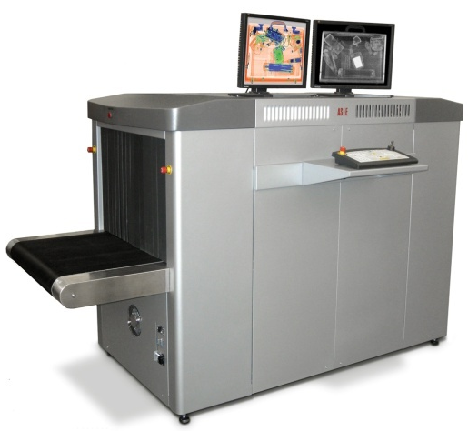
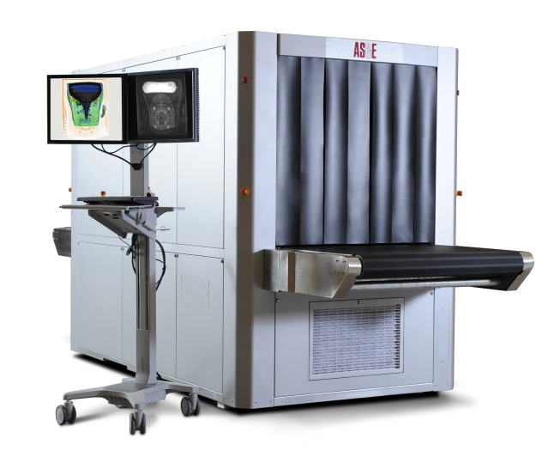
Gemini Parcel X-ray Inspection Systems
Combination of two technologies
  Dual-energy transmission and Z Backscatter
Superior threat detection
  Transmission with dual-energy provides high resolution images
    Excellent detection of metals - guns, knives, and wires
  Z Backscatter provides enhanced detection
  of explosives, drugs, and plastic weapons
  Together: improved detection over Transmission-only systems
Operational Benefits
  Faster, better image interpretation
  Fewer opened bags
Gemini 6040
Gemini 7555
Gemini 100100
Notes:
Complementary because the two images work together. Sometimes threats are found in the Tx image, sometimes in the Bx image. The Bx can help the operator interpret the TX image better.

Slide 7
Sample Gemini Images vs Dual-View Images
The following images compare Gemini Images with the two views seen by typical Dual-View systems

Slide 8
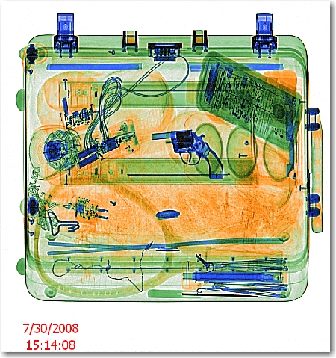
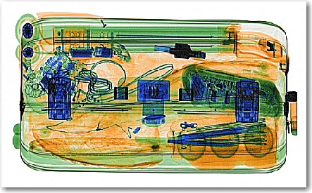
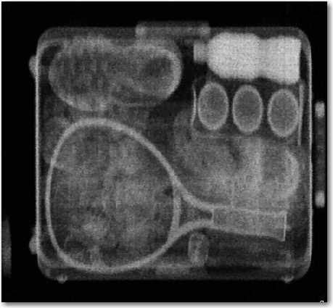
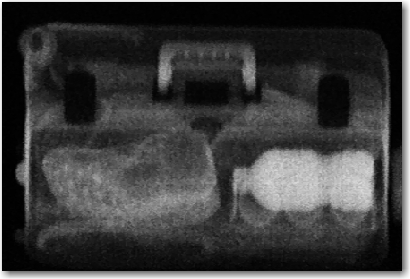
Dual-View Images Miss Hidden Water Bottle
DUAL VIEW IMAGES
Z BACKSCATTER IMAGES

Slide 9
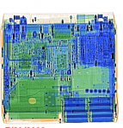

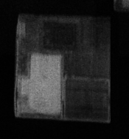

Dual-View Images Miss Explosives Hidden in Laptop
DUAL VIEW IMAGES
Z BACKSCATTER IMAGES

Slide 10
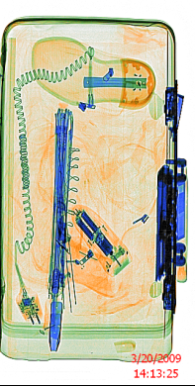
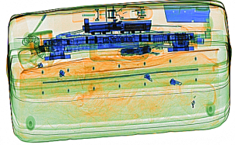
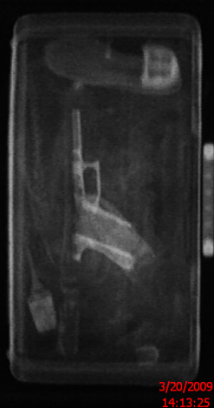
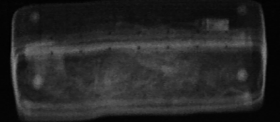
Dual-View Images Miss Glock Handgun
DUAL VIEW IMAGES
Z BACKSCATTER IMAGES

Slide 11
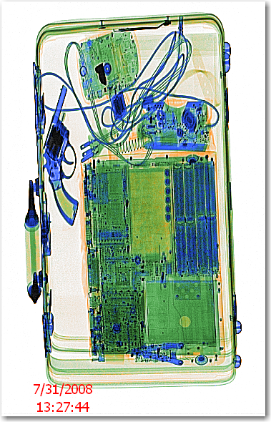
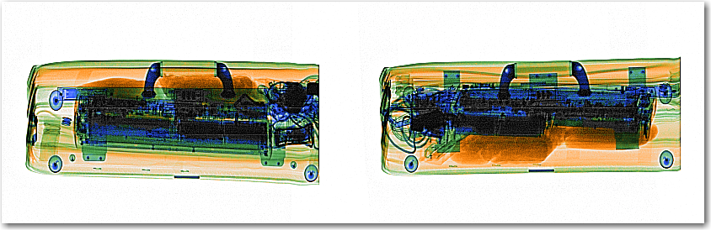
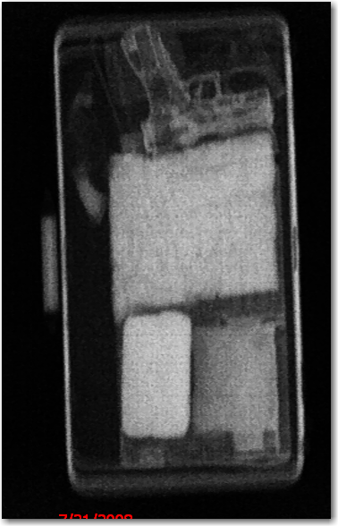
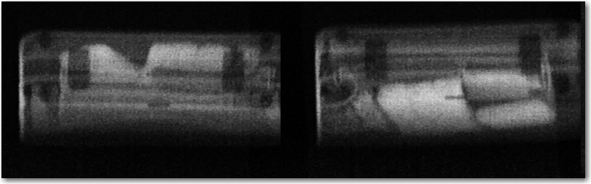
Dual-View Images Miss Explosives
DUAL VIEW IMAGES
Z BACKSCATTER IMAGES

Slide 12
Gemini Images of Concealed Pressure Cooker Bomb
Multiple Angles

Slide 13
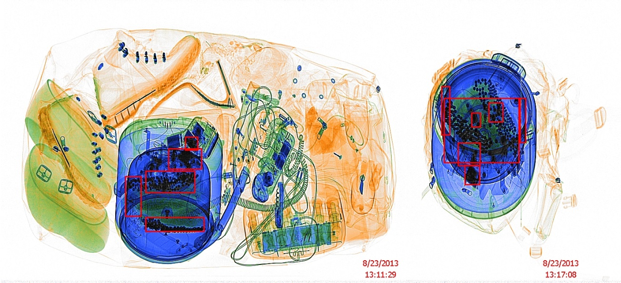
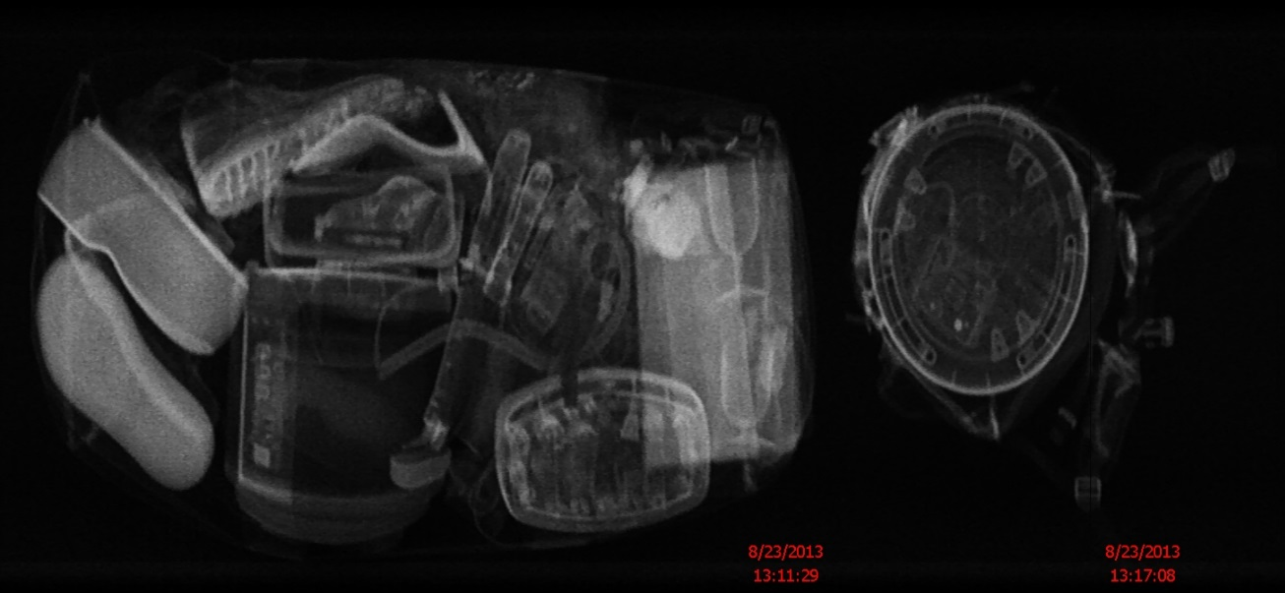
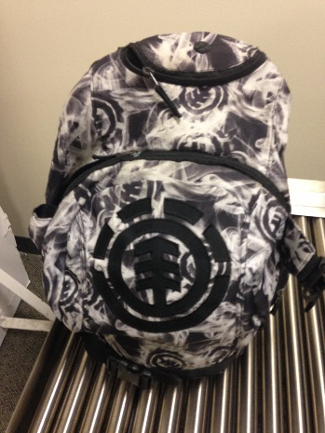
Concealed Pressure Cooker Bomb in Backpack
The organic, explosive simulant is concealed by the pressure cooker in the dual-energy image. When viewing the Z Backscatter and Dual-Energy image side-by-side, the explosive and metallic threats in the pressure cooker are easily identified.

Slide 14


Concealed Pressure Cooker Bomb in Backpack

Slide 15
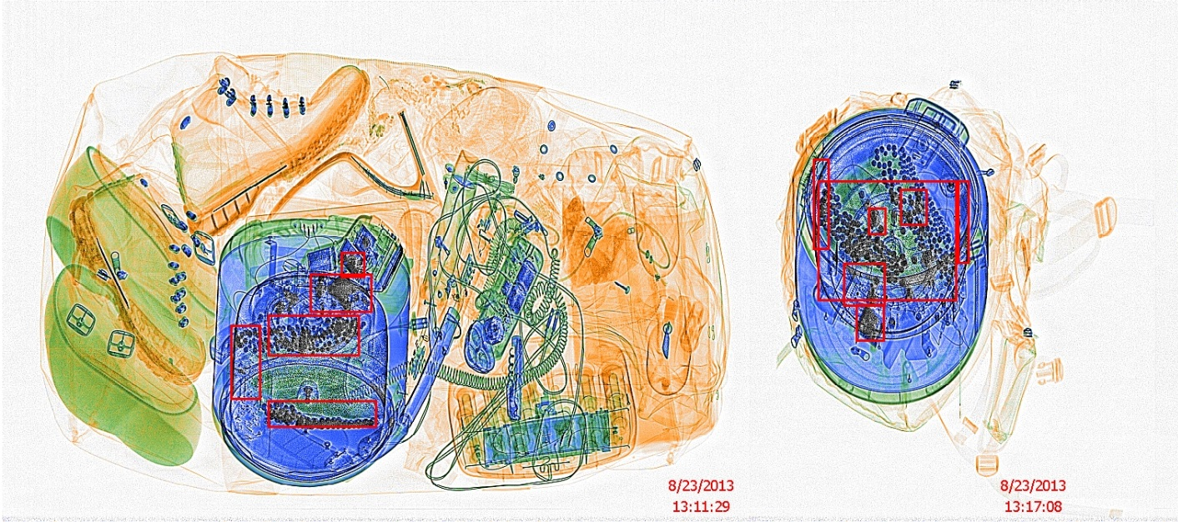
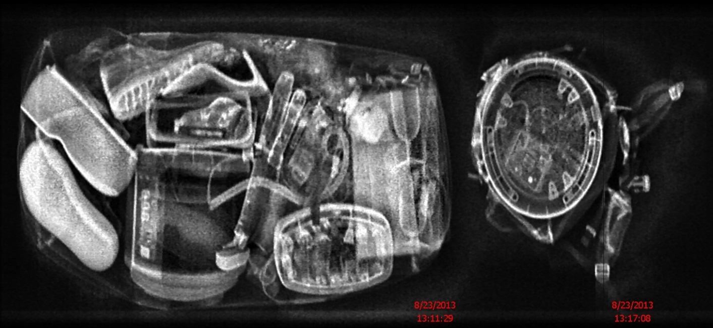
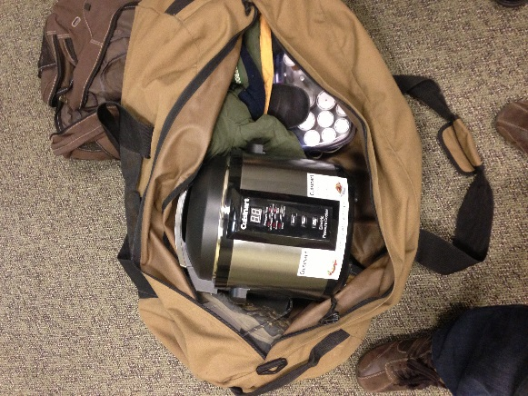
Concealed Pressure Cooker Bomb in Duffle Bag
The organic, explosive simulant is concealed by the pressure cooker in the dual-energy image. When viewing the Z Backscatter and Dual-Energy image side-by-side, the explosive and metallic threats in the pressure cooker are easily identified.

Slide 16



Concealed Pressure Cooker Bomb in Duffle Bag

