Slide 1
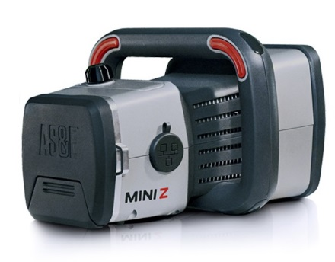
MINI Z Handheld Z Backscatter® Screening System
Product Overview
January 2015
Company Confidential

Slide 2
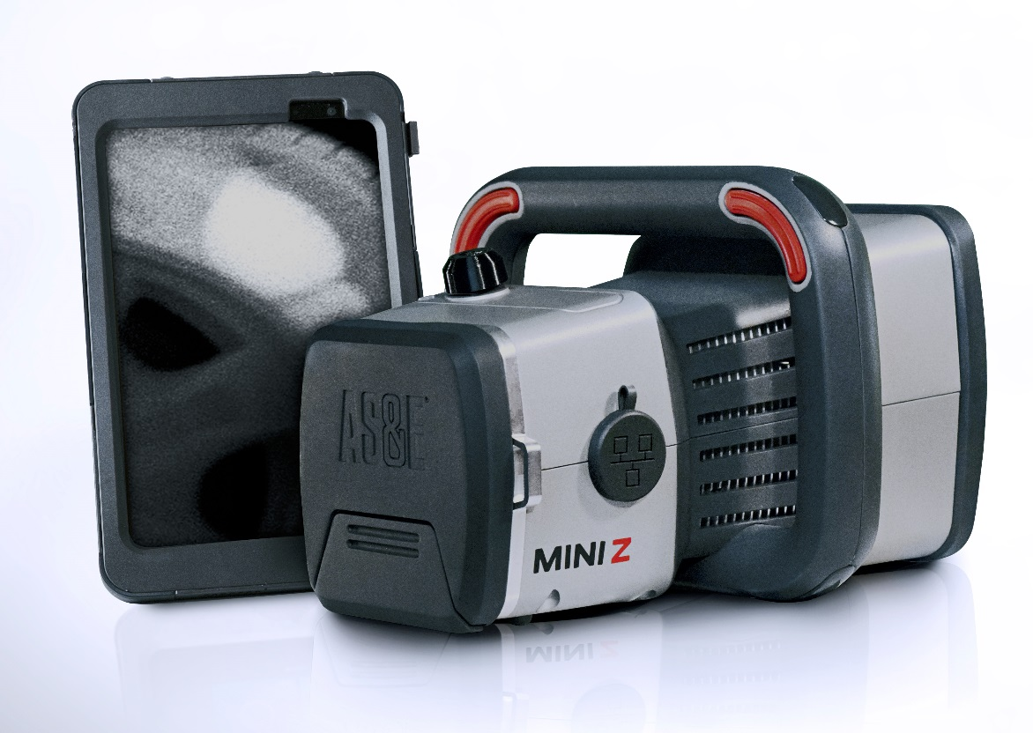
INTRODUCING MINI Z™
Handheld Z Backscatter® Screening System
The world’s first handheld Z Backscatter screening system that delivers fast, real-time images to detect drugs, contraband, and explosives in hard-to-reach locations

Slide 3
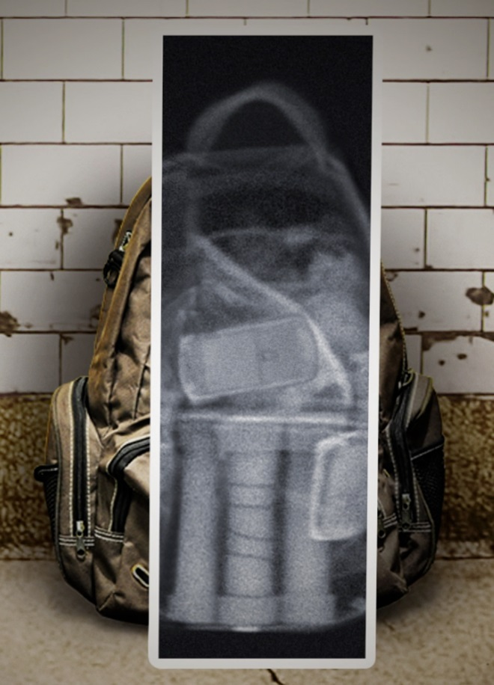
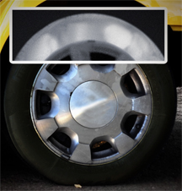
MINI Z Features Z Backscatter Technology
Unsurpassed detection of organic threats
  Using AS&E’s signature Z Backscatter technology, the MINI Z produces a real-time image of the scan target, highlighting organic materials that transmission X-ray systems can miss, such as explosives, currency, and drugs.
  Z Backscatter X-ray images highlight low Z effective materials, which are
  primarily composed
  of low atomic number
  elements (Hydrogen,
  Carbon, Nitrogen, and
  Oxygen).

Slide 4
How X-rays Interact With Matter
Transmission
X-ray Energy Will Do One of Three Things When Interacting With Material
  Pass Through (Transmission)
  Become Absorbed
  Scatter (Compton Scattering)
These Basic Principals Form the Basis of X-ray Imaging
  Transmission X-ray Imaging
    Absorption / Transmission
  Z Backscatter X-ray Imaging
    Compton Scattering
  Fowardscatter X-ray Imaging
    Compton Scattering / Absorption
X-ray
Matter
Absorption
X-ray
Matter
Scatter
X-ray
Matter
Notes:
Here you will begin to explain what happens to x-rays when they interact with matter. These three basic principals (absorption, transmission and refraction) for the basis for all x-ray imaging. There is not a specific ratio of each of these attributes for specific materials. Refraction, called scatter, actually scatters in all directions, not just back.
This is a pretty important concept of people going forward so make sure they understand this

Slide 5
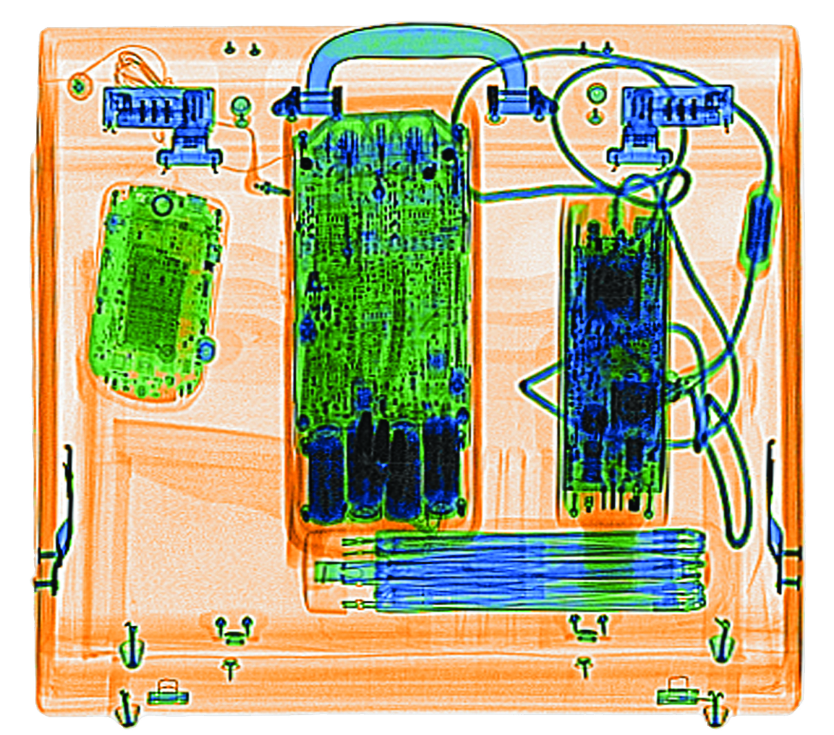

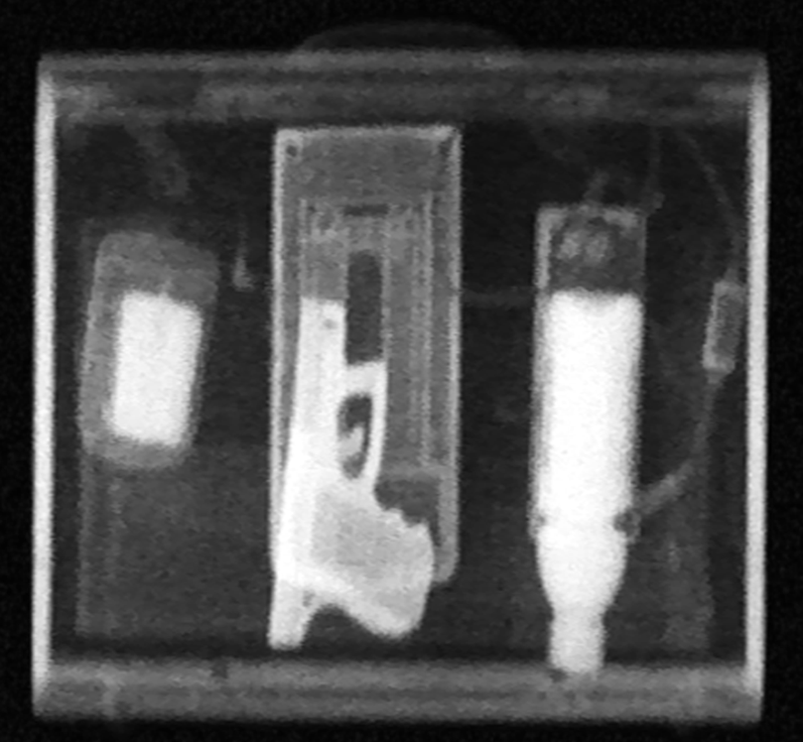
Transmission X-rays & Z Backscatter X-rays
Core Technology
TRANSMISSION
X-rays detect by passing an
X-ray beam through a target to a detector
on the far side.
X-ray Source
Target
TRANSMISSION X-RAY
Detector
Z BACKSCATTER X-rays detect by reflecting an X-ray beam from a target to a detector on the near side, creating an image that is easy to interpret and understand.
Core Technologies
Detector
Z BACKSCATTER X-RAY OF THE SAME SUITCASE
Notes:
5
Z Backscatter provides additional information about the scanned object

Slide 6
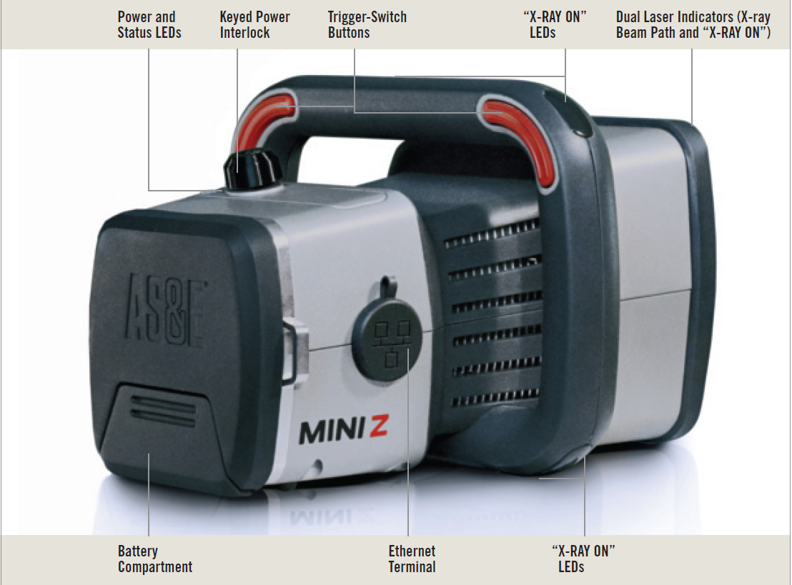
MINI Z Specs
Scanner Dimensions
Length: 11.5 in (29.2 cm)
Width: 9.8 in (24.9 cm)
Height: 7.6 in (19.3 cm)
Weight: 9.2 lbs (4.2 kg)
Operating Time: 4 hrs per battery charge (typical, based on 25% duty cycle)
Scan Speed: 6 in (15 cm) per second (typical)
Operating Environment: IP 54 Rated
Operating Temperature: 0° C to 45° C (32° F to 113° F)

Slide 7
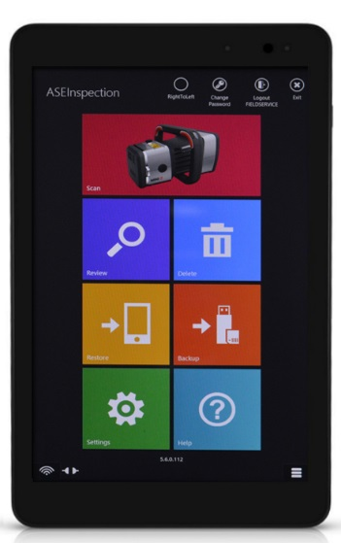
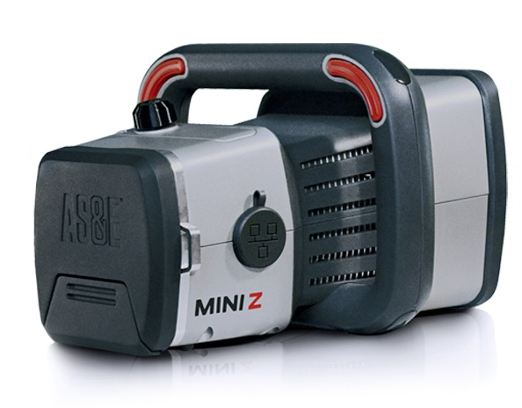
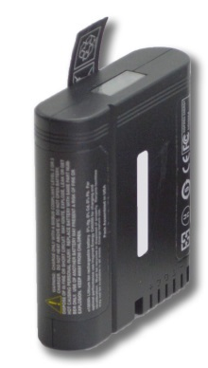
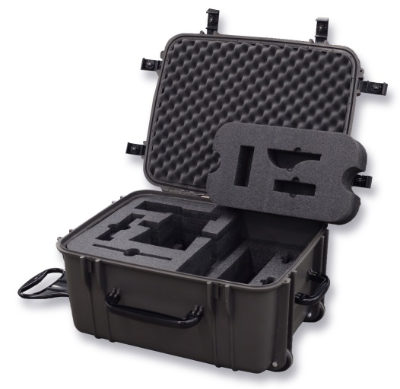
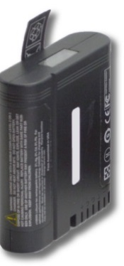
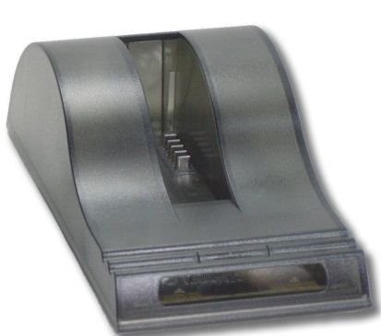
System Components
Communication Link
Wireless (Wi-Fi) & Wired
Scanner Module
Tablet PC w/ASEInspection Software
for Scan Image Viewing
Not shown:
Quick Start Guide
Ethernet Cable
Power Cords
Calibration Dock
Two scanner batteries
(one in use, one spare)
Battery Charger
Rugged Case

Slide 8
Mini Z Safety
Electrically generated X-rays only
  If the switch is off – the X-rays are off
Dose to scan object
  A typical dose to target, at 6 in/sec scan speed and 4 in. scan distance, is less than 0.10 µSv.
Operator dose
  Less than .5 µSv (100 µrem) in any one hour @ 100% Duty Cycle
One Mini Z Scan | <10uR (<0.1 uSv)
2.4 hours in Denver | 100 uR (1 uSV)
One hour on an airplane | 300 uR (3 uSv)
Natural background radiation per day | 800 uR (8 uSv)
Chest X-Ray | 10,000 uR (100 uSv)
CAT scan (Head and Body) | 110,000 uR (1,100 uSv)
Average radiation dose per year | 360,000 uR (3,600 uSv)
Notes:
An operator using the MINI Z full time, 5 days a week for a year (2000 hrs./year), would receive a dose equal to roughly 40% of the allowable annual dose.

Slide 9
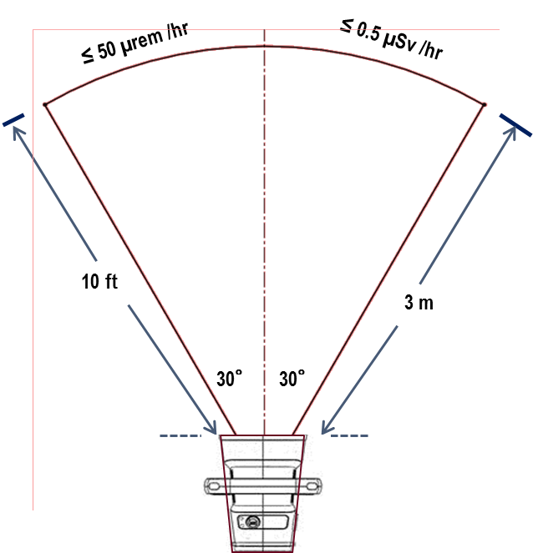
MINI Z Safety
The MINI Z system is safe for operators, bystanders, and the environment.
  The MINI Z Operator Exposure levels conform
  with the appropriate ICRP, NCRP, and EURATOM
  radiation safety standards.
    <.5uSv/hr to operator at 100% duty cycle
    The Mini Z system shielding ensures that a
    full time Operator’s Exposure remains well
    below the NCRP, ICRP, and Euratom annual
    allowable radiation dose levels for the “general
    public and minors” of 100 milliRem (1 mSv).
  The MINI Z Scan Dose, while limited, varies with scan motion
  and distance. A typical dose to target, at 6 in/sec scan speed
  and 4 in. scan distance, is less than 10 microRem (0.10 uSv).
    Although the MINI Z is a low-energy and low-dose
    Z Backscatter system, it is not designed to scan people.
    The MINI Z system must be used in accordance with the manufacturer’s instructions and under the jurisdiction of local laws and regulations.
Radiation Controlled Zone
Notes:
An operator using the MINI Z full time, 5 days a week for a year (2000 hrs./year), would receive a dose equal to roughly 40% of the allowable annual dose. This would be equivalent to the additional dose received from taking 1 US round trip, cross country flight per month for 1 year. A more typical usage model with a duty cycle of 25% for the operator, is equivalent to a US round trip cross country flight every 3 months.

